Slide 1
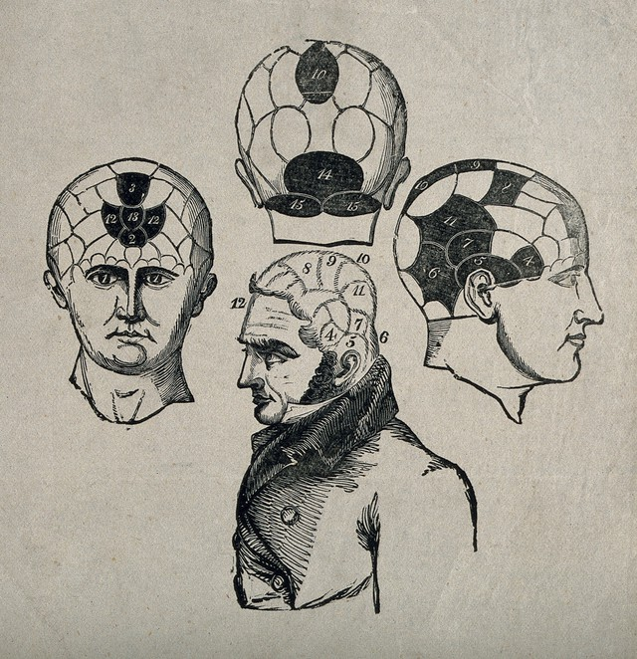
Unit 10 – From the Asylum to Care in the Community; From Paternalism to Autonomous Decision Making
University of Bristol, United Kingdom

Slide 2
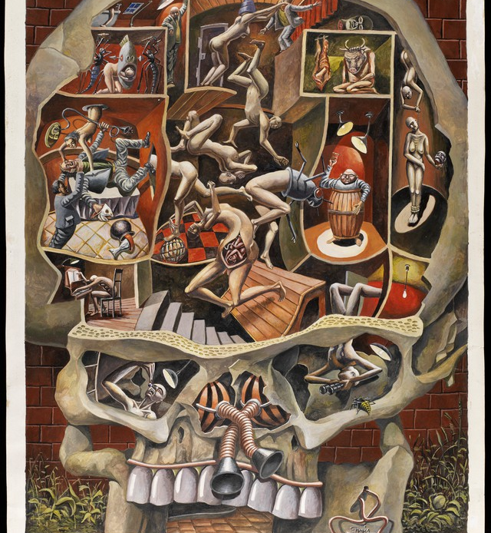
Lecture overview
Examines the development social and legal apparatus to enable autonomous decision making over healthcare by those with reduced capacity
Focus especially on the treatment of the mentally ill
Long term change from paternalistic approach, to attempts at enabling patients to make informed decisions regarding their welfare
Has this left patients neglected?
A human skull with scenes representing mental activities. Gouache painting by R. Ennis, 1991. Credit: Wellcome Collection. Attribution 4.0 International (CC BY 4.0)

Slide 3
Part I: Into the Asylum: Paternalistic Approaches to the Mentally Ill
Part II: Hysteria: A Means of Control?
Part IV: Autonomy in Healthcare: Lasting Power of Attorney and Do Not Attempt Resuscitation Orders
Part III: Deinstitutionalisation and Care in the Community

Slide 4
Part I: Into the Asylum: Paternalistic Approaches to the Mentally Ill
Part III: Deinstitutionalisation and Care in the Community
Part II: Hysteria: A Means of Control?
Part IV: Autonomy in Healthcare: Lasting Power of Attorney and Do Not Attempt Resuscitation Orders

Slide 5
A note on terminology
In this lecture several terms will appear which are no longer deemed appropriate for use in medical practice.
These terms are used sparingly in this lecture to remain faithful to its historical content.
By doing so, not only will the development of ideas and practices regarding mental illness be highlighted, but they changes in the way we discuss those ideas and practices.
Modern treatment of the mentally ill and the terms used in discussing it is focused on sensitivity, understanding, and respecting the dignity of patients.
Understanding this development provides important perspective on why certain terms are no longer used, and deemed unacceptable in modern practice.

Slide 6
Into the Asylum: Paternalistic Approaches to Treating the Mentally Ill

Slide 7
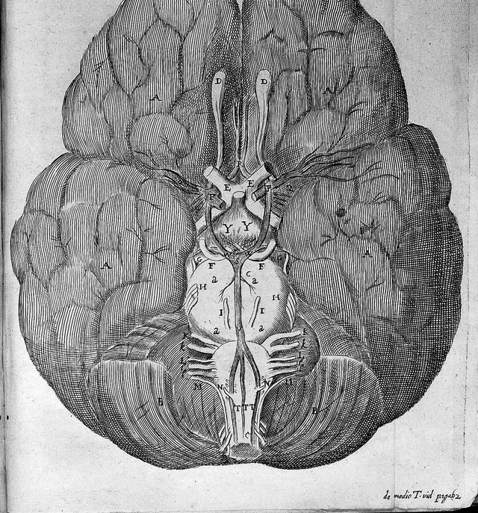
Enlightenment philosophy of the mind
René Descartes (1596–1650) posited that the mind and body were separate entities—how were they connected?
Thomas Willis (1621–1675) investigated how the soul acted on the body through dissection
John Locke (1632–1704) argued that the mind was a tabula rasa at birth—a blank slate upon which impressions were made through sense experience and learning
T. Willis, Opera Omnia. Credit: Wellcome Collection. Attribution 4.0 International (CC BY 4.0)

Slide 8
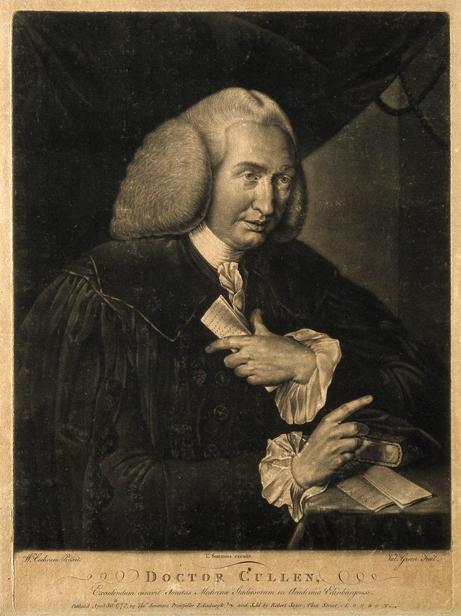
Mental Illness in the eighteenth century
William Cullen. Mezzotint by V. Green, 1772, after W. Cochran. Credit: Wellcome Collection. Attribution 4.0 International (CC BY 4.0)
William Cullen (1710-1790) employed a Lockean framework of the mind to explain madness
Some types of madness were anatomically located in the nerves
But others were due to the unusual or illogical association of ‘ideas’ in the mind. Madness was thus often a psychological condition requiring treatment of the psyche
Case histories of insane patients began to be made in order to improve diagnosis and treatment, just as regular medicine worked

Slide 9
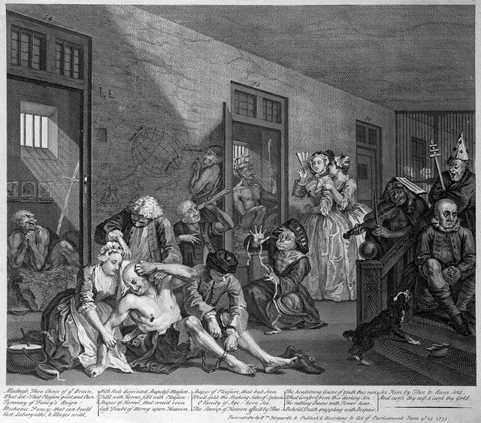
Asylums
Private asylums for ‘lunatics’ and ‘madmen’ had a long history
Treatments were often neglectful and cruel
William Hogarth’s set of prints, A Rake’s Progress, ended in the notorious asylum ‘Bedlam’, where visitors could pay to see the mad
Hogarth's The Rake's Progress; scene at Bedlam. Credit: Wellcome Collection. Attribution 4.0 International (CC BY 4.0)

Slide 10
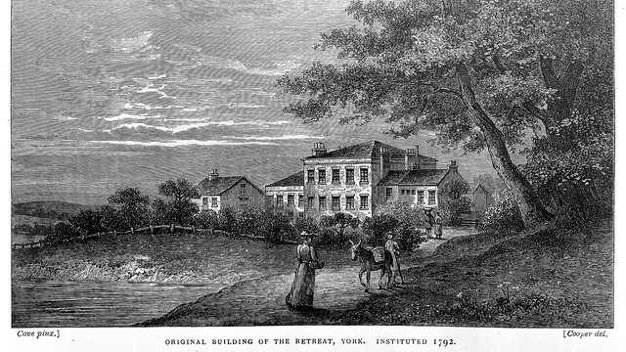
‘Moral Treatment’
From the late eighteenth century, different ways of treating the insane were tried (though not completely new)
The ‘moral treatment’ focused on treating inmates humanely, avoiding restraint and encouraging ‘healthy’ habits
Kept patients under close supervision at all times
The York Retreat, opened in 1796 by the Quaker businessman William Tuke (1732–1822) was one of the first asylums purpose-built for this practice
The Retreat, York. Credit: Wellcome Collection. Attribution 4.0 International (CC BY 4.0)

Slide 11
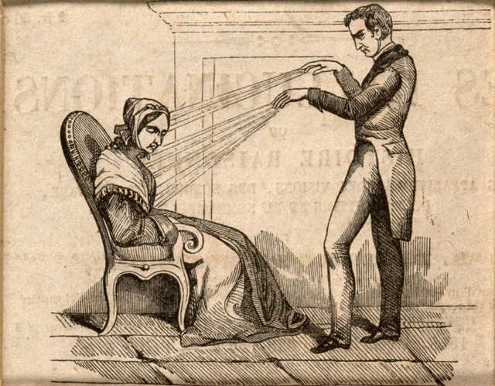
Therapeutic optimism
A practitioner of Mesmerism using Animal Magnetism. Credit: Wellcome Collection. Attribution 4.0 International (CC BY 4.0)
The shift from restraining individuals to surveillance was mirrored by a shift towards attempting to properly treat and cure patients
Encouraged experimentation in different ways of curing the mentally ill
Mesmerism and phrenology were two popular, but ultimately discredited, ways of understanding mental illness
A male figure and three phrenological heads. Wood engraving. Credit: Wellcome Collection. Attribution 4.0 International (CC BY 4.0)

Slide 12
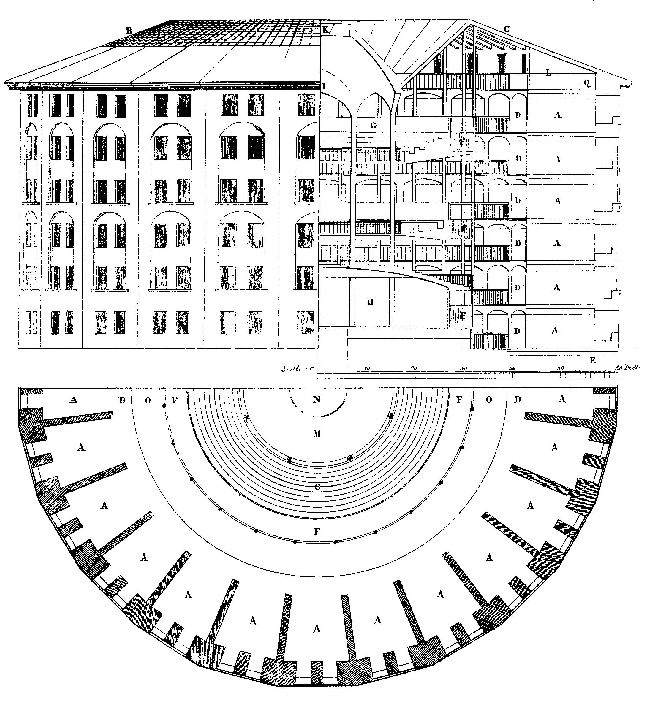
Growth of asylums
Asylums were built across Britain in the nineteenth century, creating enormous capacity to house the mentally ill away from society
Total asylum population rose from 5,000 patients in 1826 to over 74,000 in public asylums alone by the end of the century
Michel Foucault: This was the extension of state control over individuals deemed deviant
Uncommon for patients to leave once inside
Asylums often followed the principles of ‘panopticon’ design—patients could be observed at all times

Slide 13
Hysteria: A Means of Control?

Slide 14
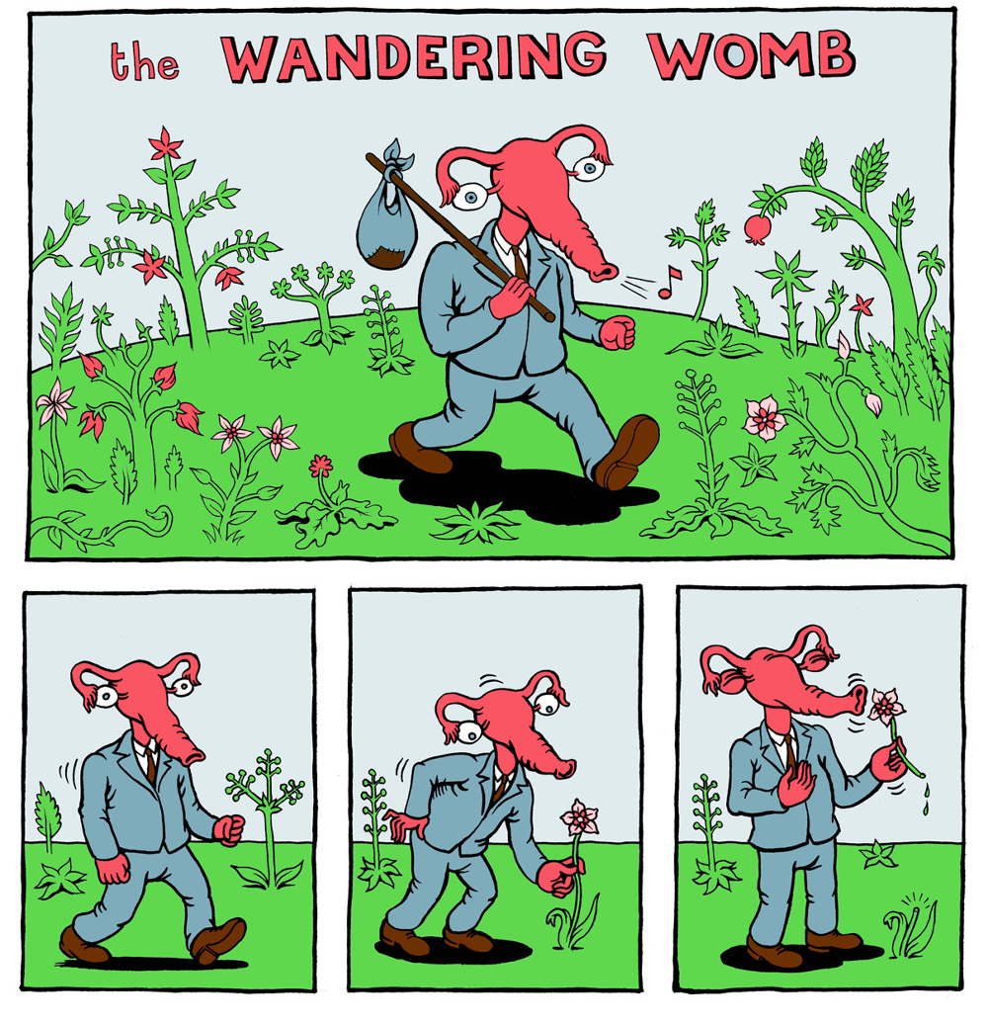
Hysteria
First described in ancient Greece, but gained particular prominence in psychiatric diagnosis in the nineteenth century
Understood as a disease that primarily affected women. The term hysteria derives from the Greek word for womb, ‘hystera’
Understanding of the disease causation gradually changed: 1) gynaecological 2) demonological 3) neurological 4) psychological
Matteo Farinella …

Slide 15
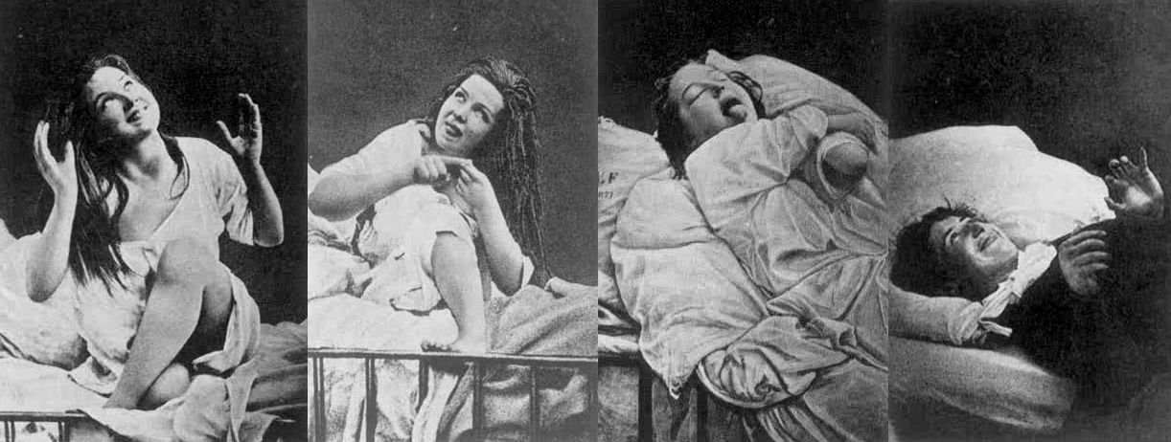
Defining hysteria in the nineteenth century
Jean-Martin Charcot (1825–1893) worked to improve the definition of hysteria, as he had for a series of neurological disorders
The disease left no physical trace, so he employed ‘objective’ photography in an attempt to identify the different stages of the disease: 1) epileptoid fits 2) contortions and grand movements 3) ‘passionate attitudes’ 4) final delirium
Believed these stages could be brought on by hypnosis

Slide 16
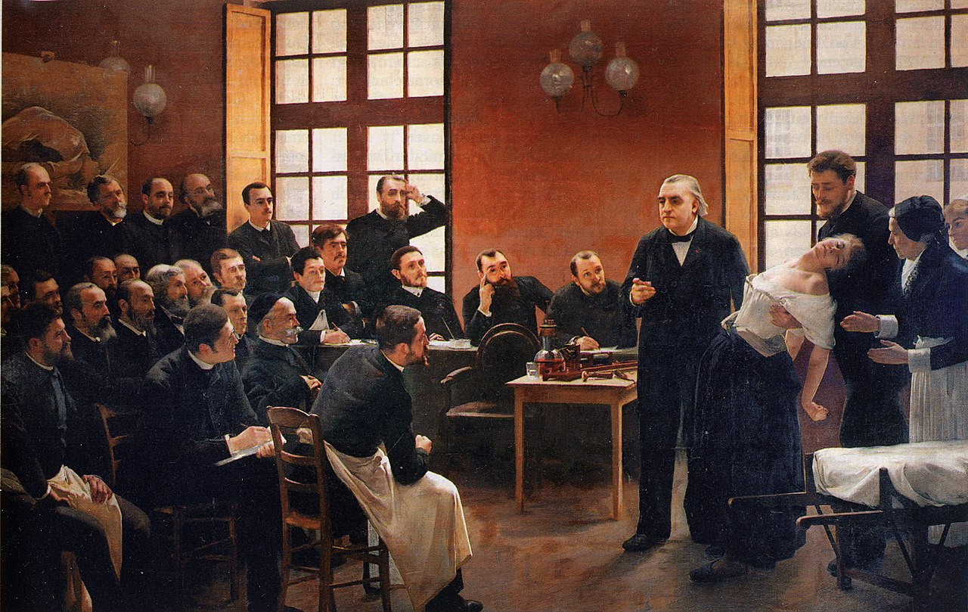
Une leçon clinique à la Salpêtrière, André Brouillet 1887

Slide 17
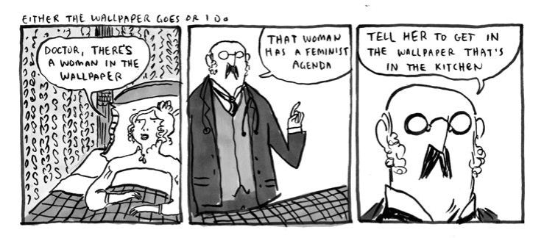
Treatment of hysteria
Little innovation in treatment in nineteenth century
Rest cure had been developed by Silas Weir Mitchell (1829–1914)
Isolated, enforced bed rest for long periods, fed on a fatty, milk-based diet, prohibited from doing anything
Mitchell believed this helped patients physically and morally
Historians have argued that the point was to break the patients’ will
The rest cure was abhorred by Virigina Woolf (1882–1941) and the subject of Charlotte Perkins Gilman’s (1860–1935) short story The Yellow Wallpaper

Slide 18
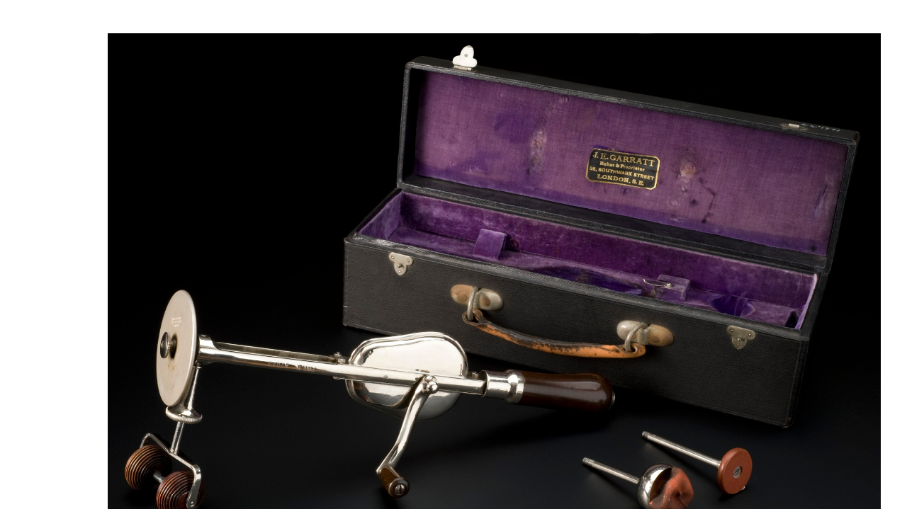
Other treatments
'VeeDee' Mechanical vibrator, London, England, 1900-1915. Credit: Science Museum, London. Attribution 4.0 International (CC BY 4.0)
Some new therapies were attempted:
Isaac Baker Brown (1811–1873) notoriously performed clitoridectomies on hysterical patients in the 1860s
He was expelled from the Obstetrical Society for his work
Emphasises the close links between hysteria and supposed sexual deviancy in women
Vibrators were not developed to cure hysterical women, but the technology was sometimes advertised as a panacea

Slide 19
Psychoanalysis
In the twentieth century, psychoanalysis provided a new understanding and approach to hysteria
The ‘talking cure’ was developed by Sigmund Freud (1856–1939), his mentor Josef Breurer (1842–1925) and their patient ‘Anna O’ (1859–1936)
Talking about symptoms’ onset then tracing them back to a traumatic event would trigger a catharsis that would make the symptoms disappear
Freud argued that the symptoms were somatic expressions of psychological distress, often of a sexual nature

Slide 20
Psychoanalysis in the twentieth century
Freud’s theories enjoyed an enormous vogue in the early twentieth century
Became undermined by their pseudoscientific nature (all opposition to the theory could be explained by the theory)
New problems in psychiatry emerged, such as shell shock
Women’s sexuality came to be understood differently
Paternalism was challenged
Hysteria gradually reduced as a diagnosis

Slide 21
Deinstitutionalisation and Care in the Community

Slide 22
Criticism of asylum care
Seen to have failed therapeutically
Very low cure rate for patients
Legacy of new therapeutic developments questionable
Lobotomy
Electric therapy
Questions about the morality of locking people away for the long-term

Slide 23
Changing attitudes
Rejection of eugenics
Mass traumatisation of soldiers
Mental illness taken seriously
New research into the problem
Pharmaceutical revolution led to effective drugs
New treatments like Cognitive Behaviour Therapy

Slide 24
Deinstitutionalisation
Move away from asylum care to ‘care in the community’
Asylums attacked from the political right and left
The Left
Argued against the control the asylum exerted over the individual
Worked to tackle the stigma of mental illness—though it might be chronic, it was manageable and individuals with such issues were able to contribute to society
The Right
Primarily concerned with the costs of housing so many patients

Slide 25
Care in the community
Day hospitals became places of treatment and support for the mentally ill without being the permanent, controlling environments asylums had sometimes become
Emphasis on self-care and self-medication, trusting patients
Increased range of treatments
Residential policies changed: ‘open door’ policies literally left doors open to the outside and within the hospital
Transitional homes
Numbers of in-patients reduced

Slide 26
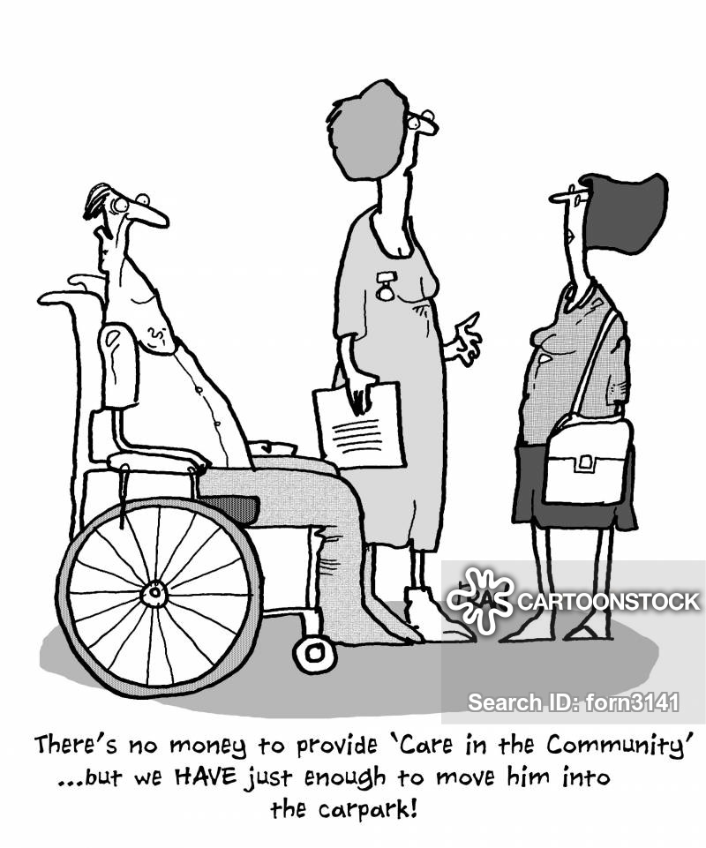
Failure of deinstitutionalisation?
Community care began to exclude the hospital altogether from 1970s and 1980s. In 1990s the old county asylum system was abolished and the role of social services in care for the mentally ill grew
Idea not matched by the reality?
Not enough support available
Budgetry cuts to local councils
Overreliance on voluntary sector
Average stay of those admitted for psychiatric care is now only two weeks

Slide 27
Autonomy in Healthcare: Lasting Power of Attorney and Do Not Attempt Resuscitation Orders

Slide 28
Changing legal frameworks of care
Mental Capacity Act (2005) was developed whilst deinstitutionalisation and its initial problems occurred
Law Commission report (1995) stated that the existing legal framework was “one of incoherence, inconsistency and historical accident”—reform was necessary and urgent!
In the new care in the community model, there was little clarity over who, what, or how decisions could be made on behalf of patients, which had led to cases of abuses of power

Slide 29
LPA and DNAR
Important examples of modern attempts at enabling patient choice in healthcare
LPAs: give another adult legal authority to make certain decisions for someone if they lose the capacity to do so themselves
DNARs: instructs healthcare professionals not to attempt cardiopulmonary resuscitation (CPR) in cases of sudden cardiopulmonary arrest
The core principle of both is that individuals should be allowed to choose for themselves, either through advance statement or via a trusted person who will look after their interests

Slide 30
Five principles for advance directives
1) Capacity should always be assumed. A patient’s diagnosis, behaviour, or appearance should not lead you to presume capacity is absent.
2) A person’s ability to make decisions must be optimised before concluding that capacity is absent. All practicable steps must be taken, such as giving sufficient time for assessments; repeating assessments if capacity is fluctuating; and, if relevant, using interpreters, sign language, or pictures
3) Patients are entitled to make unwise decisions. It is not the decision but the process by which it is reached that determines if capacity is absent.
4) Decisions (and actions) made for people lacking capacity must be in their best interests.
5) Such decisions must also be the least restrictive option(s) for their basic rights and freedoms

Slide 31
Issues
Decisions and judgements of capacity are difficult to make and require interpretation, which can be very tricky in circumstances where a patients’ condition deteriorates rapidly or suddenly
Potential family resistance
Those without advance directives might not have their wishes followed, even when they were well-known in advance
An unrealistic expectation of being able to control the process of dying?

Slide 32
Conclusion
Long term social and legal move towards personal autonomy and care in the community approaches for those with less capacity (not only mentally ill patients)
Major changes to the way that the mentally ill were treated, housed, and understood by society
Current issues in care in the community and advance directives question the simple notion of progress in the move away from paternalistic approaches
Need to ensure ‘community neglect’ is avoided

