Slide 1
Unit1 : History of pre-Columbian and Inca medicine in Peru
Agueda Muñoz del Carpio Toia. Md, MPH Universidad Católica de Santa María- Peru

Slide 2
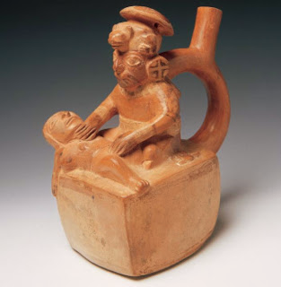
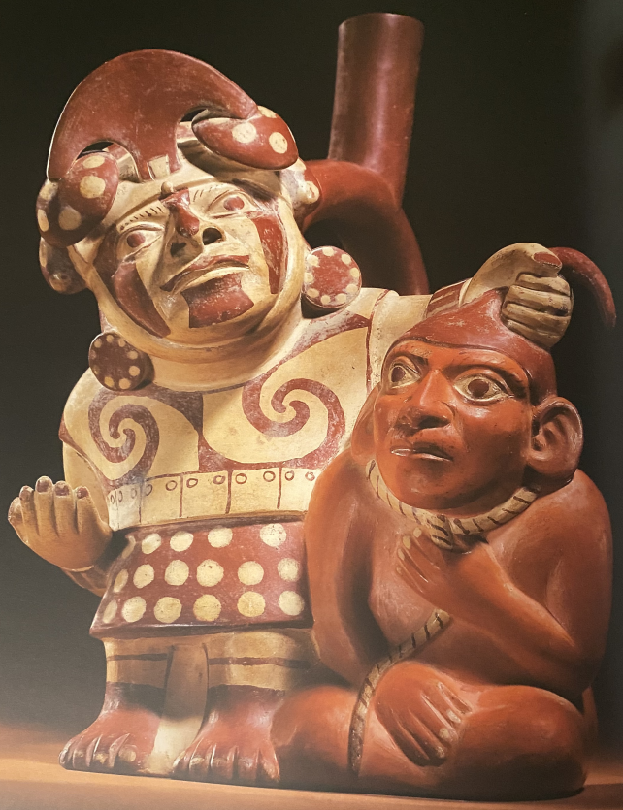
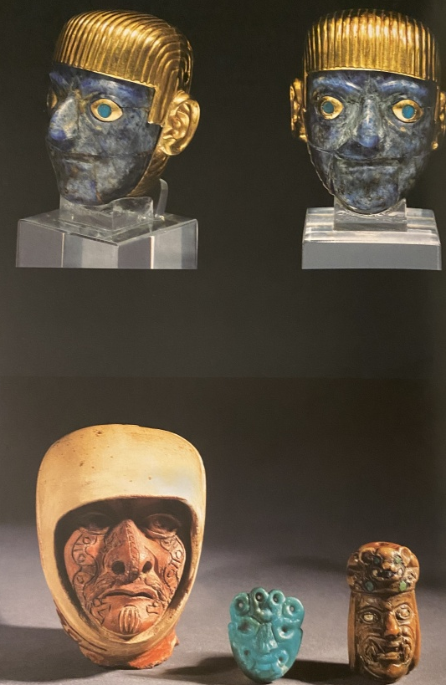
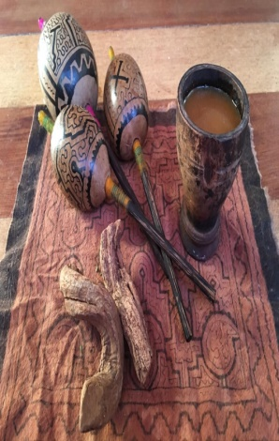
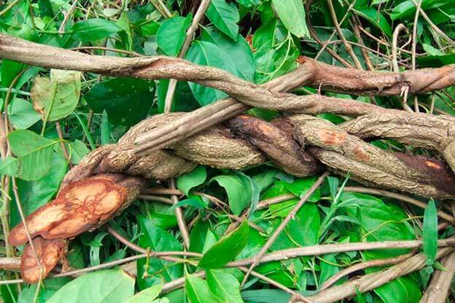
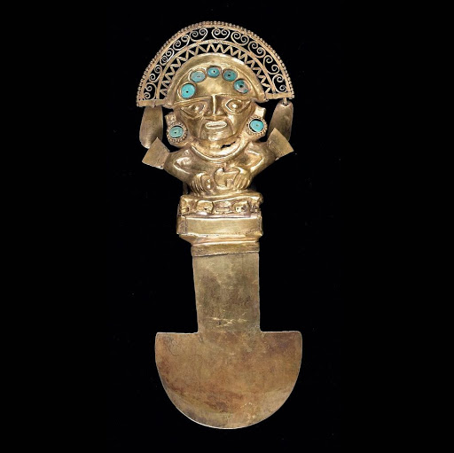
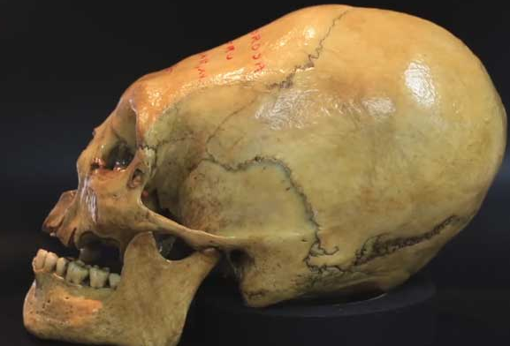
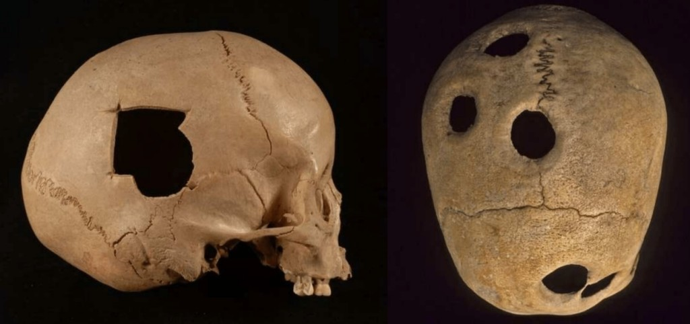
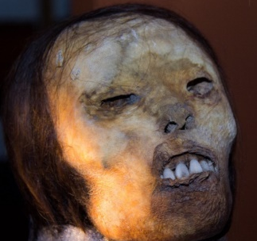
HISTORY OF PRECOLOMBINE AND INCA MEDICINE. PERUVIAN CHAMANISM

Slide 3
Table of Contents
Preamble
Introduction
Pre-Columbian medicine definition
Definition of the worldview of the pre-Columbian and Inca populations of Peru.
List of the main sources of evidence in the history of pre-Columbian and Inca medicine in Peru.
Cranial trepanations
Cranial bone deformations.
Mummification process. Juanita Mummy

Slide 4
Preamble
This Unit makes available to medical students around the world, historical educational material related to the values ​​of our history of pre-Columbian medicine and Inca medicine. Aspects of shamanic medicine will also be developed, as part of the ancestral extension of these pre-Columbian and Inca medicines today.

Slide 5
1. INTRODUCTION
In pre-Columbian history, there were always diseases, patients, and people (shamans and healers) who tried to cure the sick with the tools and knowledge they had access to.
The ancient populations of the American continent, such as the pre-Columbian cultures and the pre-Hispanic Inca empire, created their own medicine, which had special characteristics: It was a magical, religious, empirical and rational medicine.
There is evidence of some acute and chronic diseases present in these ancient populations. Ancient knowledge is still used in some Peruvian populations.
You will understand that science today discovers the evidence of that vast knowledge in knowledge of its ecosystem, of medicinal plants, nutritional plants, minerals, animals, therapeutic methods, surgical techniques and mummification.
Pamo Reyna Oscar. Medicina Prehispánica. En Alarcón Graciela, Espinoza Luis, Pamo-Reyna Oscar, Eds. Medicina y Reumatología Peruanas: historia y aportes. Lima, Comité Organizador PANLAR 2006. http://sisbib.unmsm.edu.pe/bibvirtualdata/libros/2007/med_reumat/a02es.pdf (Spanish), http://sisbib.unmsm.edu.pe/bibvirtualdata/libros/2007/med_reumat/a02in.pdf (English)

Slide 6
Pre-Columbian cultures
Both pre-Columbian medicine and Inca medicine, arised in Latin America, to relieve pain and prolong life of:
The severity of the weather.
The soldiers of territory wars.
The suffering caused by diseases.
Other damage to health.
All these situations were dealt by healers, also known as shamans, sorcerers, healers, and various other denominations according to the culture in which they worked.
Ruíz Alarcón, E. (2000, diciembre 9). Medicina Prehispánica. Medicina, 22(3), 200-206. Recuperado a partir de https://revistamedicina.net/ojsanm/index.php/Medicina/article/view/54-7

Slide 7
In the Pre-Columbian cultures of Mexico (Maya and Aztec) and Peru, traditional medicine was empirical and based on magical religious rituals, there are writings, ceramics, bone remains, others that reveal the knowledge of these cultures.
There is evidence that shaman healers handled various pathologies in the pre-Columbian period, such as:
Epilepsy
Tetanus
Facial paralysis
Bone disorders Pott's disease
Cranial deformations
Cranial trepanations
Among others.
Galán-Rodas Edén, Laberiano Fernández Caddie, Maguiña Vargas Ciro. Historia del Tumi: Símbolo de la Medicina Peruana y del Colegio Médico del Perú. Acta méd. peruana [Internet]. 2012 Ene [citado 2020 Mar 20] ; 29( 1 ): 56-58. Disponible en: http://www.scielo.org.pe/scielo.php?script=sci_arttext&pid=S1728-59172012000100014&lng=es

Slide 8
2. Chronology of Andean Pre-Hispanic (Pre-Columbian) cultures
The appearance of man in America occurred around 15,000 years a. C., with its appearance the population and civilization of the American continent begins. Andean or pre-Hispanic or pre-Columbian civilizations developed towards along the western coast of America The development of pre-Columbian cultures has 2 periods: The first period is the preceramic and is the longest: it covers from 15,000 BC. C. until 2000 a. C .; it includes the “lithic” periods (15,000-7000 BC), early archaic (7000-4000 BC) and late archaic (4000-2000 BC). The second period begins from 2000 a. C., with the appearance and development of ceramics, and it is the ceramic or formative period, which is divided into lower or initial, intermediate or middle, and upper or final.
Jorge Moscol Gonzales. El conocimiento anatómico en el Perú preincaico. / Revista de la Asociación Médica Argentina, Vol. 131, Número 4 de 2018. https://www.ama-med.org.ar/uploads_archivos/1583/Rev-4-2018-completa%20AMA.pdf#page=6

Slide 9
Inca empire
The Inca empire is considered one of the most developed indigenous cultures, whose territory encompassed the territory of present-day Colombia in the north, in the west the coasts of the Pacific Ocean and in the south it came to occupy part of the current country of Chile. It also spread to land at high geographic altitude in the Andes. There is reasonable evidence on various aspects of Inca medicine, including the presence of healers, also called shamans, the use of medicinal plants, surgical operations, trepanations, and other procedures.
Jan G. R. Elferink. The Inca healer: empirical medical knowledge and magic in pre-Columbian Peru Revista de Indias, 2015, vol. LXXV, n.º 264 Págs. 323­350, ISSN: 0034­8341 doi:10.3989/revindias.2015.011

Slide 10
3. Definitions: 3.1 Definition of pre-Columbian and Inca medicine.
Pre-Columbian Medicine: The original peoples, who populated Latin America, conceived the process of health, disease, with a magical-religious thought in which there were good gods who granted well-being (wealth, health and love) and bad gods who attracted disease and cataclysms. (one) Inca Medicine: "Inca medicine was a mixture of magical-religious conceptions with an empiricism given fundamentally by the knowledge of the healing properties of medicinal plants, like other medicines from other pre-Hispanic cultures that preceded or existed together with she throughout the continent ”(2).
1. Frisancho Velarde, Óscar. Concepción mágico-religiosa de la Medicina en la América Prehispánica. Acta Médica Peruana, 2012, vol. 29, no 2, p. 121-127. http://www.scielo.org.pe/scielo.php?script=sci_arttext&pid=S1728-59172012000200013
2. Pamo Reyna Oscar. Medicina Prehispánica. En Alarcón Graciela, Espinoza Luis, Pamo-Reyna Oscar, Eds. Medicina y Reumatología Peruanas: historia y aportes. Lima, Comité Organizador PANLAR 2006. http://sisbib.unmsm.edu.pe/bibvirtualdata/libros/2007/med_reumat/a02es.pdf (Spanish), http://sisbib.unmsm.edu.pe/bibvirtualdata/libros/2007/med_reumat/a02in.pdf (English)

Slide 11
3. Definition of the worldview of the pre-Columbian populations of Peru.
3.2 WORLD VIEW PRE-COLOMBIAN COSMOVISION
Consideration of disease and health as the perfect balance between the body, soul and spirit. The pre-Hispanic Andean worldview was intimately linked to nature, in which land, fire, air and water interrelated.
1. Frisancho Velarde, Óscar. Concepción mágico-religiosa de la Medicina en la América Prehispánica. Acta Médica Peruana, 2012, vol. 29, no 2, p. 121-127. http://www.scielo.org.pe/scielo.php?script=sci_arttext&pid=S1728-59172012000200013

Slide 12
3. Definition of the worldview of the Inca population of Peru.
Inca worldview The Incas had a conception of the universe, divided into three planes: the divine world of the gods (Hanan Pacha), the present world inhabited by men (Kay Pacha) and the underground world of the dead (Uku Pacha). These three worlds were permanently related.
1. Frisancho Velarde, Óscar. Concepción mágico-religiosa de la Medicina en la América Prehispánica. Acta Médica Peruana, 2012, vol. 29, no 2, p. 121-127. http://www.scielo.org.pe/scielo.php?script=sci_arttext&pid=S1728-59172012000200013
2. Pamo Reyna Oscar. Medicina Prehispánica. En Alarcón Graciela, Espinoza Luis, Pamo-Reyna Oscar, Eds. Medicina y Reumatología Peruanas: historia y aportes. Lima, Comité Organizador PANLAR 2006. http://sisbib.unmsm.edu.pe/bibvirtualdata/libros/2007/med_reumat/a02es.pdf (Spanish), http://sisbib.unmsm.edu.pe/bibvirtualdata/libros/2007/med_reumat/a02in.pdf (English)

Slide 13
3. Definition of the worldview of the Inca population of Peru.
Inca worldview The ancient pre-Columbian settlers developed a medicine based on respect for the knowledge of shamans. In the Piura Region, in the north of Peru, a tomb of two thousand years old has been discovered. Inside this tomb, the remains of a healer buried with various elements used in his work as a shaman were found: stones, crystals, teeth of puma, seashells, etc. It is worth mentioning that at present it is the same content of the "table" of work used in the rituals of the healers of Peru in that northern area, which would reveal the historical continuity of medicine to the Andes in these times.
Frisancho Velarde, Óscar Concepción mágico-religiosa de la Medicina en la América Prehispánica Acta Médica Peruana, vol. 29, núm. 2, abril-junio, 2012, pp. 121-127 Colegio Médico del Perú Lima, Perú

Slide 14
3. Definition of the worldview of the Inca population of Peru.
The variety of Quechua and Aymara names for indigenous healers suggests that there were many types of physicians in ancient Peru who healed in different ways, using a varying amount of religion, magic, and empirical knowledge of medicinal plants and surgical skills in their cures. It seems that the hampicamayoc was among all those practitioners that most corresponded with the European healer of the time.

Slide 15
3. Definition of Shamanism
Pre-Columbian medicine, was based on shamanism and curanderismo, these "healers" were chosen by tradition from generation to generation or by the call of deities and took charge of the health of the population. These shaman healers were in charge of attending to the individual and collective health of the indigenous physical, mental and spiritual peoples with great success. Many of these practices of pre-Columbian Andean medicine, remained as a historical-cultural legacy in ceramics, textiles and other artistic expressions of magical-religious content preserved in pre-Columbian pre-Columbian archaeological remains.
R. G. Franco:chamanismo y plantas de poder en el mundo Precolombino de la Costa Norte del Perú . Perspectivas Latinoamericanas El Taki Onqoy, 2015

Slide 16
3. Definition of the worldview of the Inca population of Peru.
Quechua and Aymara names for indigenous healers:
Indigenous name: | Description:
Ambicamayo | Witch doctor (=hampicamayoc)
Camasca | Healer-magician
Camasca osoacoyoc | Healer
Chukri hampicamayok | Surgeon
Chukrihampik | Surgeon
Circay camayok | Surgeon (for bleedings)
Colla camana | see: collacamana
Collacamana | Surgeon, healer
Collayoc | Herbalist
Hambi camayoc | Medical practitioner
Hanpi camayoc | Healer, surgeon
Hampicamana | Healer
Hampipayak | Priest-healer
Hanpiyoc | Healer for criminal practices
Huachachicuk | Midwife
Huachachik | Midwife
Huahuachiti | Midwife
Jan G. R. Elferink. The Inca healer: empirical medical knowledge and magic in pre-Columbian Peru. Revista de Indias, 2015, vol. LXXV, n.º 264, 323-350, ISSN: 0034-8341 doi:10.3989/revindias.2015.011

Slide 17
4. List of the main sources of evidence in the history of pre-Columbian and Inca medicine in Peru
Evidences of the testimonies of the so-called chroniclers.
The coprolites.
The study of the mummy bone remains.
The ceramics.
Pamo Reyna Oscar. Medicina Prehispánica. En Alarcón Graciela, Espinoza Luis, Pamo-Reyna Oscar, Eds. Medicina y Reumatología Peruanas: historia y aportes. Lima, Comité Organizador PANLAR 2006. http://sisbib.unmsm.edu.pe/bibvirtualdata/libros/2007/med_reumat/a02es.pdf (Spanish), http://sisbib.unmsm.edu.pe/bibvirtualdata/libros/2007/med_reumat/a02in.pdf (English

Slide 18
4. List of the main sources of evidence in the history of pre-Columbian and Inca medicine in Peru
When we need to know about pre-Columbian and Inca cultures, we turn to several sources:
Not having left a legacy written by the aborigines of this continent, we must look for evidence of the testimonies of the so called chroniclers, who were the Spanish military, friars and lawyers, who witnessed what was happening in the New Continent about Andean medicine and wrote it in books.
The references reported in the chronicles are only valid for the indigenous people.
Pamo Reyna Oscar. Medicina Prehispánica. En Alarcón Graciela, Espinoza Luis, Pamo-Reyna Oscar, Eds. Medicina y Reumatología Peruanas: historia y aportes. Lima, Comité Organizador PANLAR 2006. http://sisbib.unmsm.edu.pe/bibvirtualdata/libros/2007/med_reumat/a02es.pdf (Spanish), http://sisbib.unmsm.edu.pe/bibvirtualdata/libros/2007/med_reumat/a02in.pdf (English

Slide 19
4. List of the main sources of evidence in the history of pre-Columbian and Inca medicine in Peru
The first sources on traditional Andean medicine were the writings of the Spanish and the indigenous chroniclers who learned to write and left their messages for the world: Writings of the Jesuit father Bernabé Cobo.
COBO, Bernabé 1964 Works by Fr. Bernabé Cobo of the Society of Jesus (edition of the Library of Spanish Authors, BAE). Madrid: Atlas Editions.
One of the most important evidences is the book "Real comments of the Incas", whose author was the Inca Garcilaso de la Vega (1609), in which he describes the different indigenous treatments carried out on the Hispanic conquerors, both in their struggles against the incannate as in their civil wars. Another important evidence is the "New Chronicle and Good Government" written by Guamán Poma de Ayala (Hispanicized Indian) in the year 1615.
There is other literature that highlights the work of Indian healers, with medicinal plants, but criticizes the healing rituals of indigenous people, for their magical component, for which they were branded as witchcraft. These messages can be found in the works of Cristóbal de Molina (1573) "Relation of fables and rites of the Incas".Apuntes para la elaboración de una historia de la medicina tradicional andina* Notes for the development of a history of traditional Andean medicine. Erick Devoto Bazán** Universidad de Lima. Revista del Instituto Riva-Agüero RIRA vol. 1, n° 2 (octubre 2016) pp. 79-116 / ISSN: 2415-5896 https://doi.org/10.18800/revistaira.201602.003
POMA DE AYALA, Guamán [1615] El primer nueva corónica y buen gobierno (1615-1616). [Manuscrito original de la Biblioteca Real de Dinamarca]. København, Det Kongelige Bibliotek, GKS 2232 4°. <http://www.kb.dk/permalink/2006/ poma/840/es/text/>

Slide 20
4. List of the main sources of evidence in the history of pre-Columbian and Inca medicine in Peru
In the book "Real Comments of the Incas", Inca Garcilaso de la Vega (1609), he narrates the cures with auquénido manure mixed with a particular "tallow", to treat war wounds.
Joseph de Acosta (1590) in his work "Natural and Moral History of the Indies, the use of American plants and their medical properties is narrated, the author highlights that the pre-Columbian Andean culture used diet as a healing practice," use and consumption of food products. "
Apuntes para la elaboración de una historia de la medicina tradicional andina* Notes for the development of a history of traditional Andean medicine. Erick Devoto Bazán** Universidad de Lima. RIRA vol. 1, n° 2 (octubre 2016) pp. 79-116 / ISSN: 2415-5896 https://doi.org/10.18800/revistaira.201602.003

Slide 21
4. List of the main sources of evidence in the history of pre-Columbian and Inca medicine in Peru
Evidence of treatment for polyglobulia and headaches:
Great evidence of the quality of indigenous medicine was the use of bleeding as a tool to improve the health condition of patients.
The bleeds were performed by experienced healers called Circay camayok.
The Spanish people when they arrived to America, verified the use of the hemorrhages in the Incas, because the hemorrhages were fashionable in Europe, they considered it as proof of the high level of Inca medicine.
Pre-Columbian cultures had developed, through goldsmithing, various surgical instruments such as very thin needles, mostly flint tips, to cause bleeding. Pre-Columbian cultures treated pain in the head, puncturing the jugular vein, and also bled between the eyebrows on the bridge of the nose.
Jan G. R. Elferink. The Inca healer: empirical medical knowledge and magic in pre-Columbian Peru. Revista de Indias, 2015, vol. LXXV, n.º 264 Págs. 323­350, ISSN: 0034­8341. doi:10.3989/revindias.2015.011

Slide 22
4. List of the main sources of evidence in the history of pre-Columbian and Inca medicine in Peru
Chroniclers like Garcilazo de la Vega, wrote a lot about the treatments of indigenous healers. A subject that caught his attention was the medicine used for reproduction. Garcilazo mentions in one of his writings that indigenous doctors used plants for their effects on virility.
For example, he described that the huarnapu plant was rubbed on the pudenda area to achieve greater excitability. Likewise, a half blood chronicler named Santa Cruz Pachacutic, described how the Inca Sinchi Roca used the Chotarguanarpu plant.
The incense stick with huallaquita has a virilizing effect, which was also achieved with worms called sucama. The chutarpulo was used for the sterilizing effect.
According to Garcilaso it was known that the añus plant managed to reduce sexual potential as a contraceptive.

Slide 23
4. List of the main sources of evidence in the history of pre-Columbian and Inca medicine in Peru
The coprolites (faeces remains) of the pre-Columbian gum cultures have been well studied thanks to the remains of latrines found in tombs around the Peruvian territory.
Pamo Reyna Oscar. Medicina Prehispánica. En Alarcón Graciela, Espinoza Luis, Pamo-Reyna Oscar, Eds. Medicina y Reumatología Peruanas: historia y aportes. Lima, Comité Organizador PANLAR 2006. http://sisbib.unmsm.edu.pe/bibvirtualdata/libros/2007/med_reumat/a02es.pdf (Spanish), http://sisbib.unmsm.edu.pe/bibvirtualdata/libros/2007/med_reumat/a02in.pdf (English
The coprolites are the dry and lumpy stools, hardened by dehydration, which, properly treated, can give us health information and other information such as the intestinal parasites of the individuals from which they came.

Slide 24
4. List of the main sources of evidence in the history of pre-Columbian and Inca medicine in Peru
The coprolites "are the dry and lumpy stools, hardened by dehydration, which, duly treated, can give us information about the intestinal parasites of the individuals from which they came." (Pamo)
The study of the coprolites in the latrines of pre-Hispanic remains shows various intestinal parasites
In Los Gavilanes (Ancash), remains from the years 2850 to 2700 BC, corresponding to the Late Archaic period, and where Diphyllobotríum pacificum eggs were found.
In remains of the Chiribaya culture, between 700 and 1350 AD, eggs of D. pacificum and T. trichuris were found in the coprolites.
Pamo Reyna Oscar. Medicina Prehispánica. En Alarcón Graciela, Espinoza Luis, Pamo-Reyna Oscar, Eds. Medicina y Reumatología Peruanas: historia y aportes. Lima, Comité Organizador PANLAR 2006. http://sisbib.unmsm.edu.pe/bibvirtualdata/libros/2007/med_reumat/a02es.pdf (Spanish), http://sisbib.unmsm.edu.pe/bibvirtualdata/libros/2007/med_reumat/a02in.pdf (English

Slide 25
4. List of the main sources of evidence in the history of pre-Columbian and Inca medicine in Peru
Coprolite study results:
Eggs of Enterobius vermicularis
Ascaris lumbricoides
Trichiura trichuris
Giardia lamblia
among others.
The analysis of the coprolites have revealed that our ancient pre-Columbian and Inca settlers lived with intestinal parasites and that some medicinal plants were used to combat intestinal parasites were used for their treatment.
GUERRA, Francisco; SÁNCHEZ, Maréa C. Las enfermedades del hombre americano. Quinto Centenario, 1990, vol. 16, p. 19-52.

Slide 26
4. List of the main sources of evidence in the history of pre-Columbian and Inca medicine in Peru
Pamo Reyna Oscar. Medicina Prehispánica. En Alarcón Graciela, Espinoza Luis, Pamo-Reyna Oscar, Eds. Medicina y Reumatología Peruanas: historia y aportes. Lima, Comité Organizador PANLAR 2006. http://sisbib.unmsm.edu.pe/bibvirtualdata/libros/2007/med_reumat/a02es.pdf (Spanish), http://sisbib.unmsm.edu.pe/bibvirtualdata/libros/2007/med_reumat/a02in.pdf (English
c. The study of mom's skeletal remains have revealed information about some diseases and treatments in these pre-Columbian and Inca towns.

Slide 27
4. List of the main sources of evidence in the history of pre-Columbian and Inca medicine in Peru
The study of skeletal remains from pre-Columbian and Inca cultures, also showed evidence of diseases in the ear.
They were found in skulls, bony prominences called "osteoma of the external auditory canal", these deformations are found as a reaction to frequent infections of the external auditory canal.
It should be noted that our ancestors were deep-sea shellfish collectors, these injuries being common in coastal towns or near large lakes, from which it is concluded that there was a relationship with the work activity of diving and this type of disease.
Pamo Reyna Oscar. Medicina Prehispánica. En Alarcón Graciela, Espinoza Luis, Pamo-Reyna Oscar, Eds. Medicina y Reumatología Peruanas: historia y aportes. Lima, Comité Organizador PANLAR 2006. http://sisbib.unmsm.edu.pe/bibvirtualdata/libros/2007/med_reumat/a02es.pdf (Spanish), http://sisbib.unmsm.edu.pe/bibvirtualdata/libros/2007/med_reumat/a02in.pdf (English)

Slide 28
4. List of the main sources of evidence in the history of pre-Columbian and Inca medicine in Peru
The study of pre-Inca and Inca mummy bone remains also showed evidence of vertebral tuberculosis or Pott's disease found in the mummies. (1, 2)
The bones were subjected to various radiological and molecular studies to confirm the diagnosis.
Radiological study + polymerase chain reaction (PCR) study = vertebral tuberculosis or Pott's disease.
1. GUILLÉN, Sonia E. A History of paleopathology in Peru and Northern Chile: From head hunting to head counting. The global history of paleopathology: Pioneers and prospects, 2012, p. 312-328.
2. Pamo Reyna Oscar. Medicina Prehispánica. En Alarcón Graciela, Espinoza Luis, Pamo-Reyna Oscar, Eds. Medicina y Reumatología Peruanas: historia y aportes. Lima, Comité Organizador PANLAR 2006. http://sisbib.unmsm.edu.pe/bibvirtualdata/libros/2007/med_reumat/a02es.pdf (Spanish), http://sisbib.unmsm.edu.pe/bibvirtualdata/libros/2007/med_reumat/a02in.pdf (English)

Slide 29
4. List of the main sources of evidence in the history of pre-Columbian and Inca medicine in Peru
Pamo Reyna Oscar. Medicina Prehispánica. En Alarcón Graciela, Espinoza Luis, Pamo-Reyna Oscar, Eds. Medicina y Reumatología Peruanas: historia y aportes. Lima, Comité Organizador PANLAR 2006. http://sisbib.unmsm.edu.pe/bibvirtualdata/libros/2007/med_reumat/a02es.pdf (Spanish), http://sisbib.unmsm.edu.pe/bibvirtualdata/libros/2007/med_reumat/a02in.pdf (English
Another interesting evidence of disease in the Andean populations was the presence of lesions known as porotic hyperostosis or spongiohyperostosis, these lesions occured in patients with chronic severe anemias.
This porotic hyperostosis was found in the skulls of coastal populations, but it was not based on quinoa.

Slide 30
4. List of the main sources of evidence in the history of pre-Columbian and Inca medicine in Peru
Experts in the use of medicinal plants in pre-Columbian medicine:
The inclusion of hampi in the name for surgeon is striking. Although the word hampi in compound words could have some meanings it suggests that (botanical) medicines played a role during surgery.
That is not surprising because the high percentage of recovery among patients with trepanned skulls indicates that the healer used medicinal plants to prevent infection and inflammation and possibly also analgesics to reduce pain during the operation.
The Inca healer: empirical medical knowledge and magic in pre-Columbian Peru. Jan G. R. Elferink. Revista de Indias, 2015, vol. LXXV, n.º 264 Págs. 323­350, ISSN: 0034­8341 doi:10.3989/revindias.2015.011

Slide 31
4. List of the main sources of evidence in the history of pre-Columbian and Inca medicine in Peru
In 1973, the presence of tuberculosis in South America was confirmed, Allison et al. after carrying out pathological, radiological and bacteriological studies of mummified remains of an 8-10 year old boy in Peru, they confirmed the diagnosis. Subsequently, various studies were performed with microscopic demonstration of mycobattery in archaeological material in mummies from Chile and Peru Then with molecular diagnosis using PCR techniques for mycobacterial DNA in the same material. Other research analyzed skeletal series, with the first population-based approach that determined the prevalence of tuberculosis.

Slide 32
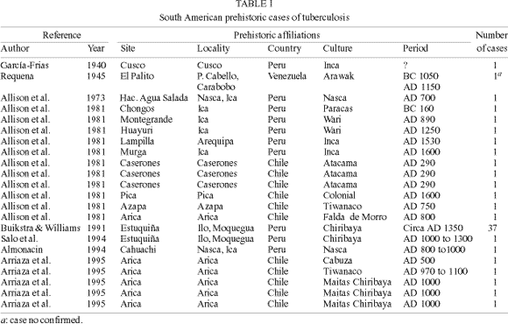
4. List of the main sources of evidence in the history of pre-Columbian and Inca medicine in Peru
Presence of tuberculosis in pre Columbian:
GÓMEZ I PRAT, Jordi; SOUZA, Sheila MF. Prehistoric tuberculosis in America: adding comments to a literature review. Memórias do Instituto Oswaldo Cruz, 2003, vol. 98, p. 151-159.

Slide 33
4. List of the main sources of evidence in the history of pre-Columbian and Inca medicine in Peru
d. The Ceramics found in the tombs reveal the recognition of various diseases in these cultures.
“From the analysis of the figures, the existence of specific pathological entities, among other cultural appreciations, during ancient Peru has been assumed. Researchers and medical historians agree in the recognition of diseases by the manifestations of externalized signs coinciding with those of the semiological methodology in force in the medical sciences.”
From the faces or facie of each ceramic icon (popularly known as "huacos") a retrospective collection of "the semiology of some modalities of the pathology of the Inca" can be formulated. (29)

Slide 34
4. List of the main sources of evidence in the history of pre-Columbian and Inca medicine in Peru
“The ceramics of the faces reveal manifestations of physical and psycho-expressive alterations that resemble a photograph due to the precision and fineness of the details; They are known as the "huaco-portraits" of the Moche culture. Furthermore, it is possible to identify congenital and neurological entities that include various characteristics of paralysis and multiple pathological deformations with dermal diseases and some of anthropomorphic conception. There are structural somatic representations with musculoskeletal deformations, traumatic absence of extremities, brachial and crural defects, tumors” (29).

Slide 35
4. List of the main sources of evidence in the history of pre-Columbian and Inca medicine in Peru
“Many are the diseases identified based on ceramics; such as the following: obesity, thyroid goiter, steatopygia, facial lesions of the facial and trigeminal nerves, blindness, cleft lip, nasal deformations and destruction of the congenital and acquired septum, exophthalmos, palpebral ptosis, facial syphilitic gum, uta, pinta, skin erosions, mutilated faces, cranial deformations, etc. ”(29).

Slide 36
4. List of the main sources of evidence in the history of pre-Columbian and Inca medicine in Peru
Another valuable information that results from the study of pre-Columbian ceramics, but also from the writings of the chroniclers is the way of childbirth.
Many pre-Columbian, Inca ceramics reveal that labor and birth were carried out with the mother in an upright position.
Also in the Larco Museum you can see a pottery in which a woman (apparently a midwife) helps another in labor in an upright position. "Mochica Ceramic that is reproduced in the book of Los Mochichas by Rafael Larco"
NOTES OF HEALTH AND MEDICINE OF ANCIENT PERU

Slide 37
4. List of the main sources of evidence in the history of pre-Columbian and Inca medicine in Peru
HERRERA, Jesús Baldomero Valdez. Las Infecciones y el Descubrimiento y Conquista de América y del Perú. http://www.acadnacmedicina.org.pe/documentos/Infecciones_y_descubrimiento.pdf
The Ceramics were a great source of evidence of the things that the ancient inhabitants of the pre-Columbian and Inca cultures observed, because it was a way of communicating effectively.
Ceramics revealed several infectious diseases in pre-Columbian America:
Tuberculosis
Histoplasmosis
Leishmaniasis
Uta Chagas disease
Amebiasis
Peruvian wart Endemic
Syphilis Tetanus

Slide 38
4. List of the main sources of evidence in the history of pre-Columbian and Inca medicine in Peru
R. G. Franco:chamanismo y plantas de poder en el mundo Precolombino de la Costa Norte del Perú . Perspectivas Latinoamericanas El Taki Onqoy, 2015
Pre-Columbian ceramics also reveal medicinal or surgical practices and various diseases, such as:
Pathological, toxic and physiological states:
Acromegaly
Blindness
Facial paralysis
Physical deformities
Autochthonous conditions such as the "Peruvian wart“
Pathological mutilations (leprosy, sore, uta, syphilis, leishmaniasis, blastomycosis, lupus)
Wounds
Hemorrhages, etc.

Slide 39
4. List of the main sources of evidence in the history of pre-Columbian and Inca medicine in Peru
1. AKHOUNDI, Mohammad, et al. A historical overview of the classification, evolution, and dispersion of Leishmania parasites and sandflies. PLoS neglected tropical diseases, 2016, vol. 10, no 3. https://journals.plos.org/plosntds/article/file?type=printable&id=10.1371/journal.pntd.0004349
Presence of Leishmaniosis. "Leishmaniasis has a long history, dating to 2,500 B.C., with several primitive descriptions of the disease having been found in ancient writings and recent molecular findings from ancient archeological material" (1)
Leishmania infection in a 6-year-old girl mummy in Peru. (700 B.C.): (First century A.D.)
Evidence for the presence of the cutaneous form of the disease in Ecuador and Peru, South America.
Avicenna (10th century A.D.): Description of cutaneous lesions called Balakh sore and probability of mosquito intervention.
15th and 16th centuries A.D : Inca period: Notification of "valley sickness," "Andean sickness," or "white leprosy," which are likely to be South American Cutaneus Leishmaniosis.

Slide 40
4. List of the main sources of evidence in the history of pre-Columbian and Inca medicine in Peru
Various ceramics revealed the presence of facial paralysis treated by medical healers in pre-Columbian cultures
CAROD ARTAL, Francisco Javier; VÁZQUEZ CABRERA, Carolina B. Malformaciones y parálisis faciales en la cerámica de las culturas precolombinas Moche y Lambayeque. Neurologia, 2006, vol. 21, no 6, p. 297-303.

Slide 41
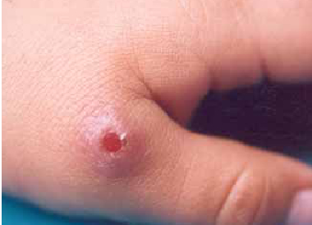
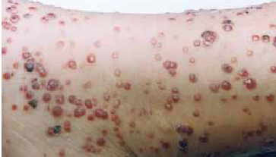
4. List of the main sources of evidence in the history of pre-Columbian and Inca medicine in Peru
Infections with Bartonella bacilliformis result in Carrion's disease in humans. In the first phase of infection, the pathogen causes a hemolytic fever ("Oroya fever") with case-fatality rates as high as ~90% in untreated patients, followed by a chronical phase resulting in angiogenic skin lesions ("verruga peruana"). Bartonella bacilliformis is endemic to South American Andean valleys and is transmitted via sand flies (Lutzomyia spp.). Humans are the only known reservoir for this old disease and therefore no animal infection model is available.
Kempf, V. A. J., Garcia-Quintanilla, M., Guerra, H., & Dichter, A. A. (2019). Carrion's disease: More than a neglected disease. BMC.

Slide 42
Daniel Carrion’s experiment
“In 1885, Daniel Carrion (1857-1885), a young Peruvian medical student, was trying to establish the prodromal symptoms of 'verruga disease', an infectious disease rare outside South America but endemic in parts of Peru. As part of this investigation he was inoculated with fluid from a verruga lesion from a patient with the chronic form of the disease. He recorded the clinical features which developed, including fever, malaise, arthralgia, vomiting and anaemia, and it became apparent that he had developed the anaemic, febrile, acute phase of the illness (known as Oroya fever). This did not however progress in his case to the chronic form of the disease, and he died a few weeks later on 5 October 1885. His sacrifice served to establish, supposedly, that Oroya fever and verruga disease had a common aetiology and his death stimulated further research into the cause, now established as the bacterium Bartonella bacilliformis. Carrion is considered a martyr of Peruvian medicine and 5 October has been designated Peruvian Medicine Day in his honour.”
Pamo Oscar. Daniel Carrion’s experiment: the use of selfinfection in the advance of medicine. J R Coll Physicians Edinb 2012; 42:81–6 doi:10.4997/JRCPE.2012.119 © 2012 Royal College of Physicians of Edinburgh

Slide 43
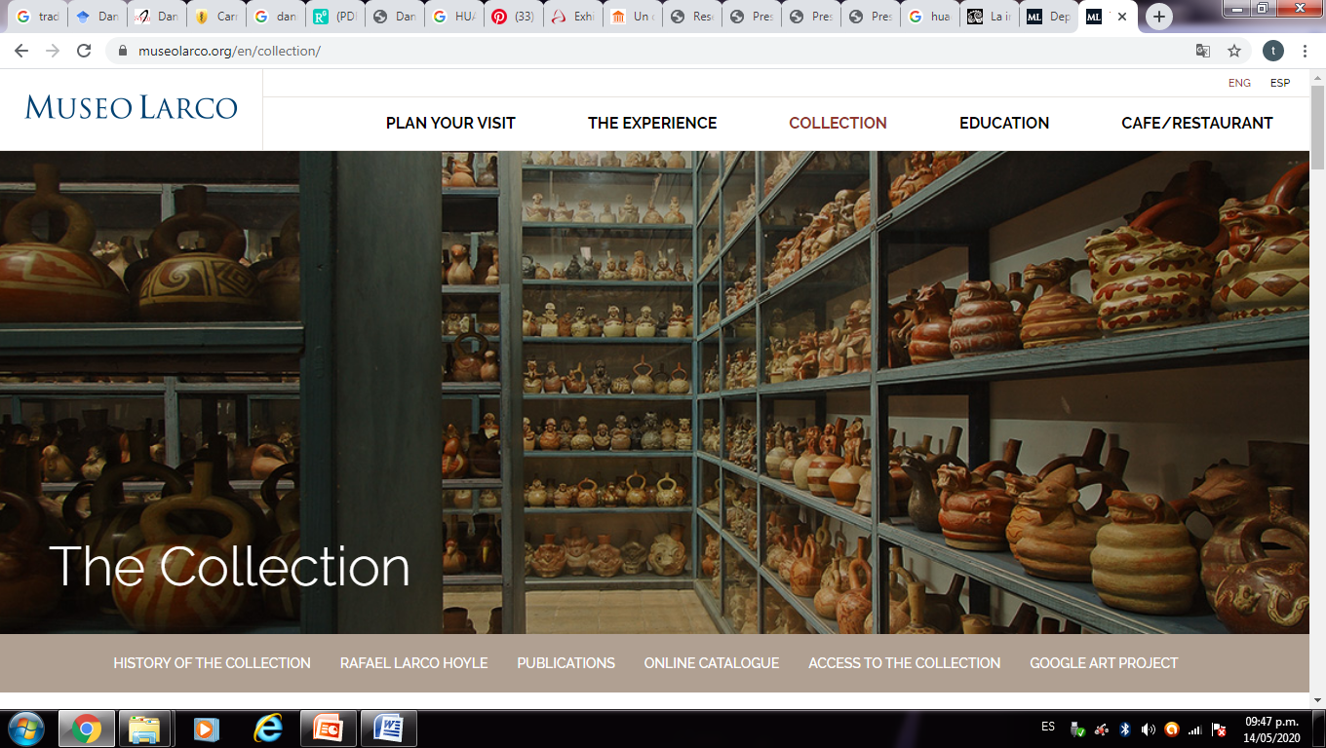
5. Current evidence of diseases that affect the pre-Columbian population of Peru.
PATHOLOGIES REPRESENTED IN HUACOS LARCO PERU MUSEUM
“Museo Larco – Lima, Perú”. https://www.museolarco.org/coleccion/

Slide 44
5. Current evidence of diseases that affected the pre-Columbian population and the Inca empire of Peru.
PATHOLOGIES REPRESENTED IN HUACOS “MUSEUM LARCO PERÚ”
Cifosis lumbar
CORREA-TRIGOSO, Denis E. Presencia de paleopatologías en las representaciones mochica: Un estudio de la colección cerámica del Museo Larco. Horizonte de la Ciencia, 2017, vol. 7, no 12, p. 43-60.
“Museo Larco – Lima, Perú”.

Slide 45
5. Current evidence of diseases that affect the pre-Columbian population of Peru.
PATHOLOGIES REPRESENTED IN HUACOS “MUSEUM LARCO PERÚ”
Sindrome de Crouzon
“Museo Larco – Lima, Perú”. https://www.museolarco.org/coleccion/
CORREA-TRIGOSO, Denis E. Presencia de paleopatologías en las representaciones mochica: Un estudio de la colección cerámica del Museo Larco. Horizonte de la Ciencia, 2017, vol. 7, no 12, p. 43-60.

Slide 46
5. Current evidence of diseases that affect the pre-Columbian population and the Inca empire of Peru.
PATHOLOGIES REPRESENTED IN HUACOS “MUSEUM LARCO PERÚ”
Bartonelosis
“Museo Larco – Lima, Perú”. https://www.museolarco.org/coleccion/
CORREA-TRIGOSO, Denis E. Presencia de paleopatologías en las representaciones mochica: Un estudio de la colección cerámica del Museo Larco. Horizonte de la Ciencia, 2017, vol. 7, no 12, p. 43-60.

Slide 47
5. Current evidence of diseases that affect the pre-Columbian population of Peru.
PATHOLOGIES REPRESENTED IN HUACOS “MUSEUM LARCO PERÚ”
Mutilations of members
“Museo Larco – Lima, Perú”. https://www.museolarco.org/coleccion/

Slide 48
5. Current evidence of diseases that affect the pre-Columbian population of Peru.
PATHOLOGIES REPRESENTED IN HUACOS “MUSEUM LARCO PERÚ”
Facial paralysis
“Museo Larco – Lima, Perú”. https://www.museolarco.org/coleccion/
CORREA-TRIGOSO, Denis E. Presencia de paleopatologías en las representaciones mochica: Un estudio de la colección cerámica del Museo Larco. Horizonte de la Ciencia, 2017, vol. 7, no 12, p. 43-60.

Slide 49
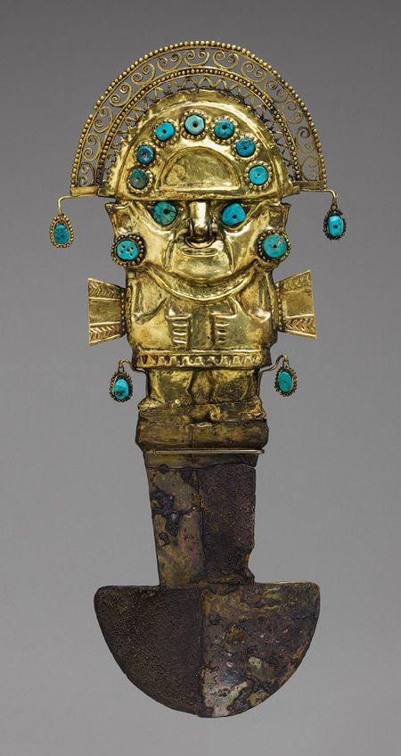
6. Cranial trepanations

Slide 50
6. Trephination
There are various archaeological evidences related to surgical practices throughout history in pre-Columbian South America. Cranial surgery in Pre-Columbian cultures was of high quality, as evidenced in skulls recovered after trepanation.
In Pre-Columbian cultures other forms of surgery were also practiced, this information is obtained thanks to the ceramics and pottery of some cultures, such as the pre-Inca Moche culture, who represent people with an amputated arm or leg, and sometimes provided with a artificial limb.
Analysis of skeleton remains of the Moche culture has been carried out, which shows that foot amputation surgeries with subsequent healing occurred in several cases. In pre-Columbian cultures, extensive surgical operations were also developed, with a large number of instruments such as different types of needles, tumi knives, and other objects that could be used in surgical operations.
Jan G. R. Elferink. The Inca healer: empirical medical knowledge and magic in pre-Columbian Peru. Revista de Indias, 2015, vol. LXXV, n.º 264 Págs. 323­350, ISSN: 0034­8341. doi:10.3989/revindias.2015.011

Slide 51
6. Trephination
A trephination is an opening in the skull that leaves a window to the brain and is the oldest form of surgery documented in the Peruvian case in the Paracas culture.
The Paracas culture was a pre-Columbian civilization of ancient Peru, in which trepanation and cranial deformation practices were developed with great success.

Slide 52
6. Trephination
Surgeon healers who used medicinal plants were called “hampi,” indicating that (botanical) medications played a role during surgery. There is evidence that in pre-Columbian medicine there was a high percentage of recovery among patients with trepanned skulls, indicated thanks to the use of medicinal plants to prevent infections and inflammation and possibly also pain relievers to reduce pain during the operation. Remains of these plants have been found next to bone remains.
Jan G. R. Elferink. The Inca healer: empirical medical knowledge and magic in pre-Columbian Peru. Revista de Indias, 2015, vol. LXXV, n.º 264 Págs. 323­350, ISSN: 0034­8341. doi:10.3989/revindias.2015.011

Slide 53
6. Trephination
Trepanation has been carried out in many cultures and requires great technical skill.
Two explanations have been given to explain why trepanning was done:
They were performed as a therapeutic process intended to relieve intracranial pressure or extract bone fragments from the surface of the brain. Magical-ritual reason, so that the evil spirits leave the head after the trepanation.

Slide 54
6. Trephination
Of all the pre-Columbian cultures in Peru, Paracas was the Pre-Columbian culture that most successfully developed trepanations.
To operate, surgical practitioners used the Tumi, among other instruments.
The procedure consisted of extracting the affected area, covering the hole with gold plates and covering the operated area with bandages with fine cotton wool.
Galán-Rodas Edén, Laberiano Fernández Caddie, Maguiña Vargas Ciro. Historia del Tumi: Símbolo de la Medicina Peruana y del Colegio Médico del Perú. Acta méd. peruana [Internet]. 2012 Ene [citado 2020 Mar 20] ; 29( 1 ): 56-58. Disponible en: http://www.scielo.org.pe/scielo.php?script=sci_arttext&pid=S1728-59172012000100014&lng=es.

Slide 55
6. Trephination
The Inca bronze instruments (champi) used in craniotomies: a bone elevator, crescent tumis, dissectors, and needles.
Ceremonial gold tumi of Chimu culture, c. AD 1000 to 1600, decorated with precious turquoise stones. This important piece “TUMI” can be seen in the Gold Museum in Lima Peru
Marino, R., & Gonzales-Portillo, M. (2000). Preconquest Peruvian Neurosurgeons: A Study of Inca and Pre-Columbian Trephination and the Art of Medicine in Ancient Peru. Neurosurgery, 47(4), 940–950. doi:10.1097/00006123-200010000-00028
Marino, R., & Gonzales-Portillo, M. (2000). Preconquest Peruvian Neurosurgeons: A Study of Inca and Pre-Columbian Trephination and the Art of Medicine in Ancient Peru. Neurosurgery, 47(4), 940–950. doi:10.1097/00006123-200010000-00028

Slide 56
6. Trephination
The Tumi, was a surgical instrument used to perform cranial trepanations, it was first found in Lambayeque Peru, at the beginning of 1937 by the historian researcher Dr. Julio César Tello, the antiquity of this instrument is from 700 to 1300 years AD. The tumis were used by various Peruvian cultures such as the Sicán, Moche (100 BC - AD 600) and the Chimu and Inca cultures (1300-1435). The Tumi, means "knife" in Quechua, is one of the most famous pieces of pre-Columbian art, "it is a type of ceremonial knife used in ancient Peru, and according to most evidence it represents the main god or lord of the region, with its hierarchical attributes and that some authors affirm that it is the legendary God Naylamp or Ñañlap, represented as an anthropomorphic being attributed to the legend of who was the founder of Lambayeque "
Galán-Rodas Edén, Laberiano Fernández Caddie, Maguiña Vargas Ciro. Historia del Tumi: Símbolo de la Medicina Peruana y del Colegio Médico del Perú. Acta méd. peruana [Internet]. 2012 Ene [citado 2020 Mar 20] ; 29( 1 ): 56-58. Disponible en: http://www.scielo.org.pe/scielo.php?script=sci_arttext&pid=S1728-59172012000100014&lng=es.

Slide 57
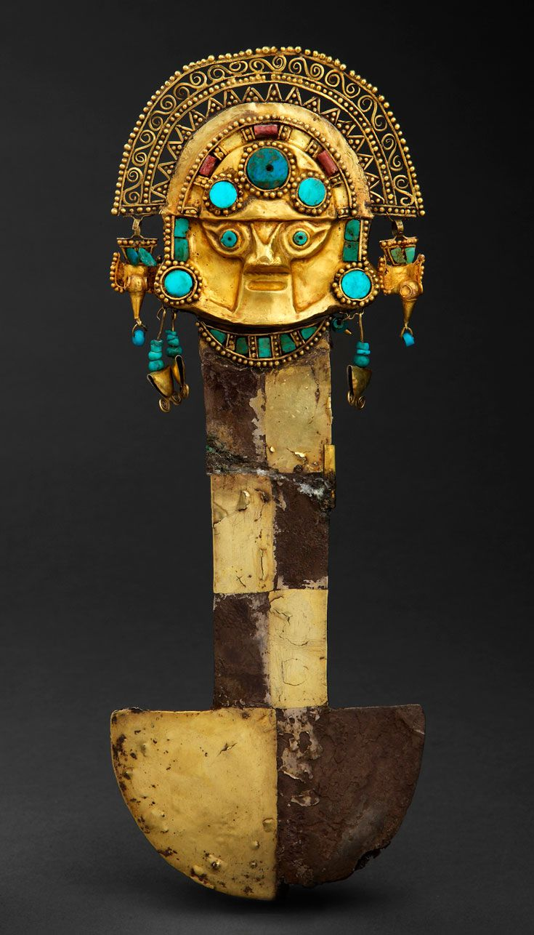
6. Trephination
The Tumi consists of a single metallic piece of two gold plates inlaid with pearl and turquoise shells. The Tumi has three parts: headband, mask head and body, it measures approximately 42 cm high and is made of solid 24 carat gold weighing approximately 1 kg (992 grams). The Tumi has an anthropomorphic face, with eyes similar to those of birds. Its body is made up of a thorax and legs of the same length. The Tumi's handle is rectangular or trapezoidal in shape. At the lower end a cutting blade in a semicircular shape (where the curved side is the one with the edge and the straight side is perpendicular to the handle).
Galán-Rodas Edén, Laberiano Fernández Caddie, Maguiña Vargas Ciro. Historia del Tumi: Símbolo de la Medicina Peruana y del Colegio Médico del Perú. Acta méd. peruana [Internet]. 2012 Ene [citado 2020 Mar 20] ; 29( 1 ): 56-58. Disponible en: http://www.scielo.org.pe/scielo.php?script=sci_arttext&pid=S1728-59172012000100014&lng=es.

Slide 58
6. Trephination
There is evidence that pre-Columbian healers and surgeons cured patients with severe head injuries by cutting and removing the damaged part of the skull by calling cranial trepanations.
The archaeological results of trepanned skulls found in the Paracas and Nazca cultures, demonstrated that the cuts were made with flint knives and metal tumis.
Galán-Rodas Edén, Laberiano Fernández Caddie, Maguiña Vargas Ciro. Historia del Tumi: Símbolo de la Medicina Peruana y del Colegio Médico del Perú. Acta méd. peruana [Internet]. 2012 Ene [citado 2020 Mar 20] ; 29( 1 ): 56-58. Disponible en: http://www.scielo.org.pe/scielo.php?script=sci_arttext&pid=S1728-59172012000100014&lng=es.

Slide 59
6. Trephination
The surgeon healers of the pre-Columbian medicine prevented the infection and inflammation of their surgeries, for this, they used a series of plants as well as in the embalming process of their dead.
Such as: Menthol, tannins, certain saponins and resins. These substances are very good antiseptics.
Jan G. R. Elferink. The Inca healer: empirical medical knowledge and magic in pre-Columbian Peru
Revista de Indias, 2015, vol. LXXV, n.º 264 Págs. 323­350, ISSN: 0034­8341 doi:10.3989/revindias.2015.011

Slide 60
6. Trephination
The Incas knew a whole series of plants against inflammation, such as acaaca, asipa (Pachyrhizus tuberosus), canayuyo (Sonchus oleraceus), caralahua (Nicotiana glauca), cochayuyo (Durvillaea antarctica), hoccururo, oca (Oxalis tuberosa), ulluco (Ullucus tuberosus), quinoa (Chenopodium quinoa), ratarata (Opuntia sulphurea), ticsau (Tropaeolum majus), tipa (Tipuana tipu), totora (Scirpus spp., Typha spp.), tulquina and yucaquiscas.
It is probable that these plants were applied to prevent or treat inflammations as a result of surgical interventions and trepanning.
Jan G. R. Elferink. The Inca healer: empirical medical knowledge and magic in pre-Columbian Peru
Revista de Indias, 2015, vol. LXXV, n.º 264 Págs. 323­350, ISSN: 0034­8341 doi:10.3989/revindias.2015.011

Slide 61
6. Trephination
Various systematic studies have been conducted on skulls found in Peru, including Cuzco, where a large number of climbed skulls have been found.
Recent studies have shown that many trepanned skulls were made at the time when the Incas.
The Incas are believed to have used coca (Erythroxylum coca) as a local anesthetic, as they knew the medicinal properties of coca well.
Jan G. R. Elferink. The Inca healer: empirical medical knowledge and magic in pre-Columbian Peru
Revista de Indias, 2015, vol. LXXV, n.º 264 Págs. 323­350, ISSN: 0034­8341 doi:10.3989/revindias.2015.011

Slide 62
6. Trephination
The trepanned skulls found in archaeological sites show that surgeons in ancient Peru developed various trepanation techniques, such as: Scraping, sawing, cutting, drilling or mixed techniques. At archaeological sites, materials such as tumis, scalpels, obsidian knives, and other objects for surgical operations have been found. The Moche and Chimú cultures also represented scenes in their ceramics in which they represented a surgeon operating a skull. It is important to note that after analyzing the skulls, it was evident that they had suffered trepanations many years ago, with this it is verified that a large percentage of the trepanned skulls show healing and that the patient continued to live after the operation shows that the surgeons of the former Peru must have been very skilled. Skulls were found of people who had been intervened several times from wounds, apparently from several wars, thus confirming the success of the surgeries.
Elsa Tomasto-Cagigao. Modificaciones craneales paracas: ¿estatus, etnicidad, estética?. BOLETÍN DE ARQUEOLOGÍA PUCP / N.° 22 / 2017, 255-276 / ISSN 1029-2004

Slide 63
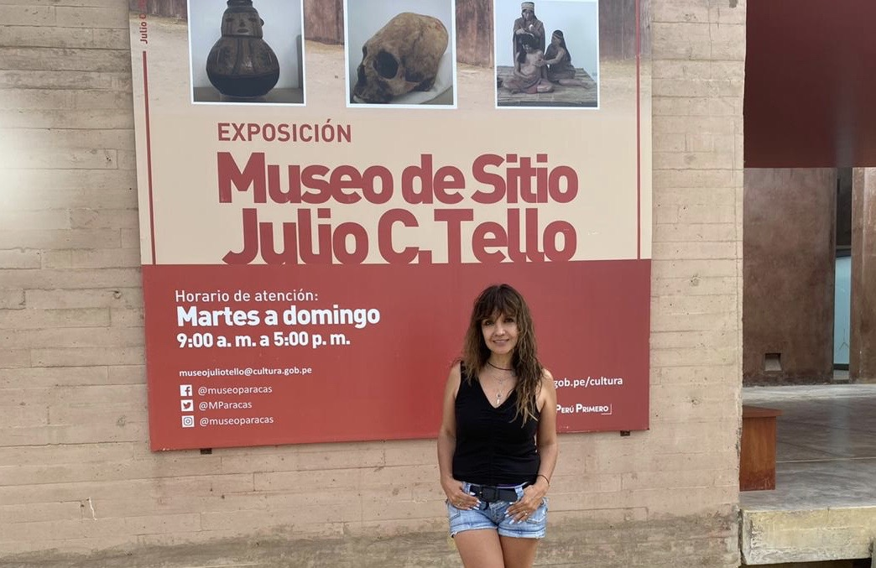
6. EVIDENCE TREPANATIONS IN PERU:
Museum Julio Cesar Tello Paracas Perú

Slide 64
6. Trephination
Museum Julio Cesar Tello Paracas Perú

Slide 65
6. Trephination
La cirujanos de la Cultura Paracas, practicaron la alta cirugía con la finalidad de intervenir heridas, tumores y fracturas. Como anestésico usaran la hoja de coca, como antiséptico (para infección) plantas medicinales: entre los instrumentos que usaron destacan:
El cincel Tumi
Cuchillos
Vendas, etc
Estas trepanaciones eran hechas por cirujanos especializados quienes quitaban fragmentos de cráneo y lo cubrían con láminas de oro y plata.
Realizaron también las deformaciones Craneanas (utilizadas solo para personas importantes). Estas trepanaciones Craneanas utilizaron Cuchillos de obsidiana. Tello afirma que un 40 % de los cráneos de las momias habían sido sometidos a las prácticas de trepanación, y que las mismas se realizaban en vida.

Slide 66
6. Trephination
The surgeons of the Paracas Culture practiced the high surgery in order to intervene wounds, tumors and fractures. Coca leaf will be used as an anesthetic, medicinal plants as an antiseptic (for infection): among the instruments used are:
The Tumi chisel
Knives
Bandages, etc
These trepanations were made by specialized surgeons who removed fragments of the skull and covered it with gold and silver foils.
They also performed the Cranial deformations (used only for important people). These Cranial trepanations used Obsidian Knives. Tello states that 40% of the skulls of the mummies had undergone trepanation practices, and that they were carried out while alive.

Slide 67
6. Trephination
Marino, R., & Gonzales-Portillo, M. (2000). Preconquest Peruvian Neurosurgeons: A Study of Inca and Pre-Columbian Trephination and the Art of Medicine in Ancient Peru. Neurosurgery, 47(4), 940–950. doi:10.1097/00006123-200010000-00028
Skull showing two circular cutting craniotomies, probably a correction of a depressed cranial fracture caused by a stone porra weapon.

Slide 68
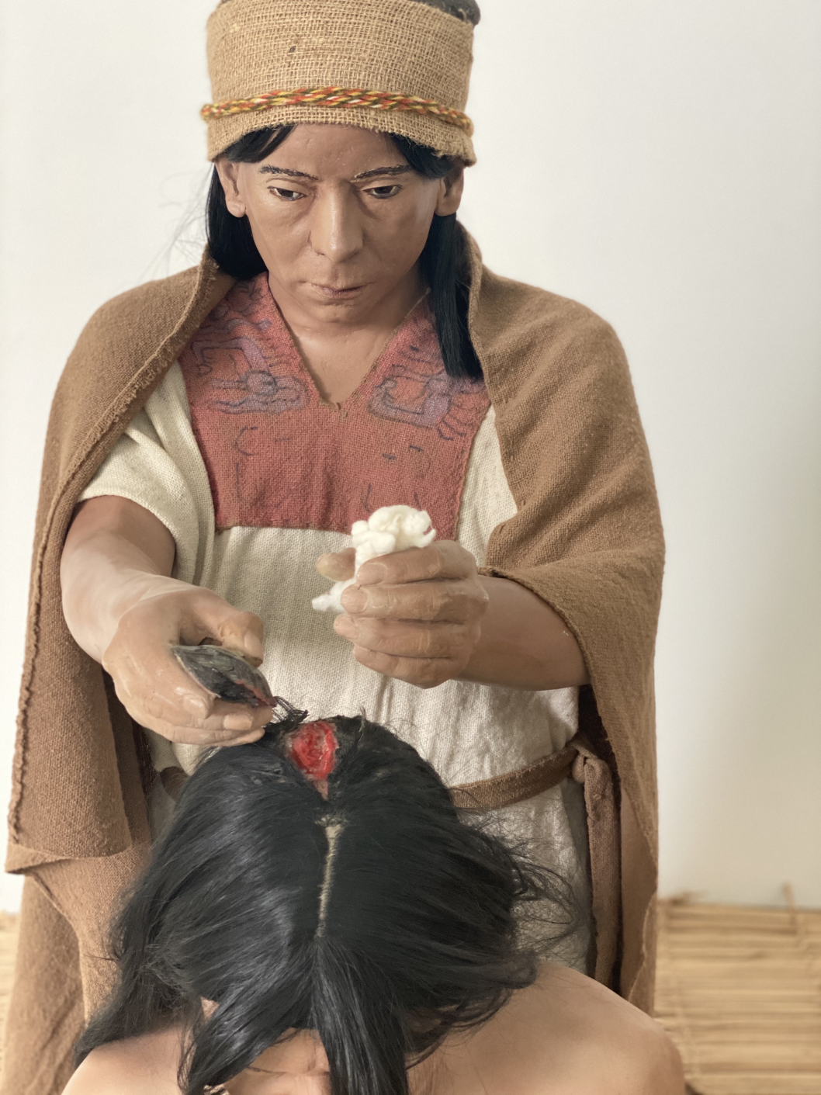
6. Trephination
Inca and Pre-Columbian Trephination of Medicine in Ancient Peru
Museum Julio Cesar Tello Paracas Perú

Slide 69
6. Trephination
The centers where the first skulls were found were in Yucay, Urubamba, Cuzco and Paracas, typifying for the characteristics, according to Weiss especially. The instruments may have been "obsidian" and "wedge-shaped volcanic glass blades." In addition to the skulls, bandages have been found in the form of cloths, cotton rolls, in the form of a thread and bandages made of very soft cotton fabric, which contributes to the criterion of the existence of a surgical method next to trepanation. The results intuited by the research are highlighted that in the series studied by Tello of 400 skulls, it is found that in 250 they surely "cured" (65%)

Slide 70
6 Trephination
The result of the study of archaeological specimens has been found that among the possible causes of trepanation that could be considered:
Inflammatory processes
Hemorrhages with lifting of the periosteum,
Tuberculosis
Osteomyelitis
Tumors

Slide 71
6. Trephination
Radiological studies of the skulls trepanned by pre-Columbian Peruvian surgeons: "reveal anatomical knowledge and unsurpassed skill and delicacy of the hands, the bridge that divides the wounds, is a luxury of bone dissection" ... "the resource of dissecting the internal table without penetrating the cranial cavity was frequently used by Peruvian surgeons in the delicate area of ​​the head »; Weiss wrote.

Slide 72
6. Trephination
“Amazing skull showing the impressive result of a frontal cranioplasty performed with gold plate, followed by perfect healing around the bone. A smaller crosscut open craniectomy is observed over the left parietal region”
This important bone piece can be seen in the Gold Museum in Lima Peru
Marino, R., & Gonzales-Portillo, M. (2000). Preconquest Peruvian Neurosurgeons: A Study of Inca and Pre-Columbian Trephination and the Art of Medicine in Ancient Peru. Neurosurgery, 47(4), 940–950. doi:10.1097/00006123-200010000-00028

Slide 73
6. Evidence of Traphination
Museum Julio Cesar Tello Paracas Perú

Slide 74
7. Cranial deformations
In Peru there are notable pieces of cranial deformations. In some mummies the technique is still insinuated with remains of strongly tied slats. Deformed skulls are found in all directions and even clearly double-headed. Also the presence of sesamoid or supernumerary bones in the posterior sutures and hence the generic name of Inca bones (epactal).
Historia de la Medicina Medicina prehispánica. Edwin Ruiz Alarcón. Revista MEDICINA - Vol. 22 No. 3(54) - Diciembre 2000

Slide 75
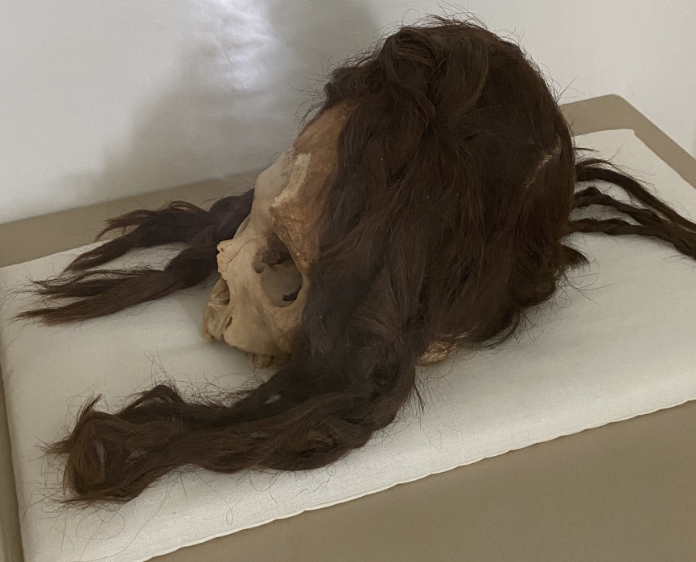
7. Cranial deformations.
Museum Julio Cesar Tello Paracas Perú

Slide 76
7. Cranial deformations
Museum Julio Cesar Tello Paracas Perú

Slide 77
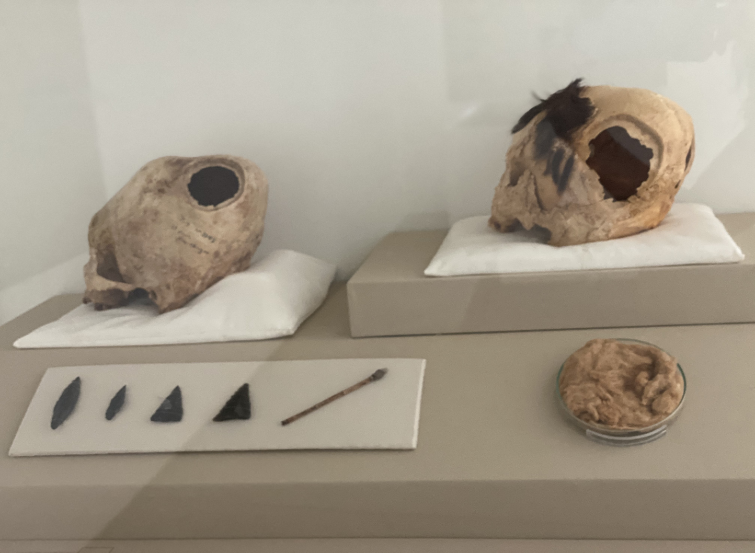
7. Cranial deformations
Cradles were the most complex instruments used in deformation; they were made from reed or cane, wich were covered with various layers of clothes and placed over a cotton pad.
The infant was bound to the bed by several ribbons, on its head were placed ties, wich facilitied the deformation. As the chils grew, bands and ribbons of cloth or wood stat cane and cotton threads were tied to the front and back of the head for the intented effect in the deformation.
Museum Julio Cesar Tello Paracas Perú

Slide 78
7. Cranial deformations
Museum Julio Cesar Tello Paracas Perú

Slide 79
7. Cranial deformations
Museum Julio Cesar Tello Paracas Perú

Slide 80
7. Cranial deformations
Museum Julio Cesar Tello Paracas Perú

Slide 81
7. Cranial deformations
Evidence has been found that pre-Columbian cultures developed important techniques of cranial deformations by finding mummified remains with cranial remodeling. Cranial deformation consists of the placement of rigid elements (splints) and / or flexible elements (pads of different shapes, tapes, straps) which adjust to the skull in the first months of life and up to three years of age, to exert pressure in certain areas, managing to direct the growth towards the areas of the skull where there was less pressure.
Tiesler, V. The bioarchaeology of artificial cranial modifications. New approaches to head shaping and its meanings in precolumbian Mesoamerica and beyond, Springer, New York. 2014. https://doi.org/10.1007/978-1-4614- 8760-9

Slide 82
7. Cranial deformations
In Andean cultures, the modification of the shape of the skull was carried out to identify people from different geographical or social origins. Among the skull alterations, the chroniclers describe: “the widened fronts; sunken or thinned; flat or flattened napes; and the elongated heads, which, in some cases, take the shape of a mortar ”.
Elsa Tomasto-Cagigao. Modificaciones craneales paracas: ¿estatus, etnicidad, estética?. BOLETÍN DE ARQUEOLOGÍA PUCP / N.° 22 / 2017, 255-276 / ISSN 1029-2004. https://doi.org/10.18800/boletindearqueologiapucp.201701.010

Slide 83
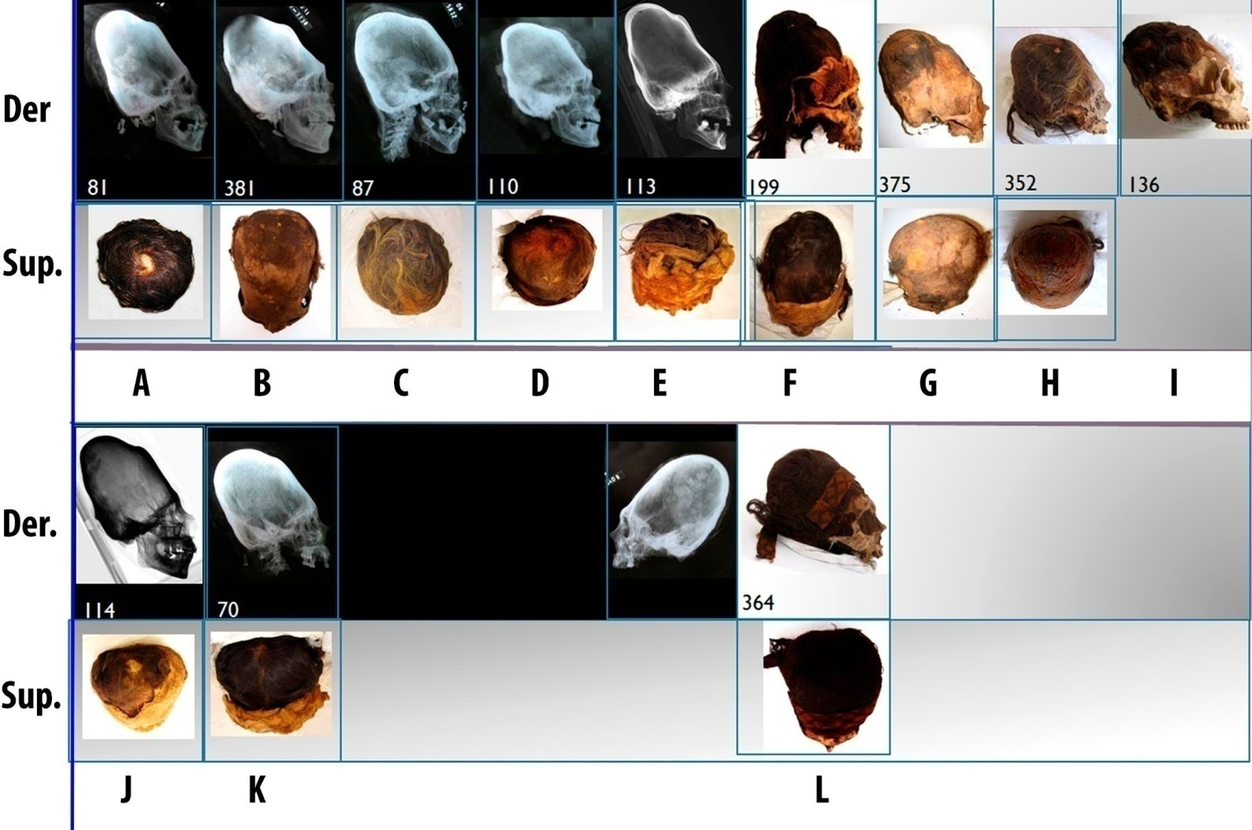
7. Cranial deformations
Wari Kayan skulls of the Early Horizon in right and top side views. 352 (H) and 136 (I): Lower skulls with a sycipital cap, frontal morrillo and less coronal retro-groove. 87 (C) and 375 (G): Pressure mark on the forehead less marked. 81 (A), 381 (B), 110 (D), 113 (E): Pressure footprint at the height of the Lambda. 114 (J) and 70 (J): Skulls with vertex in oval or heart shape. 364 (L): Skull that does not present characteristic features of this group (photos Elsa Tomasto-Cagigao).
Elsa Tomasto-Cagigao. Modificaciones craneales paracas: ¿estatus, etnicidad, estética?. BOLETÍN DE ARQUEOLOGÍA PUCP / N.° 22 / 2017, 255-276 / ISSN 1029-2004. https://doi.org/10.18800/boletindearqueologiapucp.201701.010

Slide 84
8. Mummification process.

Slide 85
8. Mummification process.

Slide 86
8. Mummification process.

Slide 87
8. Process of mummification

Slide 88
Andean Sanctuaries Museum ,Universidad Católica de Santa María
“The Andean Sanctuaries Museum is one of the main museums that are located within the Arequipa region. That museum is currently under the administration of the Santa María Catholic University, and was created with the intention that at some point it will become an institute for scientific research, especially those archaeological pieces that were found during the duration of the High Andean Sanctuaries project. This Museum is important, because it houses among its different pieces, neither more nor less than the famous Juanita Mummy, known as the Lady of Ampato, when found on top of this volcano. The Juanita Mummy, which throughout its discovery has been exhibited in different museums, both nationally and internationally; It is a key piece of archeology, which allows knowing the ritual customs of the ancient inhabitants of this area of ​​Peru. In addition to the Juanita Mummy, the Andean Sanctuaries Museum is pleased to present in its different exhibition rooms, the valuable collection of findings that were found, in the aforementioned project that studied archaeological remains from the heights of the southern Andes; Among the different pieces that make up the museum, that one presents archaeological remains whose greatest antiquity is recorded a little over 550 years ago, which is why, to a large extent, they are legacies left by the culture of the Incas. In addition to the different archaeological pieces, found during the project process. The museum also exhibits what is known as the “Capaccochas”, which are neither more nor less than those offerings that were made to the apus. The reason to expose what the Capaccochas were during the incan, allows the museum visitor to understand the value of the discovery of the Lady of Ampato.”
https://turismoi.pe/museos/museo-santuarios-andinos-universidad-catolica-de-santa-maria.htm

Slide 89
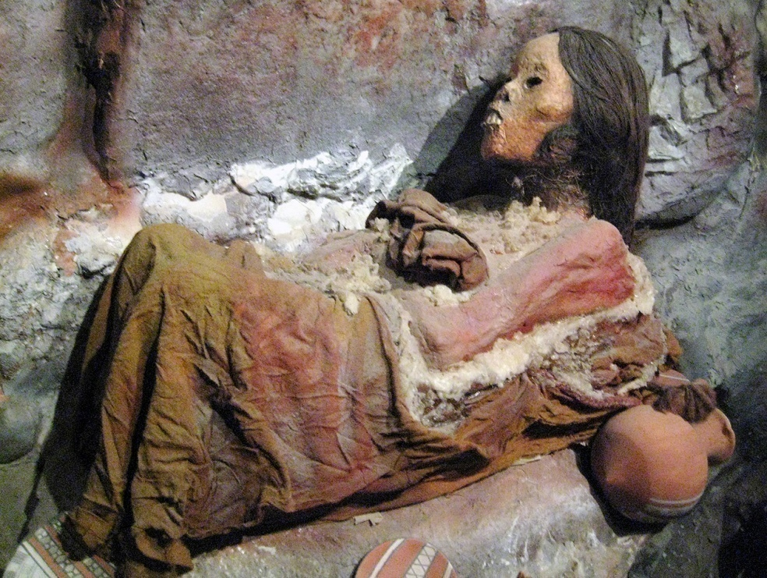
8. Mummification process: The Mummy Juanita
The Juanita Mummy, was a maiden sacrificed by the Incas being found after 500 years on a mountain top in Arequipa, Peru. She is known as "the girl of the ice" or the "lady of Ampato" and is considered the best preserved mummy in human history

Slide 90
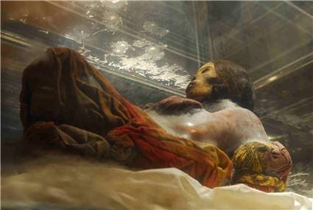
8. Mummification process: The Mummy Juanita
The Juanita Mummy is one of the best preserved corpses in the world. The mummy's head has preserved its hair as well as the skin of its entire body. Even the clothes she was wearing on the day of her sacrifice were well preserved, she wore a red robe as well as her alpaca wool shoes. The mummy had food, coca leaves, offerings like gold statuettes, miniature llamas, among others.

Slide 91
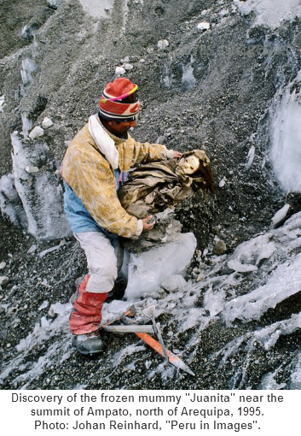
8. Mummification process: The Mummy Juanita
The Juanita mummy died as part of a human sacrifice. For this, she was taken to a mountain in a ritual called "capacocha", in which children were offered to the "apus". to appease the gods. This sacrifice ritual was performed to stop a natural disaster or ensure a healthy harvest. The body of the Juanita Mummy was discovered in the upper part of the snowy Ampato, in September 1995 by anthropologist Johan Reinhard and Miguel Zárate.

Slide 92
8. Mummification process: The Mummy Juanita
The Juanita Mummy, being one of the best preserved corpses in the world, has drawn the attention of the international scientific community for study. For example, the gastric content of the hours prior to their slaughter has been studied, concluding that they had consumed coca, alcohol and chicha. The Juanita Mummy, having preserved all its organs, has been part of various local, national and international investigations: tomography, DNA studies, etc.
MEDINA, ANGELICA ISABEL BRAÑEZ. INDUMENTARIA DE PODER FEMENINO EN EL PERÚ ANTIGUO LA DAMA DE LOS CUATRO TUPUS, LA SEÑORA DE CAO, LA SACERDOTISA DE CHORNANCAP Y JUANITA DE AMPATO. En [GKA ARTS 2020] Congreso Internacional de Artes y Culturas. 2020.

Slide 93
8. Mummification process: The Mummy Juanita
The 12-year-old Inca girl, who was ritually sacrificed around 1440 to appease the gods of Mount Ampato, is now hermetically sealed and will be kept in total darkness at a constant temperature of 20 degrees below zero.
Reinhard, along with José Antonio Chavez, dean of archaeology at the Catholic University in Arequipa, discovered Sarita atop a ritual platform on the east face of the Sara Sara volcano.
MEDINA, ANGELICA ISABEL BRAÑEZ. INDUMENTARIA DE PODER FEMENINO EN EL PERÚ ANTIGUO LA DAMA DE LOS CUATRO TUPUS, LA SEÑORA DE CAO, LA SACERDOTISA DE CHORNANCAP Y JUANITA DE AMPATO. En [GKA ARTS 2020] Congreso Internacional de Artes y Culturas. 2020.

Slide 94
8. Mummification process: The Mummy Juanita
The Juanita Mummy dies of a certain blow of macana (metal or stone star with five or more points), in the right parietal area. The blow received in the right parietal area caused Juanita a fracture of the right superciliary arch; the tips of the instrument used "macana" also penetrated the eye socket, causing injury to the optic nerve, eye effusion and subsequent sphenoid fracture. The Juanita Mummy suffered a cranial brain trauma that displaced the brain to the opposite side, causing death. Currently, the mummy is still being studied thanks to advances in genetics and molecular biology, great findings are expected.
CHÁVEZ CHÁVEZ, José Antonio. Investigaciones arqueológicas de alta montaña en el sur del Perú. Chungará (Arica), 2001, vol. 33, no 2, p. 283-288.

Slide 95
8. Mummification process: The Mummy Juanita
The Mummy Juanita is in the Museum of Andean Sanctuaries at the Catholic University of Santa Maria (UCSM), in the southern Peruvian city of Arequipa, are astonished by how well her body is preserved, so well that every detail of her face, her skin. The mummy has all its organs intact and even her veins.

Slide 96
8. Mummification process: The Mummy Juanita
The Juanita Mummy, being one of the best preserved corpses in the world, has attracted the attention of the international scientific community for study. For example, the gastric content of the hours prior to their slaughter has been studied, concluding that they had consumed coca, alcohol and chicha. The Juanita Mummy, having preserved all its organs, has been part of various local, national and international investigations: tomography, DNA studies, etc.
MEDINA, ANGELICA ISABEL BRAÑEZ. INDUMENTARIA DE PODER FEMENINO EN EL PERÚ ANTIGUO LA DAMA DE LOS CUATRO TUPUS, LA SEÑORA DE CAO, LA SACERDOTISA DE CHORNANCAP Y JUANITA DE AMPATO. En [GKA ARTS 2020] Congreso Internacional de Artes y Culturas. 2020.

Slide 97
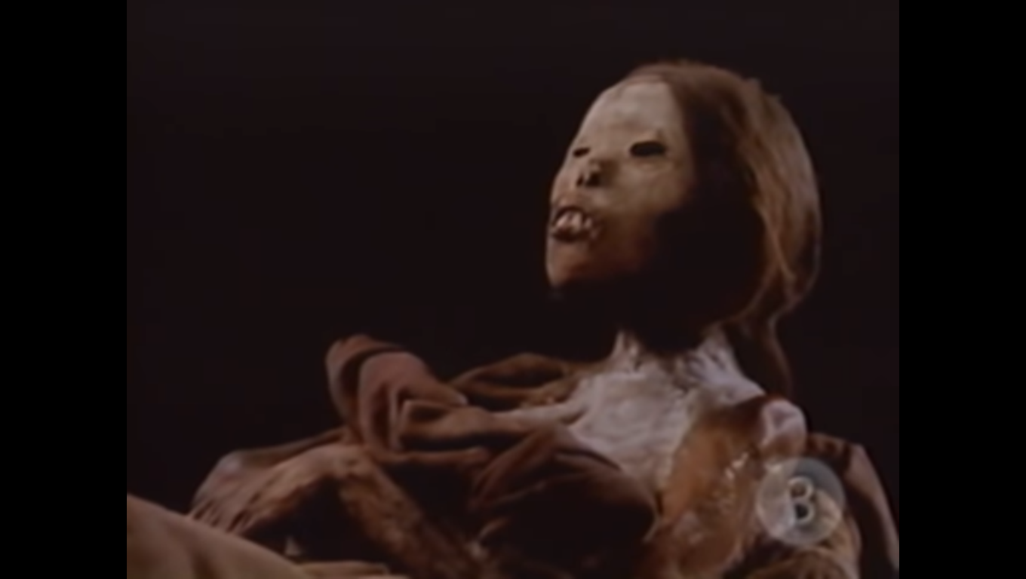
8. Mummification process: The Mummy Juanita
https://www.youtube.com/watch?v=vUDiXs927-U

