Slide 1
Unit 12 - Biopolitics and eugenics –
determining factors in a nation’s governing
Popa” University of Medicine and Pharmacy & Fundatia EuroEd
Iași, Romania

Slide 2
Eugenics is the science that deals with the improvement and the development of the racial qualities of an individual or the innate qualities of a race.

Slide 3
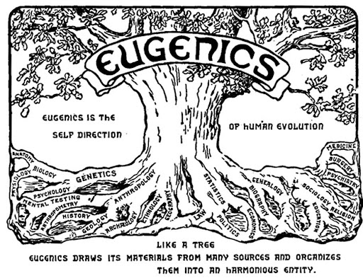
Famous eugenic images
One of the famous eugenic images is that a of a tree- used as a logo for the 2nd International Eugenic Congress and then for the 3rd International Eugenic Congress.
So, we believed that in 1945 we defeated Nazis and then we cut down the tree and eugenics was gone, by cutting down that eugenic tree. But what we didn’t realize at that time is that what you see with a tree is only the canopy and the trunk. But what you don’t see is the roots. The roots of that tree remained and they thrived for the past 50 years.
(interview with Prof.Marius Turda)

Slide 4
Information for lecturers (1)
Long term impact of biopolitics and eugenics during the 20th century worlwide and its consequences.
The lecture contains four sections
the first section defines the concept of biopolitics and presents significant historical information in order to offer a context for the evolution of the main European ideologies of the 20th century.
the second section centres on eugenic sterilisation with examples from different cultures around the world and Romania. It then elaborates on the “why”, “how” and “on whom” this procedure was implemented.
the third section reviews women’s role in the Romanian society of various periods of time, in accordance with the political system.
the fourth section is dedicated to the case study which reflects upon the Romanian decree passed in ’66 concerning abortion laws and its impact.

Slide 5
Information for lecturers (2)
What is essential for the students :
to know as much as possible about eugenic practices in time, some obvious , but many ‘camouflaged’.
to remember that medical staff has always played an important part in applying the eugenistic methods
to understand the moral aspects of eugenics in order to take an informed and ethical decision if the situation requires it
to reflect on what eugenics means for contemporary societies and people.

Slide 6
Learning objectives (1)
Stress laid on cognitive and affective domains
Knowledge related learning objectives:
Introduce the students to the concept of eugenics and biopolitics, by defining and identifying various cases in time and geographical postion
Familiarise the students with the conceptualisation of eugenics , exemplifying with materials from past and present authors
Introduce the students to the history and motivation of eugenic attitudes along centuries in various cultures, from ancient times to the present
Familiarise the students with the differences between the motivation which led to this process and the variety of methods used to achieve the desired results, along centuries , under various forms of government,
Introduce the students to some of the ideologies of the XXth century around the world and their consequences in terms of eugenics
Introduce the students to eugenic sterilisation implemented as a rationalized practice and its outcome

Slide 7
Learning objectives (2)
Attitude and competence related learning objectives:
Raise students’ awareness about decision making in issues of medical ethics, in order for them to avoid to become uninformed tools
Introduce students to the bioethical lines a physician can be forced to cross, given the right social context, and the consequence that ensue.
Introduce students to the outcome of denying a universal human right thus enabling them ‘to draw the line between reasonable measures and excessive acts’(interview with Prof Marius Turda), when one speaks of the health os a country
Motivate students to become part of a system whose role is ‘to educate and discuss these things publicly, so younger people can be informed and they could make better decisions about how these ideas and practices are influencing their lives’
Motivate students to include historians, social workers and politicians in the deabate about eugenics and its future consequences
Stimulate reflections upon the significance of eugenics today knowing that the impact of former manifestations of eugenics continues to represent a very sensitive and emotional issue for many people, not only because eugenics was a source of discrimination based on race, social class, gender, disabilities, but also because new manifestations of these attitudes are more and more frequent
Develop students’ competence to distinguish between what is ethical and what is not
Develop students’ competence to support their ideas in discussions, speeches , public debates or in front of various administrative or political authorities

Slide 8
Teaching methodology (principles, methods and strategies)
The learning objects strategy approach – key word to the whole unit
To maximise the teaching and learning of the topic an active learning environment will be created, that is all stages of the course, be it lecture, reading or listening, have elements which will lead to reflection, questions, pair or group discussions.
Enhance motivation –expressing personal opinion
Attention focus- the assessment questionnaires a useful tool
Connecting knowledge
Presentation, example giving, explanations
Case study- leading to dialogue
Listening- an important learning strategy – very useful in their future medical activity as well
Opinion sharing and teacher-student, student- student dialogues
Reflection

Slide 9
Information for students (1)
What they are going to know
the historical evolution of processes and events which led to the birth of eugenics as a science and to biopolitics
differences between how various cultures understood and applied eugenics
the motivation behind using eugenics
important scientific discoveries can be used for harmful practises
the role of biopolitics in the life of modern society
the long-term effect on the population of various countries
society changes and transforms and eugenics changes and transforms accordingly.
the consequnces of eugenics in present day life
the role of physicians in applying eugenistic practises under biopolitical influences

Slide 10
Case Study (1)
The 770 Decree or How to appropriate a woman’s body
WW2, but especially the Romanian communist regime, mimicked the whole effort of the feminist movement in Romania. The dissolution of the feminist movement, the Romanian women’s freedom of expression, the negation of the right to make choices concerning their own bodies and the nationalisation of women’s reproductive capacity were consequences of the communist policy laws.
The 770 decree was passed on the 2nd of October 1966. This decree classified abortion as a crime and exclusively placed maternity in the services of the communist state.
women from all over Romania were subjected to a complex mechanism of control and surveillance

Slide 11
Case Study (2)
The number of deaths due to the complications of illegal abortions massively increased. In 1989, the year of the Romanian revolution, there were 1193 deaths. Throughout 1966-1989 almost 10.000 deaths of women were recorded
Poland, Hungary, Central and South America are some present day examples of countries where anti abortion laws are applied
The need to control female bodies is hidden under eugenic terms such as reproduction, breeding, the future of the nation

Slide 12
Case Study (3)
Supporting Video Interviews
Video interview 1 – Interview Prof. Marius Turda - Eugenics impact on natalist policies https://youtu.be/4G3stJuogj8
Video interview 2 - Interview Prof. Marius Turda - Eugenics in Europe and eugenic sterilization https://youtu.be/zJLcrLtNjUA
Video interview 3 - Interview Prof. Marius Turda - Eugenics belong to the history, or is still present? https://youtu.be/WguebGqd8UE
Video interview 4 – Interview Prof. Marius Turda - Eugenics and the female body propaganda https://youtu.be/wUG4_UiHi-E

Slide 13
Reading
Biopolitics is a concept defined as the calculus of costs and benefits through which the biological capacities of a population are optimally managed. In other words, a country’s demographics is taken into consideration as an economic tool in order to enhance a nation’s potential, while also perceived as a decisive factor in a country’s government policy. In this context of pondering the strategies and mechanisms through which human life processes are managed under various regimes, biopolitics introduces a new justification to ending someone’s life which is ‘protecting society as a whole and preserving the social body’s health’
Eugenics is the science that deals with the improvement and the development of the racial qualities of an individual or the innate qualities of a race.
An increase of eugenic practices was noticed all over the world

Slide 14
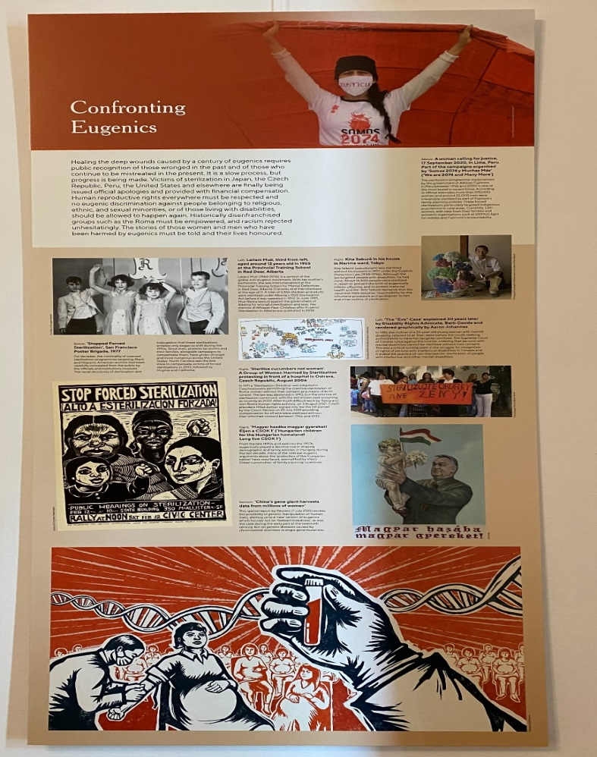
Reading –eugenic sterilisation
The medical world engaged in eugenics
Measures proposed in the 1920s in Romania
1) Every degenerate individual should be sterilized and, if possible, returned to society.
2) Every degenerate and sterilized individual should be kept in isolation in asylums and colonies until he/she can be returned to society as a useful member.
3) Only those individuals who still represent a danger to society after their sterilization should be isolated for life, while they should sustain themselves and society through work in gardens, workshops etc. (…) It is in this direction that we must orient our efforts to protect superior elements and prohibit without mercy inferior elements from producing children and incurring family responsibilities.”

Slide 15
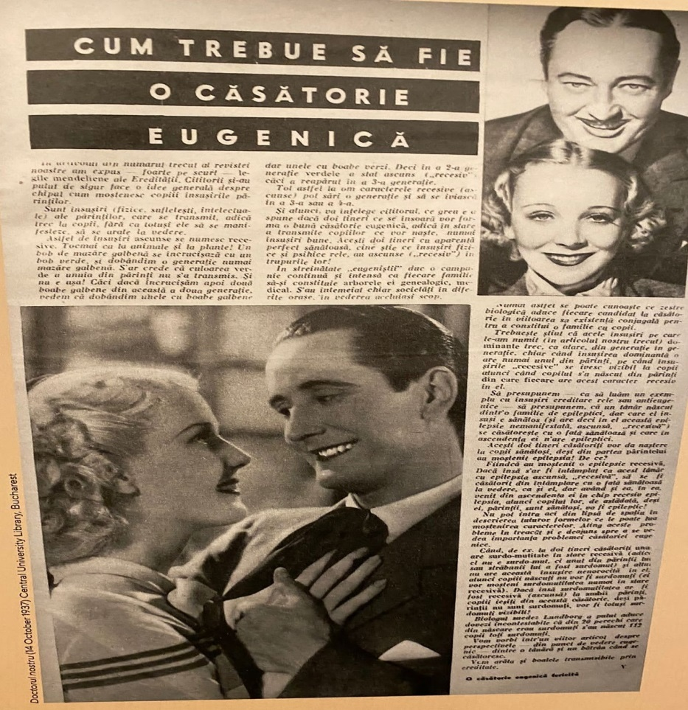
Reading –Women’s role between the two WW
A general truth, still valid in many countries nowadays is that the control of feminine fecundity represents a point of domination of one gender over the other, and natality has long embodied a game of power.
Maternity was perpetually on the political and medical agenda.
In the period between the two world wars, natality was either imposed through sanctions or encouraged by a reward system, the medical power thus holding the public control of all pregnancies, of women’s life.

Slide 16
Formative Evaluation Questionnaire
5 open-ended questions related to the unit to test students’ acquired knowledge at the end of the lecturing phase.
Question 1 | When was sterilisation first used for ? Where was it?
Question 2 | What regime advocated the ‘super race’?
Question 3 | Were women involved in advocating eugenic methods?
Question 4 | What are the main elements of the logo of the the 2nd and 3rd Congresses in Eugenics ?
Question 5 | What countries have passed laws influenced by eugenics , in our days?

Slide 17
References
Richard Cleminson, Anarchism, Science and Sex: Eugenics in Eastern Spain, 1900-1937, Bern, 2000;
Aaron Gillette, Racial Theories in Fascist Italy, New York, 2001;
Michael Burleigh, Wolfgang Wippermann, The Racial State: Germany 1933-1945, Cambridge, 1991;
Matthew Thomson, The Problem of Mental Deficiency: Eugenics, Demography and Social Policy in Britain, c. 1870-1959, Oxford, 1998;
Gunnar Broberg, Nils Roll-Hansen, eds., Eugenics and the welfare state: sterilization policy in Denmark, Sweden, Norway and Finland, 2nd ed., East Lansing, 2005;
Frank Dikotter, Imperfect Conceptions: Medical Knowledge, Birth Defects and Eugenics in China, London, 2000;
Maria Bucur, Eugenics and Modernization in Interwar Romania, Pittsburgh, 2002;
Roberto Esposito, Bios: Biopolitics and Philosophy, Minneapolis: University of Minnesota Press, 2008.
Dr. M. Zolog şi dr. O. Comșia, Indicaţiile eugenice ale avortului artificial, „Buletin eugenic și biopolitic”, vol. V, august-septembrie-octombrie 1934, nr. 8-9-10, pp. 167-172)

