Slide 1
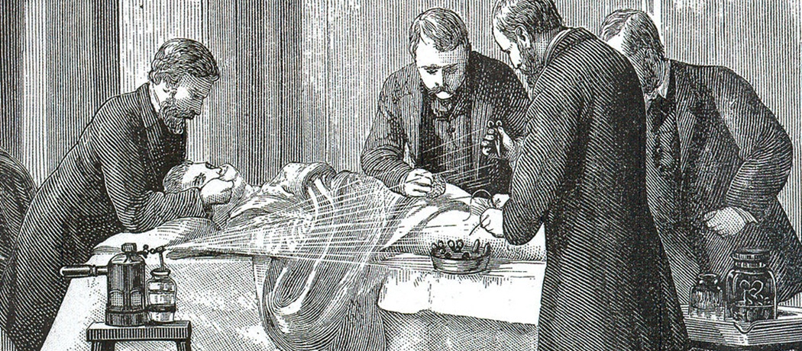
Unit 9 – The History of Medicine, 1600–1900
University of Bristol, United Kingdom

Slide 2
What is the history of medicine?
Is it a history of the profession? Of developments in medical practice? Of the fight against disease? Of doctors and surgeons? Of patients?
Lots of different perspectives of the history of medicine
Different times and places
This lecture does not provide a comprehensive history of medicine, but an overview of major developments in western medicine that originate from historical research.

Slide 3
Aims of the lecture
To provide an overview of some of the main changes in western medicine from 1600 to 1900.
To encourage reflection on one’s assumptions about medical theory, practice, and circumstance.
To problematise aspects of medicine and medical practice – history is a resource that can help improve modern knowledge and practice.

Slide 4
From Humours to Germs

Slide 5
The four humors
Humoral theory posited that the healthy body was a body in balance
Illness was caused by the humors – black bile, yellow bile, blood, and phlegm – being imbalanced.
The physician’s job was to restore balance to the patient’s constitution
Similarities with other medical traditions such as Ayurvedic medicine (which originated in India) and Chinese medicine.

Slide 6
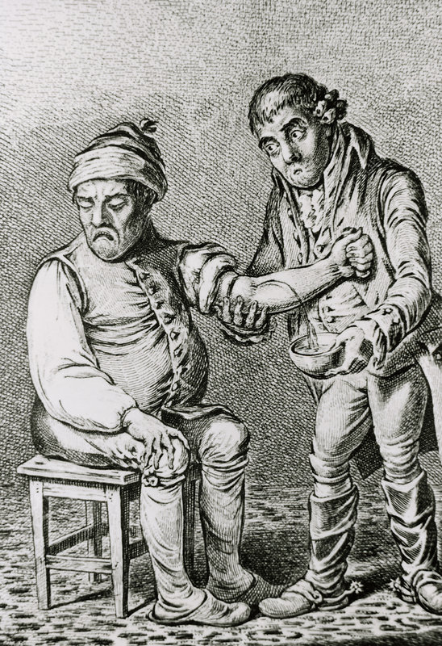
Explanatory power
Humoral theory was developed from ancient times, but especially by the third century Roman doctor Galen, whose medical system was the basis of western medicine until the nineteenth century.
A major advantage of humoral theory was that it gave a comprehensive answer to what was wrong with patients and how to treat them.
A patient presented with hot flushes and reddened skin was clearly suffering from an excess of blood, so needed to be bled.

Slide 7
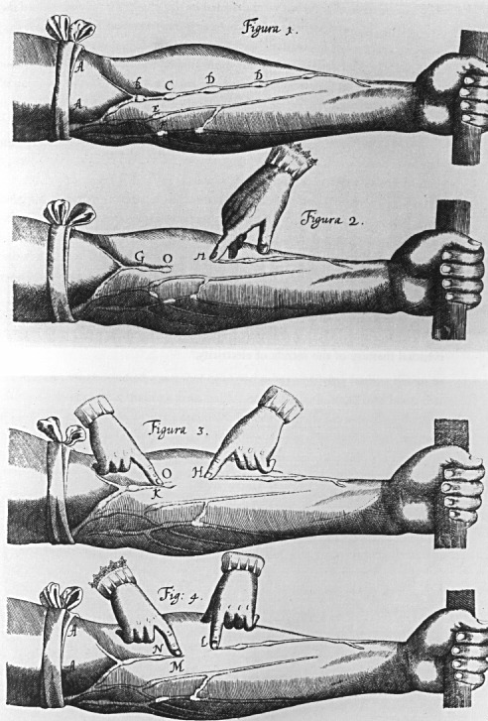
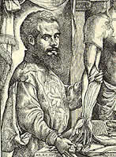
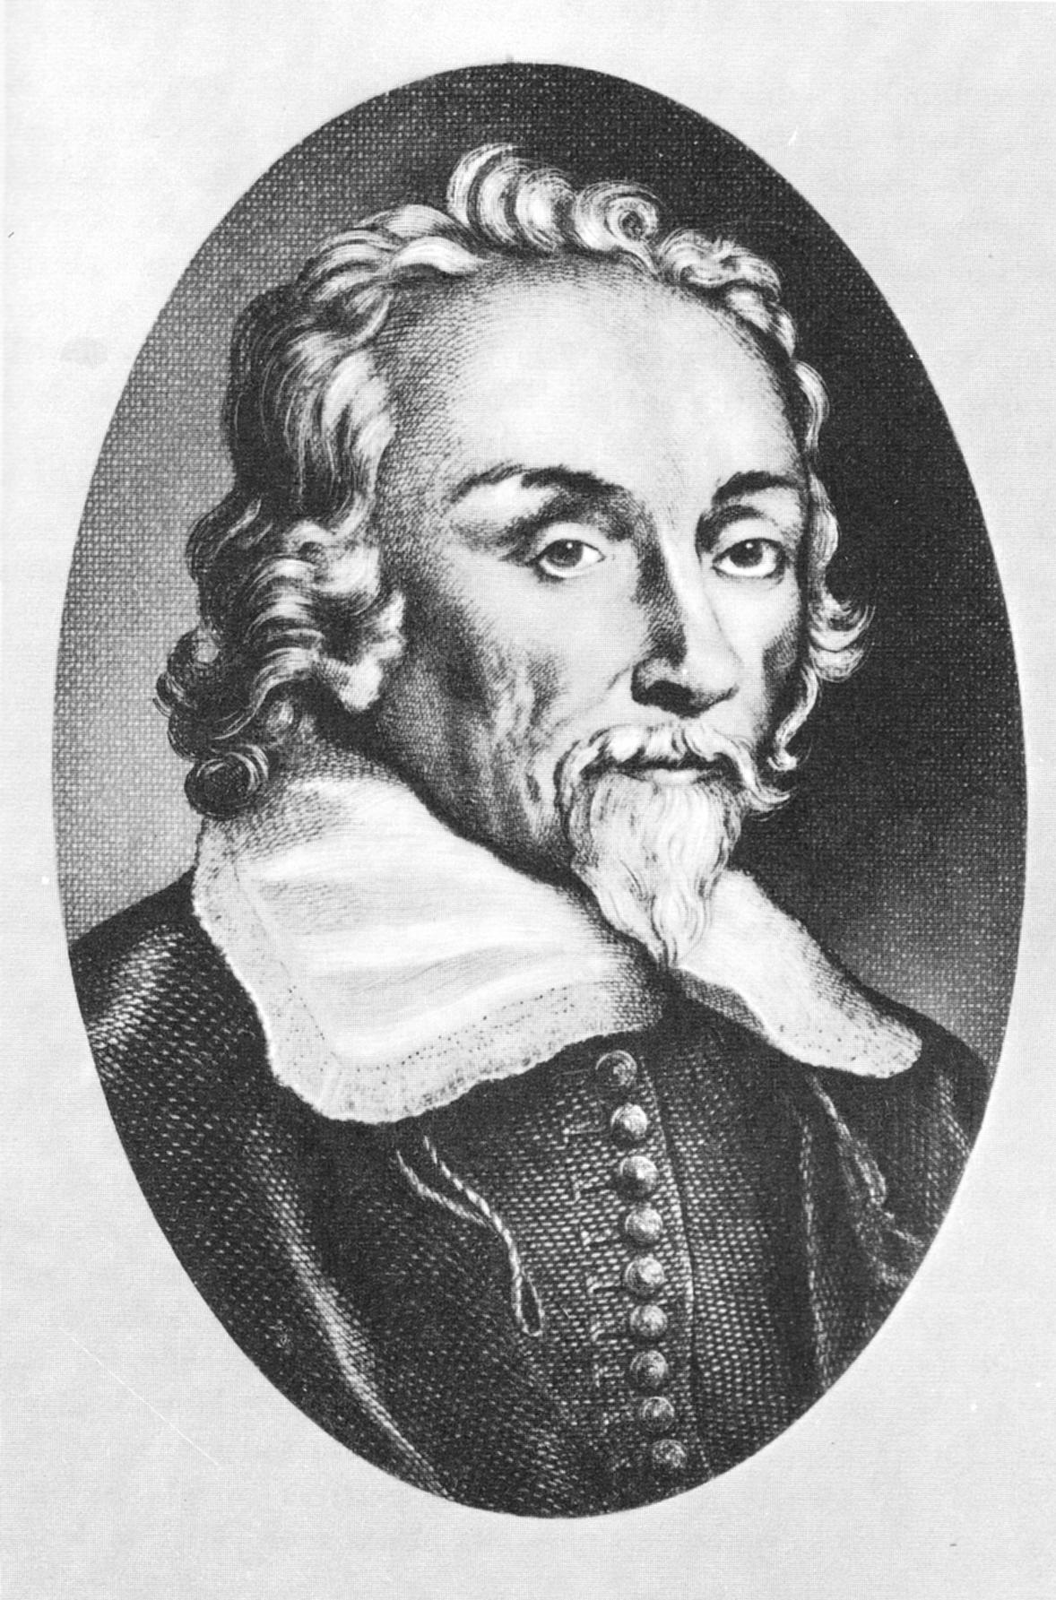
Anatomical challenges to the humors
From the sixteenth century, anatomical investigation undermined the theoretical basis of humorism.
Andreas Vesalius (1514-1564) demonstrated that Galen had been working only from animals, undermining his theories.
William Harvey (1578-1657) discovered the circulation of the blood

Slide 8
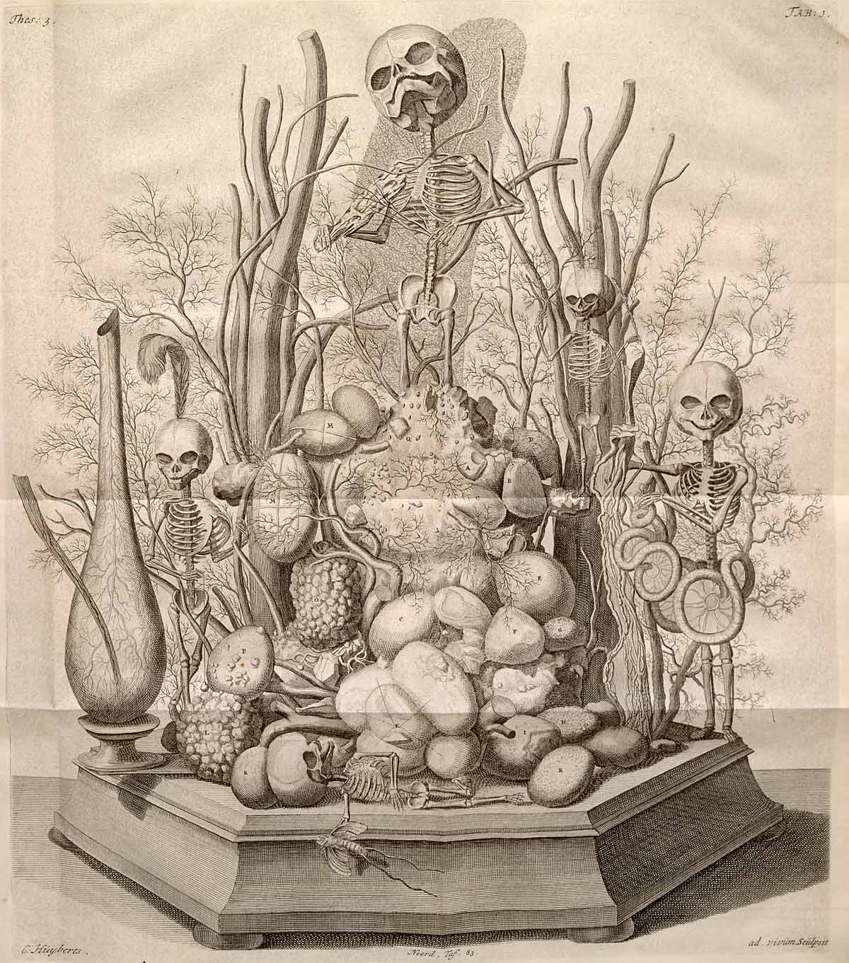
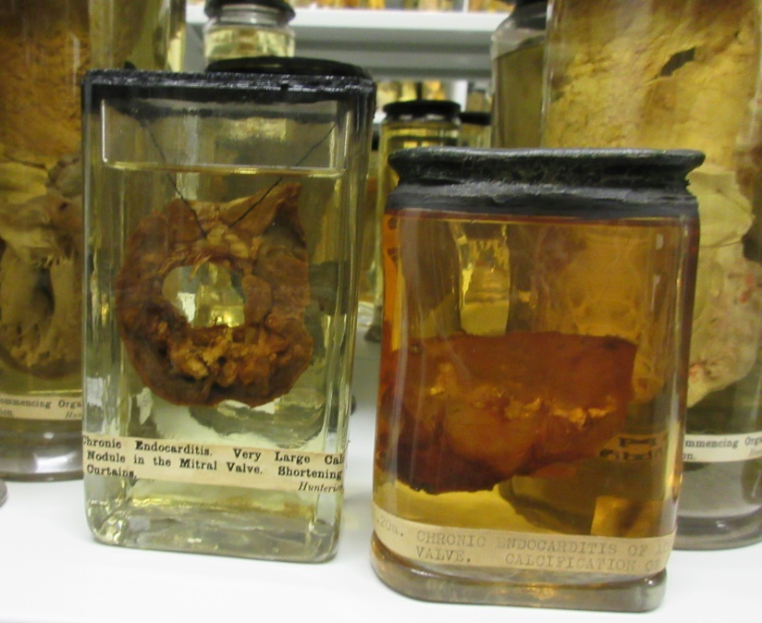
‘Big science’ in the eighteenth century: anatomical preparations
The development of preservation techniques by practitioners such as Frederick Ruysch (1638-1731) allowed body parts to be compared and contrasted in health and disease
Huge collections of preparations built up by practitioners such as William Hunter (1718-1783).
Injections of substances like wax helped track the course of the body’s vessels

Slide 9
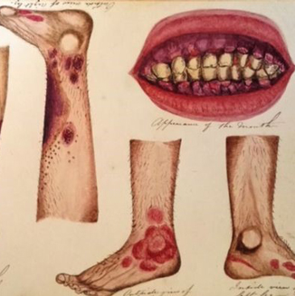
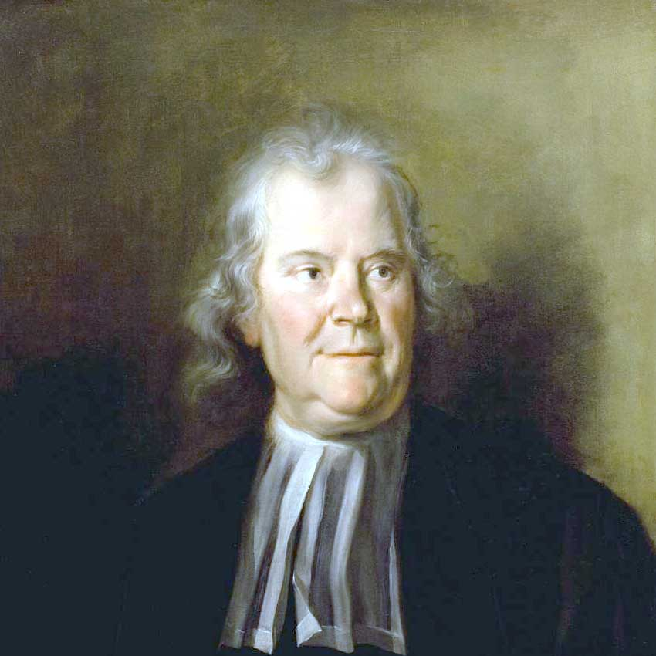
New theories and therapeutic experiments
Herman Boerhaave (1668-1738) produced a famous and popular synthesis of medical theory that described the functions of the body in terms of ‘solids’ and ‘fluids’ interacting in terms of hydraulics.
Experiments in therapeutics with new plants from abroad, new phenomena such as electricity, and new methods of testing such as the clinical trials the Royal Navy ran in an attempt to find a preventative for scurvy.

Slide 10
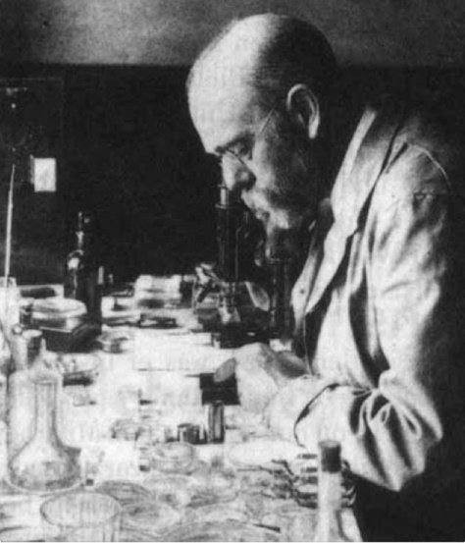
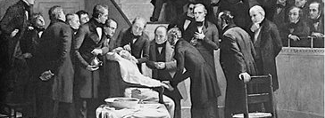
Effective remedies
In the nineteenth century, several effective therapeutics were developed, and a new understanding of the spread of disease developed: germ theory.
In surgery anaesthesia and antisepsis were developed by figures such as William T. G. Morton (1819-1868), James Young Simpson (1811-1870), and Joseph Lister (1819-1912)
The development of bacteriology was pioneered by Louis Pasteur (1822-1895) and Robert Koch (1843-1910).

Slide 11
The Disappearance of the Sick Person?

Slide 12
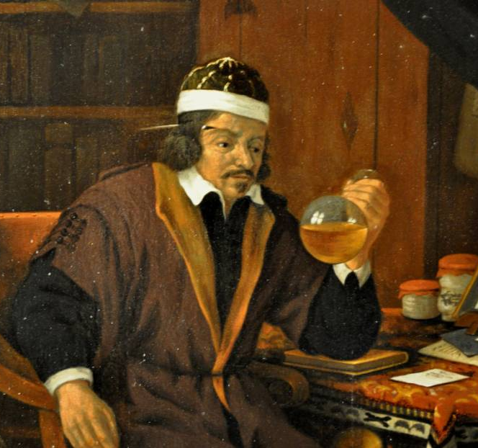
Treatment in the ‘medical marketplace’
Before the nineteenth century, the sick person had autonomy in their care – orthodox medicine was just one option of many
Physicians were concerned with the individual constitution of the patient – their symptoms, their diet, their lifestyle, and their recent life events alongside the location and season were all of concern.
Cures were individual, typically diet and regimen based and low risk.

Slide 13
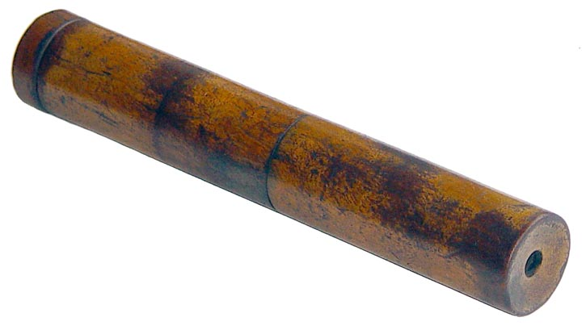
Invention of the stethoscope
By the end of the eighteenth century, medical practitioners such as Matthew Baillie (1761-1823) and Xavier Bichat (1771-1802) were locating disease anatomically.
Wanting to ‘see’ the internal lesions of his patients, Rene Laennec invented the stethoscope to examine patients by mediate auscultation. This built on the developments of percussion as a diagnostic technique (by Leopold Auenbrugger (1722-1809)) and immediate auscultation (by Jean-Nicholas Corvisart (1755-1821)).
Focus of practitioners now on patient’s lesions.

Slide 14
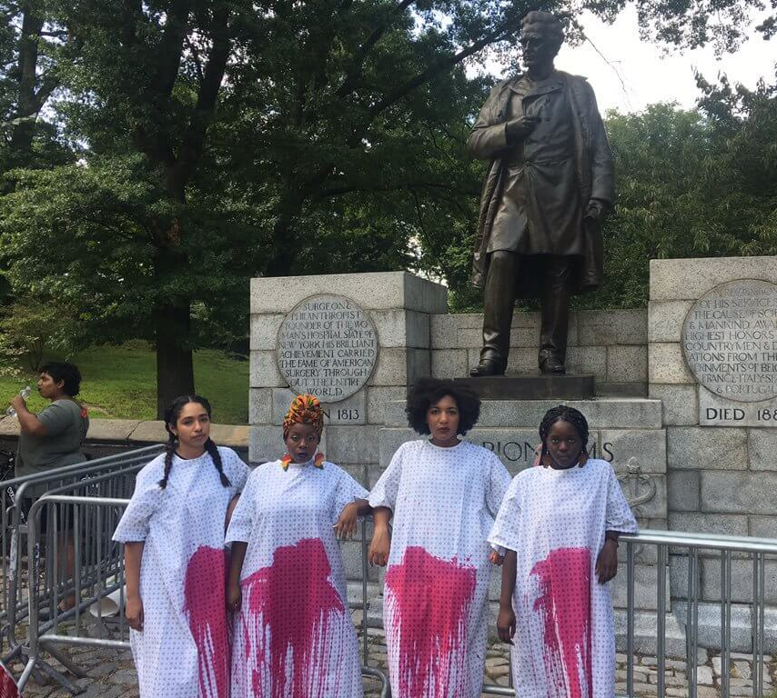
Patients as ‘things’
J. Marion Sims (1813-1883) developed a surgical technique to cure vesicovaginal fistula by conducting experiments on seven enslaved women in antebellum America.
The enslaved women underwent surgery several times – one woman, Anarcha, was operated on thirteen times. They had to cooperate – though could not consent – with Sims, both in undergoing the surgery, and working as assistants for others.

Slide 15
Professionalisation

Slide 16
Professionalisation and specialisation
In the nineteenth century the medical profession increasingly centralised, creating new governing and regulatory bodies supported by the state.
This led to increased specialisation in medicine, and new fields such as ophthalmology, dermatology, and venereology, which gained specialist clinics, hospitals, and specialist journals.

Slide 17
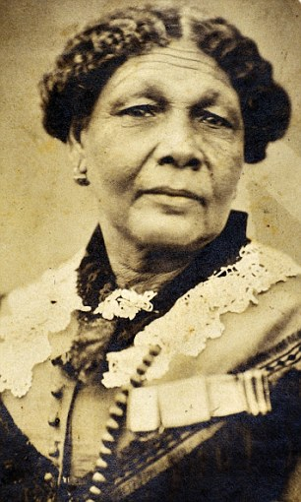
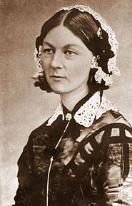
Professionalisation of Nursing
Growth in the number of hospitals fuelled demand for nurses. Religious orders such as the Sisters of Mercy in Ireland and the Deaconess Institute in Germany hired and trained thousands of women.
In the Crimean War, Mary Seacole (1805-1881) and Florence Nightingale (1820-1910) treated troops and became famous, promoting nursing as an honourable profession.

Slide 18
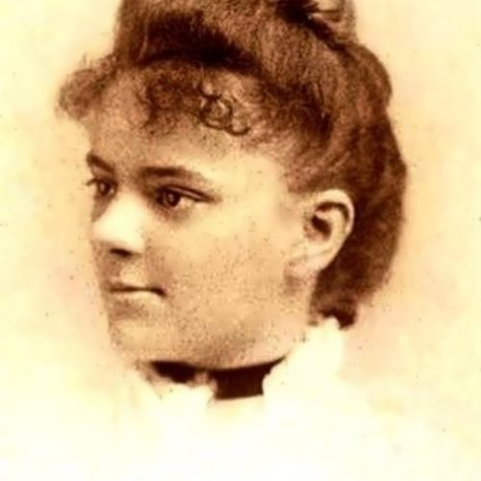
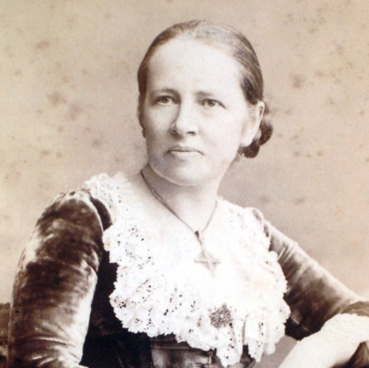
Women and medicine
Women had always had important roles in healthcare – midwifery, herbalism, and care in the home
This was undermined by professionalisation as medical elites reduced the scope of unorthodox practitioners to practice
Women forced their way into orthodox medicine: Elizabeth Blackwell (1821-1910) was the first women doctor to graduate in 1849; Elizabeth Garrett (1836-1917) the first to do so in Britain by exploiting legal loopholes.

Slide 19
Public Health Measures and the Decline in Infectious Diseases

Slide 20
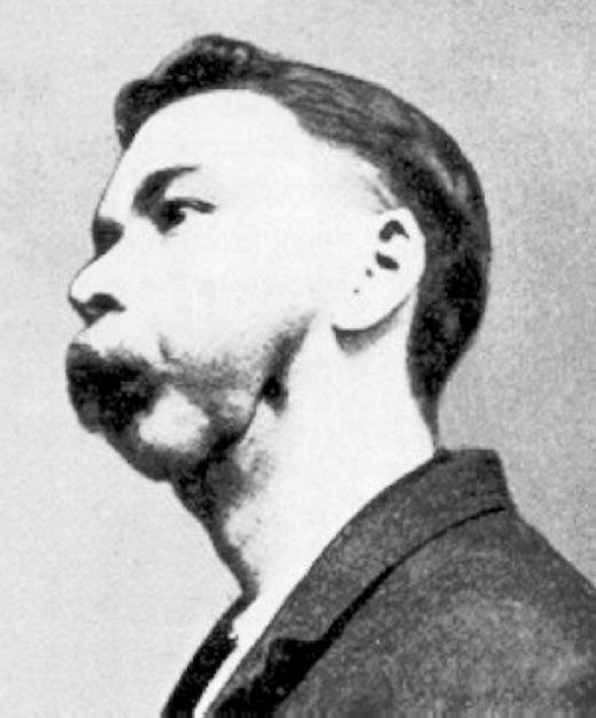
Pathological urban life
Industrialisation and rapid population growth in the nineteenth century saw the majority of nations’ inhabitants live in cities for the first time
Awful conditions
Poor housing
Lack of sanitation
Poverty and malnutrition
Adulteration of food
Dangerous occupations
Infectious disease rampant!

Slide 21
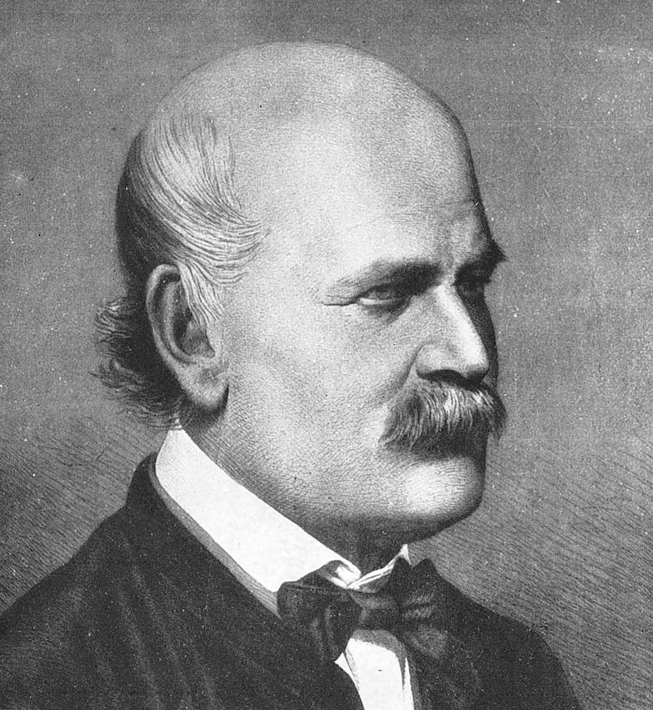
Local Health Measures 1: Ignatz Semmelweis
Invented handwashing for medical practitioners as a preventative against infection
Analysed the problem statistically – childbed fever affected 29% of women treated by medical students compared to 3% of midwifery students
Identified the problem as medical students arriving straight from the autopsy room to deliver babies
Did not immediately catch on however

Slide 22
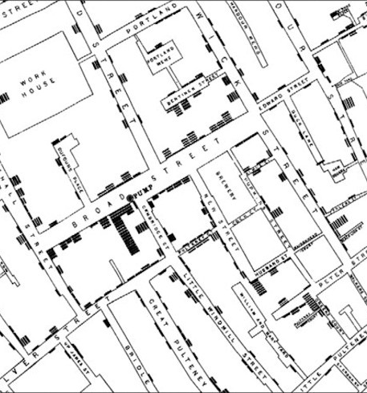
Local Health Measures 2: John Snow
John Snow carefully recorded and mapped a cholera outbreak in Soho, London
Suspecting that the disease was water borne, he located a water-pump in Broad Street as the centre of the outbreak and had the handle taken off – cases soon declined
Snow then advocated for sanitary improvements as a way of combatting disease

Slide 23
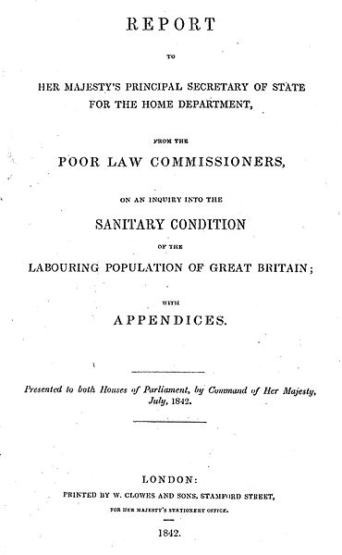
Government intervention
Statistical analysis was also important in informing governmental attempts at improving the health of the population
Edwin Chadwick’s report gave an overview of the health of the whole of Britain
Number of acts passed to empower new bodies to uphold sanitary standards in localities
Local Government At (1858)
Sanitary Act (1866)

Slide 24
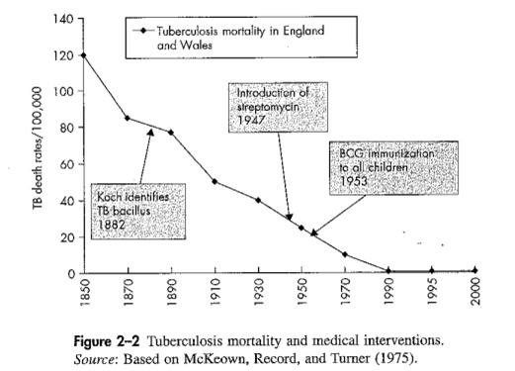
The decline in infectious diseases
Historians agree that infection rates declined and population increased, but disagree over the reasons for this.
Thomas McKeown argued that improved living conditions were the primary reason
Simon Szreter emphasised the importance of human agency and public health measures in the fight against disease
Sumit Guha suggested that the diseases themselves may have become less lethal in this period
Difficult to ascribe concrete causal factors to long-term statistical trends in health

Slide 25
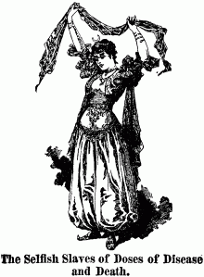
Resistance to public health measures
Many public health measures were actively opposed due to the extension of state power over people’s lives
Contagious Diseases Act (1864)
Intended to reduce instances of venereal disease in the army and navy
Targeted women deemed to be prostitutes
Empowered local authorities to forcibly examine women for venereal disease
If they were found to have venereal disease, would be put into a special hospital
Successful campaign against the act led by Josephine Butler

Slide 26
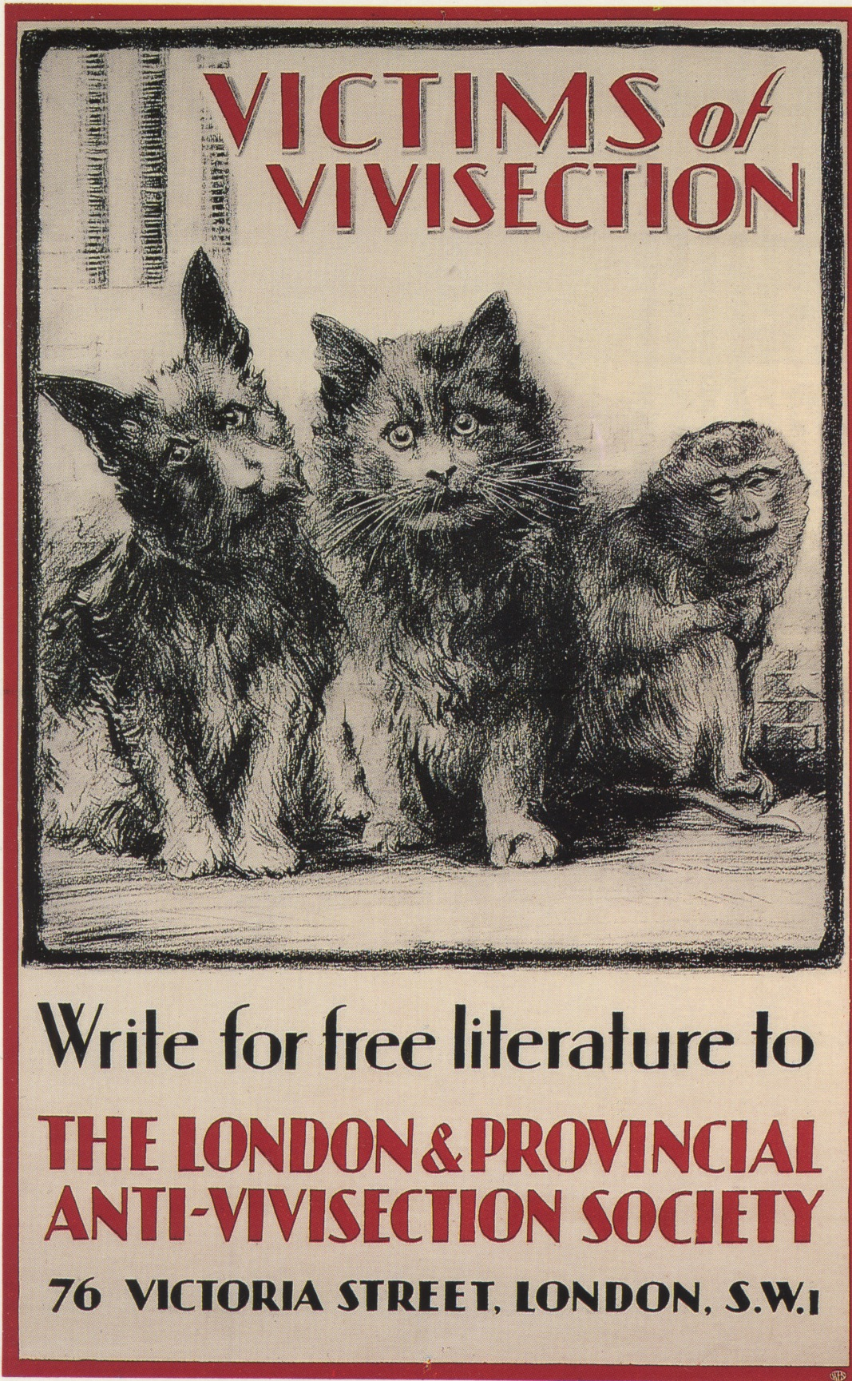
Campaigns against medical practice
Anti-vivisection movement in Britain headed by Frances Power-Cobbe, who founded the National Anti-Vivisection Society
Wanted to stop unnecessary suffering to animals
Anti-vaccination movement
Medical authorities viewed with suspicion
Government acts took choice away from individuals

Slide 27
Conclusion
Medical practice changed significantly in the period from 1600 to 1900:
New ideas about disease and new discoveries
Changing doctor-patient relationship
Professionalisation and specialisation in the profession
Statistical analyses of health, rising medical power and governmental intervention

