Slide 1
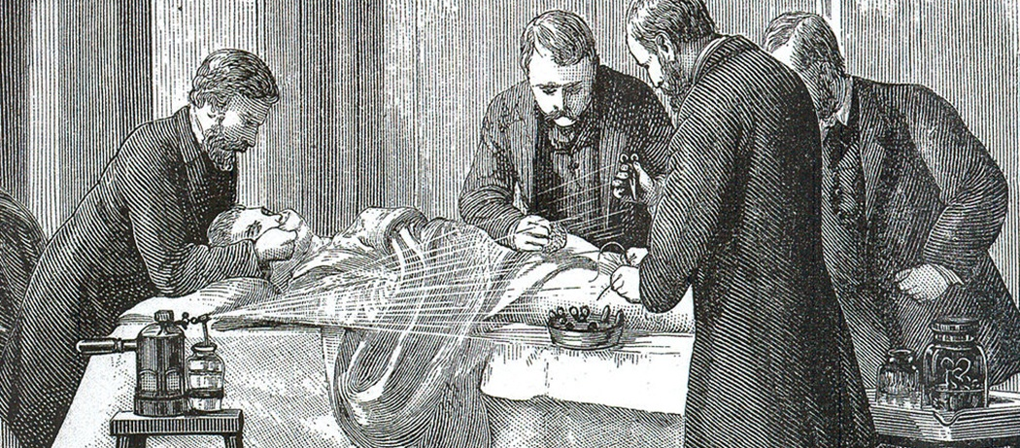
Unit 8 – Alchemy and Chemistry in the Renaissance
Sapienza University of Rome, Italy

Slide 2
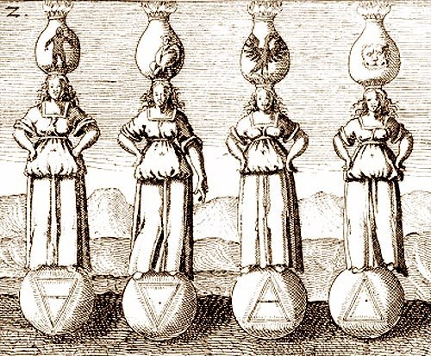
The Roots of Chemistry and alchemy
Few scientific disciplines defined the complexity of the Renaissance as much as alchemy, an area where philosophy, science, occultism and theology came together. Alchemy, a genuine protoscience?, displayed the transformation from theoretical dogma to the observation and practice based methods that gradually developed during this period of the history of science

Slide 3
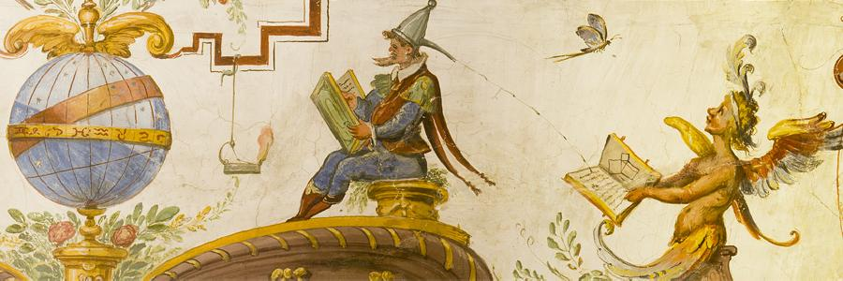
The charm of alchemy
The mysterious, occult side of alchemy still captures the imagination of the modern public, with Harry Potter chasing the elusive Philosopher’s Stone and names such as John Dee spawning thousands of occult sites studying the esoteric symbolism behind alchemical symbols
Most of the modern interpretations have a basis in historical fact, and writers such as Chaucer, Ben Jonson, and Dante gleefully included alchemists as shady charlatans and figures of parody

Slide 4
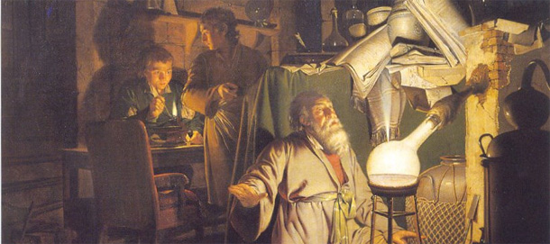
The reinaissance alchemist
However, this comedic touch should not detract from the idea that Renaissance alchemists were often bona fide scientists, searching for truth and often applying the scientific method to their research
In fact, it can be argued that, in terms of the development of science, the alchemists were further ahead than many other disciplines. For example, natural science and physics were still largely observational and theoretical, whereas alchemists already used a method involving inductive and deductive reasoning to arrive at conclusions

Slide 5
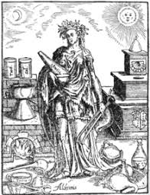
The origin of Alchemy
Alchemy was a discipline that originated with the Greeks, although the Chinese and Egyptians were also instrumental in developing the foundations, and it spread to Europe via the Islamic world. From 1147, the Almohads took control of the previously open Islamic empire in Al Andalus, in modern day Spain, leading to an intellectual decline
During this period, Christian and Jewish scholars fled to Europe, bringing knowledge with them in the form of Arabic and Jewish texts, and many of these learned men landed in Northern Italy, where they formed part of the fledgling Renaissance that challenged the prevailing medieval thought. Gerard of Cremona (1114 – 1187) and Robertus Castrensis (c1150) were just two of the translators who made the original Arabic texts available in Latin

Slide 6
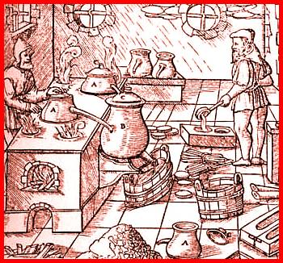
The influence of Alchemy
Alchemy was already a well-established discipline, influencing metallurgy and medicine and, as with many branches of science, it became tied to the religious establishment with which it would share an uneasy alliance over the next few centuries
As was the case with the Islamic scholars, Medieval and Renaissance alchemists followed the Aristotelian tradition of four elements as the basis of substance, a view that would not be challenged until the later Renaissance, when the findings of Newton, Boyle, and their contemporaries dragged European science and philosophy into the modern age

Slide 7
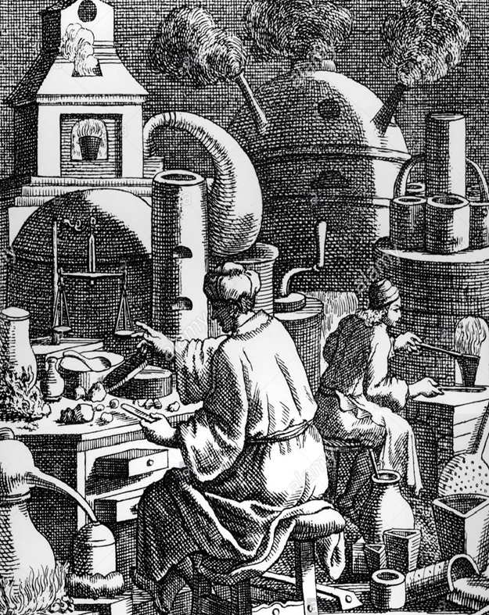
Alchemy & Chemistry
During the Renaissance, what we nowadays call ‘alchemy’ and ‘chemistry’ constituted a single, all-inclusive, sphere of activity, that involved the routine conduct of fire assay

Slide 8
Alchemy & Chemistry
The historical practice of fire assay has been addressed from different points of view. Traditionally, historians of mining and metallurgy have used the various metallurgical treatises and handbooks written during the Renaissance as a main source of information
Historians of alchemy and chemistry have started to emphasize the importance of fire assay in the development of modern science, and to use texts by early alchemists and chemists to address this issue
Historians of mining and archaeometallurgists have restricted their attention to assemblages from what is loosely defined as early metallurgy, whilst historians of alchemy and chemistry have tended to concentrate on early al/chemists and textual evidence for the practice of fire assay in their laboratories

Slide 9
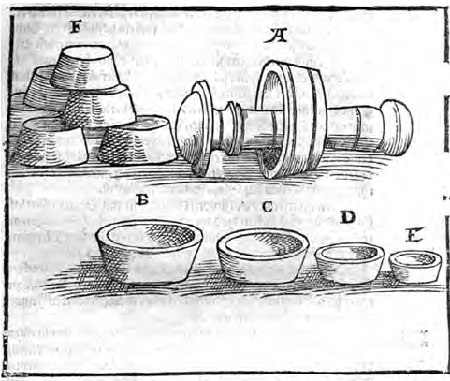
Alchemy & Chemistry
For the former groups, alchemy is often regarded as an overly theoretical endeavor bearing little relation to the practical, experience based craft; for the latter, metallurgists are sometimes thought of as mere craftsmen, practicing chemical reactions but not caring about the scientific principles behind their operations
Consequently, both groups of scholars have defined different research objectives and normally approach them without taking into account the work carried out in the other field

Slide 10
Alchemy & Chemistry
Recently, the study and interpretation of certain groups of archaeological finds from contexts without an a priori clear connection with either metallurgy or chemistry have required a consideration of both metallurgical texts and al/chemical activities, thus indicating the need for more comprehensive approaches
The practice of fire assay as an analytical tool is equally relevant to chemistry, to extractive metallurgy and to quality control in coin production; even the small-scale recycling and refining of jewellery employs the same operations
Archaeological evidence can be indicative of fire assay, but does not in itself enable identification of the immediate technological context within which these analyses were performed

Slide 11
Alchemy & Chemistry
Emphasis will be placed on two key ideas:
a) In the Renaissance, alchemy and chemistry were not distinct domains, and this inclusive field did not convey the religious, psychological or magical connotations often attached to the pursuit of metallic transmutation
b) Fire assays were al/chemical as much as metallurgical operations and, as far as assays are concerned, it is often impossible – and inappropriate – to separate one sphere of activity (alchemy/chemistry) from the other (metallurgy), given their strong intertwining

Slide 12
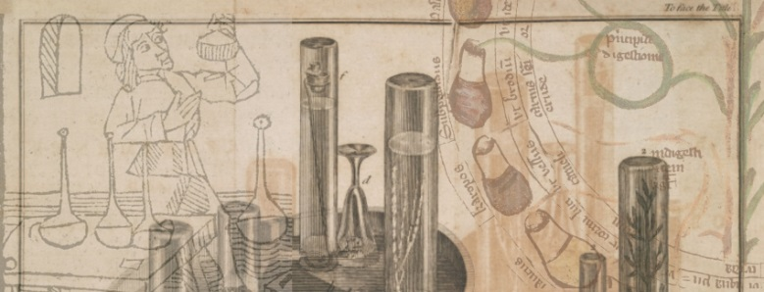
Alchemy & Chemistry? Terminological issues
In present-day language, ‘alchemy’ immediately suggests the idea of the transmutation of metals and gold making – often with many other connotations, as discussed below
‘Chemistry’ is, in turn, reserved for the more ‘rigorous’ discipline concerned with the composition of objects

Slide 13
Alchemy or chemistry? Terminological issues
The two words were synonymous; when a distinction was made, this was specific to an individual author and based on grounds different from those used in modern times
One of the best known examples of this is Andreas Libavius’ 1597 volume, which, even if entitled Alchemia, is today widely recognised as the first modern handbook on chemistry and does not even address the transmutation of metals

Slide 14
Alchemy or chemistry? Terminological issues
Biringuccio (1540) talks about arte alchimicha when discussing the philosophers’ stone (Book I) but also when describing sublimation and distillation (Book IX)
Agricola (1556), instead, uses the term chymistas/chymistae, both when discussing ‘bad’ alchemists who deceive people, as he does in his preface, and ‘good’ ones who developed early assaying methods, as referred to in his Book VII of De Re Metallica

Slide 15
What is the origin of this historiographic confusion?
Seemingly, a wrong interpretation of the etymology:
the prefix al- of alchymia is nothing but the Arabic definite article added to the Greek chēmeia or chymeia, probably derived from cheein, the word used for smelting. This al- was misinterpreted in the 17th century as connoting special excellence
Subsequently, the term alchemy was progressively reserved for what was considered the magnificent side of the discipline, i.e. the gold-making endeavour

Slide 16
Thereby ‘chemistry’ became the respectable occupation, and the foundations of the modern historiographic mistake were established
The identity of Renaissance alchemy and chemistry has been pointed out by several historians of science
Some scholars admit the character of alchemy as a ‘primitive’ or ‘pseudo’ science that, despite much obscurity and abstraction, contributed to some extent to the development of modern chemistry
Others diminish the practical side of alchemy and emphasize its connections with magic, astrology, religion or psychology, contrasting it with its contemporaneous chemistry, which is seen as the root of modern science

Slide 17
Regardless of their conclusions, all these studies suffer from a strongly biased focus
In fact, since ‘alchemy’ and ‘chemistry’ did not exist in the Renaissance as such different disciplines, their tentative differentiation is anachronistic and confusing. ‘If one defines alchemy as a non-quantitative, vitalistic or vaguely ‘non-scientific’ endeavor, and then differentiates source materials into alchemy and chemistry using these criteria, the findings will of course reconfirm the definition and all that accompanies it’ (Newman and Principe 1998, 36)
This distinction is set a priori and founded on modern conceptions, these parameters being completely alien to 16th-century al/chemists and therefore not valid as a theoretical vantage point for a scholarly study

Slide 18
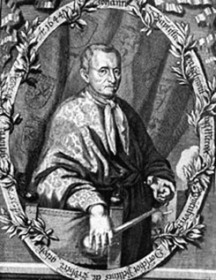
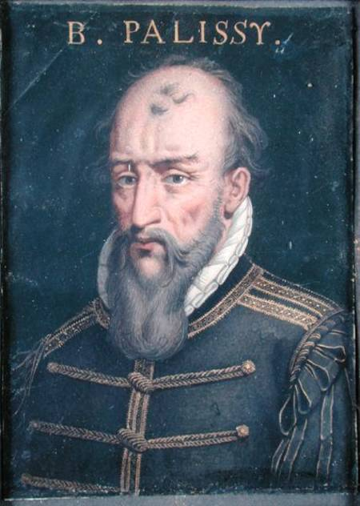
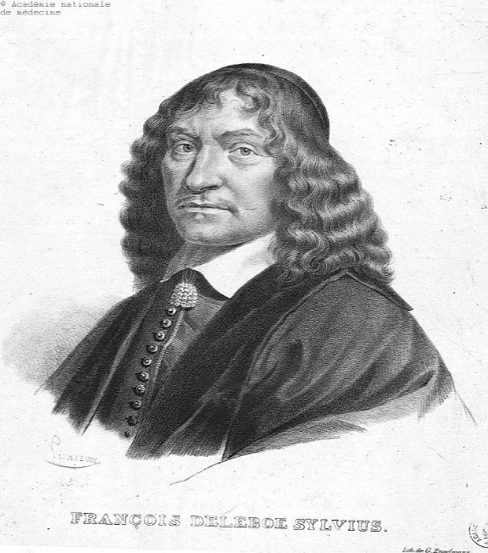
CHEMISTRY AND IATROCHEMISTRY
Since the Renaissance, in connection with the development of increasing importance in alchemy began to acquire commercial and practical focus: metallurgy, ceramics, glass and paint. The most important exponents in Renaissance of Iatrochemistry and Technical chemistry are: A. Libau, R. Glauber, JB Van Helmont , O. Taheniya, Paracelsus. Biringuccio B, G. Agricola and Bernard Palissy

Slide 19
IATROCHEMISTRY
Iatrochemistry – the section of chemical science , which originated in the XVI and XVII centuries
The word "Iatro" was the Greek word "doctor" or "medicine“
The main aim of chemistry at the time is preparation of medicines
Chemists iatrochemistry era sought to put at the service of medicine chemistry
Representatives of iatrochemistry considered the processes occurring in the body, such as chemical phenomena of disease as a result of impaired chemical equilibrium , and set the task of finding chemicals to treat them

Slide 20
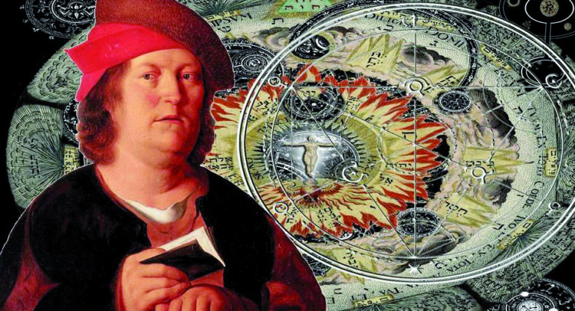
IATROCHEMISTRY
The most impact vocal proponent of iatrochemistry was Theopharastus von Honhenheim, also known as Paracelsus (Einsiedeln, 14 november 1493 – Salzburgh, 24 september 1541)
The word «Paracelsus» means «superior Celsus» Famous alchemist and physician Swiss- German descent, one of the founders of iatrochemistry. He founded the discipline of toxicology
Paracelsus as Avicenna believed that the main goal of alchemy not searching for ways to get gold, and production of medicines. He borrowed from the alchemical tradition teaching that there are three basic parts of matter mercury, sulfur, salt. Turning to determine the causes of diseases, Paracelsus claimed that fever and plague occur in the body of excess sulfur in excess mercury paralysis , etc.

Slide 21
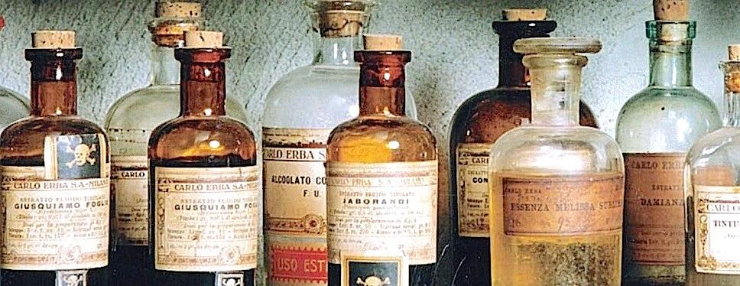
"All things are poison, and nothing is without poison; only the dose permits something not to be poisonous. "
That is to say, substances considered toxic are harmless in small doses, and conversely an ordinarily harmless substance can be deadly if overconsumed

Slide 22
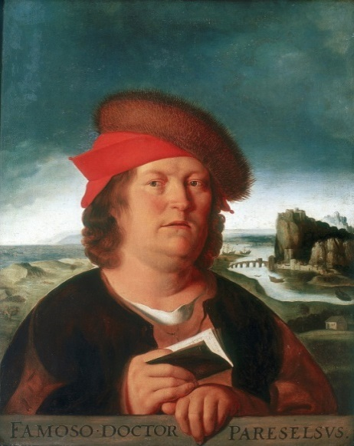
Paracelsus
Paracelsus attached great importance to careful observation of the patient and was very capable of identifying himself with his ailments
The anatomy of Paracelsus, in fact, is not based on dissection like that of Vesalius, but on the exteriority, on the physician's ability to reconnect the marks on the body to the internal agent causing the disease. It can therefore be said that it lays the foundations of semeiotics

Slide 23
Paracelsus
In his writings, in describing the anatomical parts, he simultaneously inserts his interpretations of them, does not distinguish what he sees from what he thinks. He lists the five possible principles of diseases: astral ens, venal ens, natural ens, spiritual ens and ens dei. To understand the cause of the disease, a good doctor must rely on all five bodies
Its importance in the pharmacological field is due to the fact that he was the first to recommend the use of minerals and chemicals for the treatment of human diseases, unlike the previous doctrines where it was limited to the use of plants and plant extracts

Slide 24
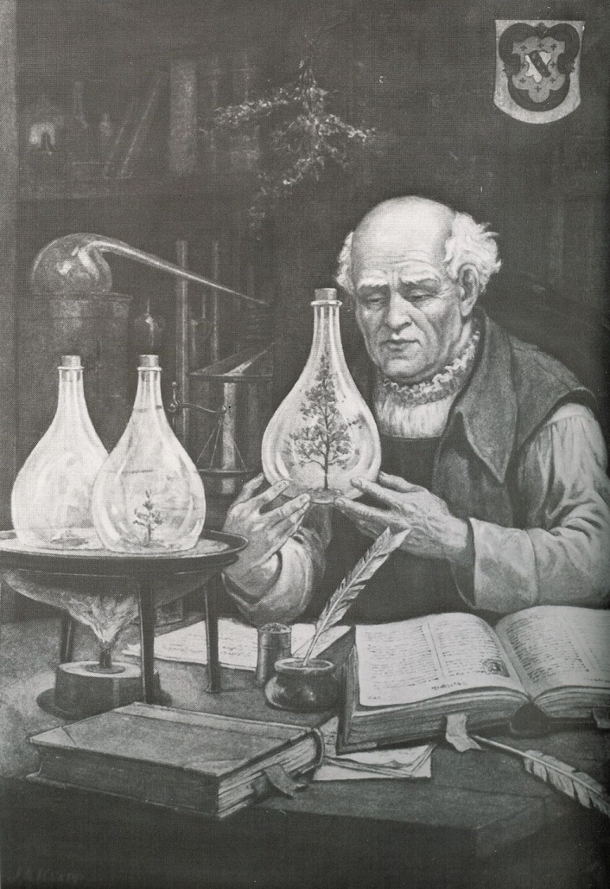
Paracelsus
One of the great contributions of Paracelsus was to stress the role of the chemistry in medicine
During the Renaissance a strong interest in the therapeutic potentialities of chemistry was afoot under the leadership of such men as Hieronymus Brunschwig and Conrad Gesner

Slide 25
The man and the Creator
According to of Paracelsus, a man - is a microcosm that reflects all the elements of the macrocosm, the link between the two worlds is the power of "M" (starts with that letter name Mercury)
According to Paracelsus, a man (who is also the quintessence, or fifth, the true essence of the world) is made by God from "drawing" of the whole world and bears the image of the Creator. There is no forbidden for a man of knowledge, he is able to and, according to Paracelsus, even the duty to investigate all the entities available not only in nature, but also beyond
Paracelsus leave some alchemical works, including "Chemical Psalter, or philosophical rules of the Stone of the Wise", "Nitrogen or the wood and the threads of life, " etc. It is believed that he gave the name of zinc metal (Zn)

Slide 26
Pre Paracelsan Pharmacology
The native alchemical tradition had been strong. During the fifteenth century George Ripley, Thoms Norton and Robert Grene had written the usual esoteric allegories on the philosopher’s stone
In the sixteenth century, Edward Cradock and John Dastin preserved obscurities; John Dee called himself an experimenter in the occult
Their value to medicine was simply the indirect one of pubblicizing the potentialities of chemistry and familiarizing readers with various types of apparatus

Slide 27
Post Paracelsan Pharmacology
In England Gesner was the prime mover of the cause of chemical medicine in its early stages
Paracelsus point does not seem to have had any effect ob English medicine before the early 1570’s
Thus the important medical works of the 1550’s by John Caius and Christopher Langton written in the 1560’s

Slide 28
Post Paracelsan Pharmacology
Between 1570 and 1580 the first discoverable mention of Paracelsus in an English medical book was a cry of scorn frome one of the established physicians: John Jones, a universitary man, writer of several medical treatises, exclaimed against mal practicers and ignorant empirics in medicine
It was erroneous theory that made the Paracelsans «vayn pratisers» in the eyes of John Jones. This attitude by the first English commentator on Paracelsism was to be prophetic of the future of the movement in England

Slide 29
Post Paracelsan Pharmacology
For the roots of the movement we must go back to Thomas Hill. In fact Hill’s real service to chemical medicine lay not so much in his own books as in his bequeathing of unfinished manuscripts to two men, John Hester and George Baker, who were in strategic positions to spread the new doctrine
To Hester went the manuscript translation of Fioravanti which started the long series of pubblications more potent than any other single force to make Paracelsism widely known in England
To Baker went Hill’s complete translation of Gesner’s Euonymus, part two
The essential point is that, through Hester and Baker, Hill made really vital contributions to the development and acceptance of chemical medicine in England

Slide 30
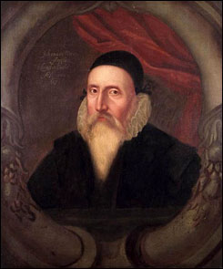
English mathematician and astrologer, was born on the 13th of July 1527, in London, where his father was, according to Wood, a wealthy vintner
In 1542 he was sent to St John's College, Cambridge. After five years spent in mathematical and astronomical studies, he went to Holland, in order to visit several eminent continental mathematicians
Having remained abroad nearly a year, he returned to Cambridge, and was elected a fellow of Trinity College, then first erected by King Henry VIII

Slide 31
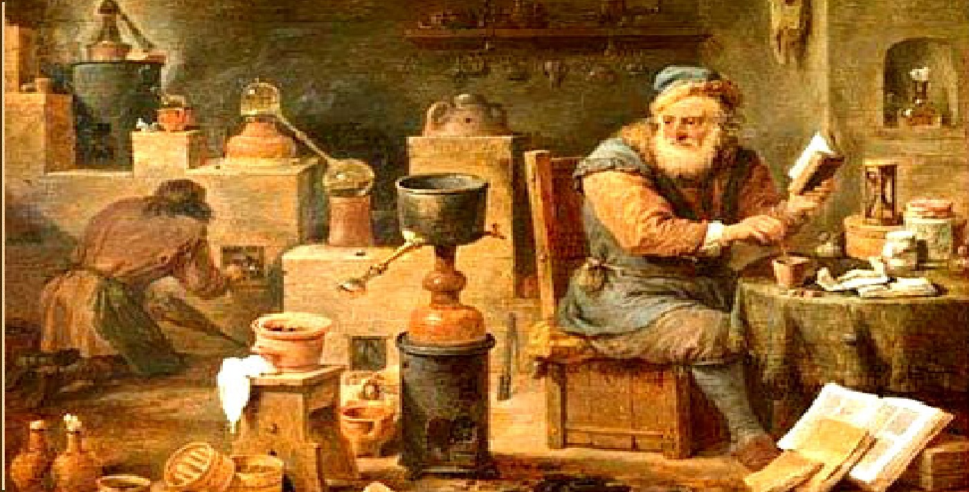
Renaissance Alchemy and the Scientific Method
As with most academic disciplines, the practice of alchemy was aided by Gutenberg’s invention of the printing press, in 1440, alongside the increased tendency of people and ideas to migrate, allowing knowledge to spread across Europe and beyond. Archaeologists have found alchemical artifacts across Europe, showing the popularity of this proto-science, although the potential for riches offered by the transmutation of base metals into gold probably lay behind the popularity. Certainly, great minds such as John Dee (1527–1608) spent a lot of time in this pursuit, often attracting the patronage of rich sponsors

Slide 32
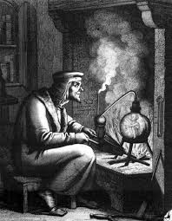
Renaissance Alchemy and the Scientific Method
Many alchemists during the Renaissance Era conducted controlled experiments and used trial and error to discover the nature of substances, studying how they reacted, interacted and changed under new conditions. The alchemists not only laid the foundations for chemistry, but they contributed to the practical side of physics, creating gases, solids, and liquids that later scientists could study, directly influencing the great physicists of the Age of Enlightenment, from the late 17th century onwards

Slide 33
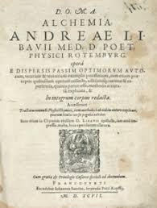
Renaissance Alchemy and the Scientific Method
To add to this shift towards a rigorous scientific method, one can look at the textbooks produced at the time. In the majority of cases, the alchemists of the late 16th and early 17th centuries still held to the Aristotelian worldview, where all metals were derived from mercury and sulfur. For example, a book by a German chemist, Andreas Libau (c1550–1616) was very thorough and undoubtedly acted as a great teaching aid, relating detailed methodology, calculations, and instructions for preparing compounds, but it also promoted this old idea, one that would persist until Boyle (1627-1691) tore it apart

Slide 34
Alchemy and Chemistry in the Renaissance
ALMAEON PROJECT – SAPIENZA UNIVERSITY OF ROME
THANKS FOR YOUR ATTENTION!!!

