Slide 1
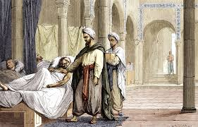
Unit 6 – The translation movement in the Medieval Europe:
from Gondishapur to Toledo
Universidad Complutense de Madrid, Spain

Slide 3
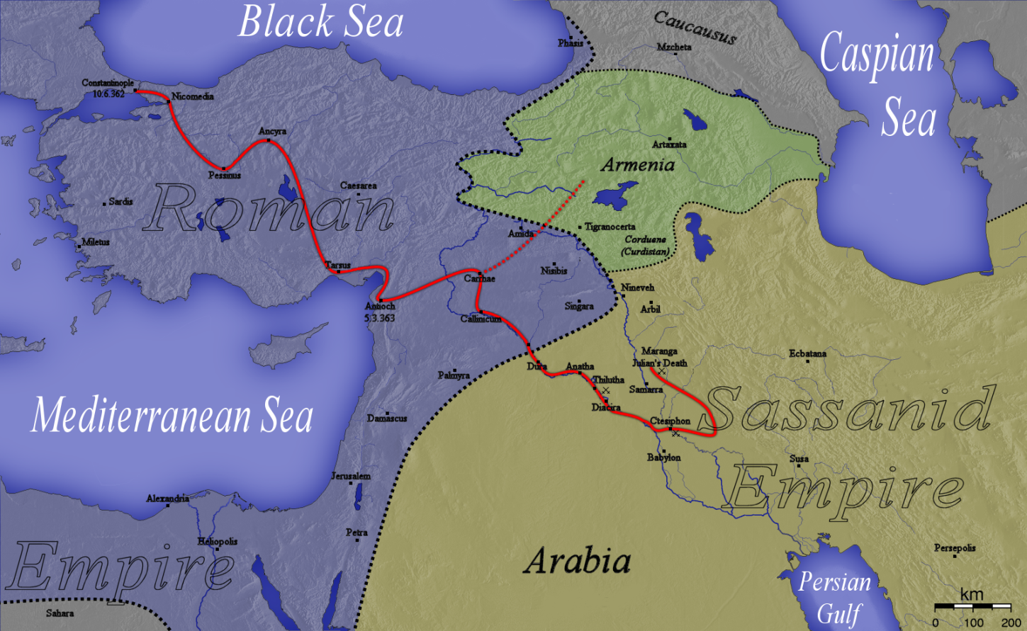
The city of Gondishapur
The first bimarestan is opened in the city on 271 A.D.
In the city there were originally Persian, Greek, Indian cultures
As a consequence of the political conflict between Byzantine and Sassanid Empire several Romans and Greeks prisoners became residents were displaced in the city

Slide 4
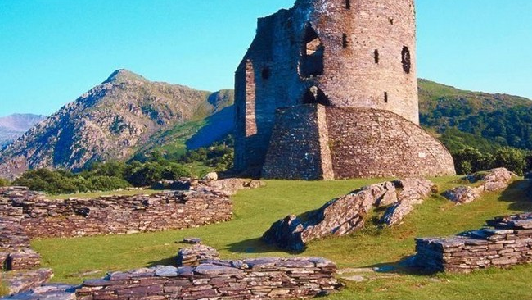
The School of Gondishapur
As a consequence of the internal Roman Empire politico-religious conflicts in the Christian Nestorians were displaced from Edessa and settled in the city

Slide 5
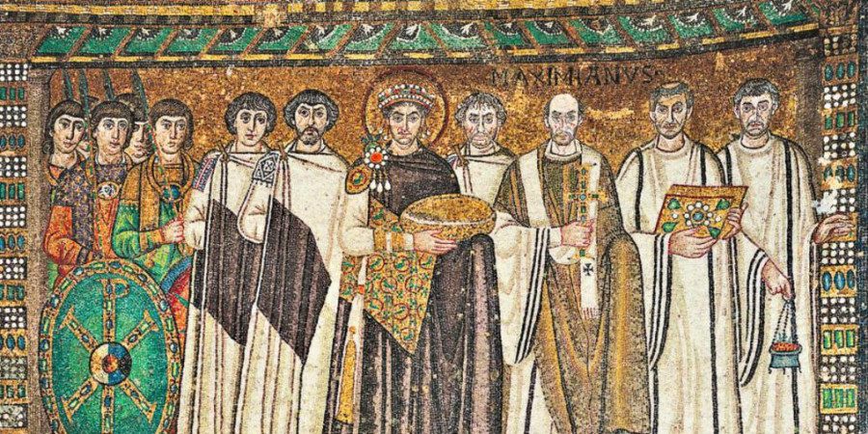
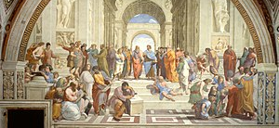
The end of the Academia
On 529 the Emperor Justinian closed the Neoplatonic Athenian School and several philosopher and physicians moved from Athens to Gondishapur

Slide 6
The great synthesis of Gondishapur
Cultures
Greek
Mesopotamian
Egyptian
Indian
Religions
Judaism
Zoroastrianism
Christian Nestorianism

Slide 7
The rise of Arabic Empire affected an extent from Spain to Hindustan. In 638 CE with conquest of the city CE the Gondishapur School legacy was spread from Baghdad to the entire territory

Slide 8
The central role of libraries
The synthesis of Gondishapur requires two elements
The building of big libraries
The translations from Greek and Sanskrit books to Persian and Syriac
An adjustment of Arabic culture to Hellenistic and Syro-Persan civilizations
The translation from Greek, Syriac and Persian to Arabic
The building of “The House of Wise” in Baghdad
The development of library as support for liturgical and pedagogical text
The availability of a great number of manuscripts
The increment of the number of philologists and exegetes

Slide 9
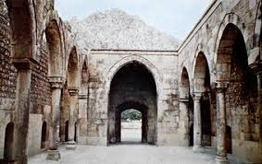
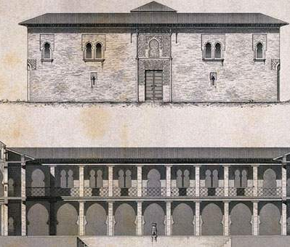
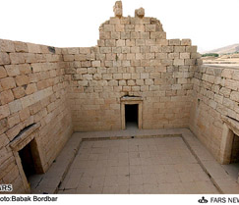
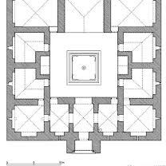
Bimarestans are originally mobile military hospitals. Shapur I in the 271 CE for strategic reasons built the first settled bimarestan in Gondishapur

Slide 10
The School of Gundishapur
Hospital
Specific clinical units: surgery, fever, wounds, mania, cold decease, diarrhoea, female disorders and eye disease
Pharmacology lab
Nurses and auxiliaries
Mosque and chapel
Medical school
Pharmacology lab
Library and translation house
Observatory

Slide 11
Medical training
Students' round in clinical units with clinicians
Rotations in different clinical units
Students´ writing of medical records edited by medical teacher
Treatments based in repeated experiences
Small group lectures during the ward rounds, discussion and reviews
3 years training program
1st year study of mathematics, geometry, logic, basic sciences
2nd-3rd years anatomy dissection, clinical work, study of medical books
The end of the training conferred to the doctor a license

Slide 12
Multicultural School
The common language used for teaching was Persian Pahlavi but is not excluded that other languages were used
Aramaic
Greek
Syriac
Sanskrit
Teachers were Christian Nestorians coming in large part form Edessa

Slide 13
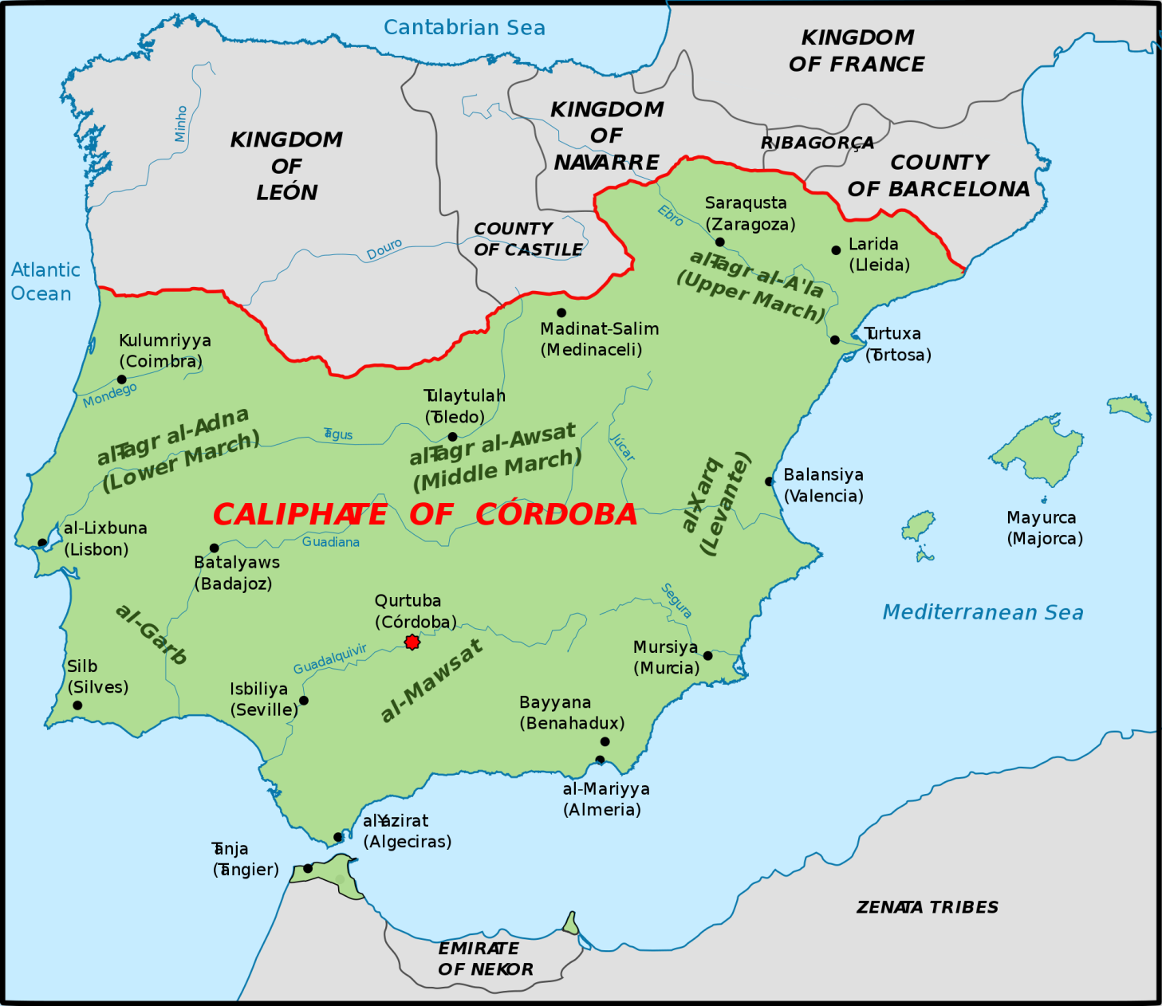
The low Middle Age
After the death of Charlemagne European culture was declined and science and medicine were banned and cultural activity relegated into the monasteries
Spain and Sicily experimented a political and cultural renaissance
In the South of Spain the Arab Empire
In the South of Italy the Norman Kingdom
The only progress of science and medicine has been possible through the contact with Arabian culture and the recovery of the arabized Greek science

Slide 14
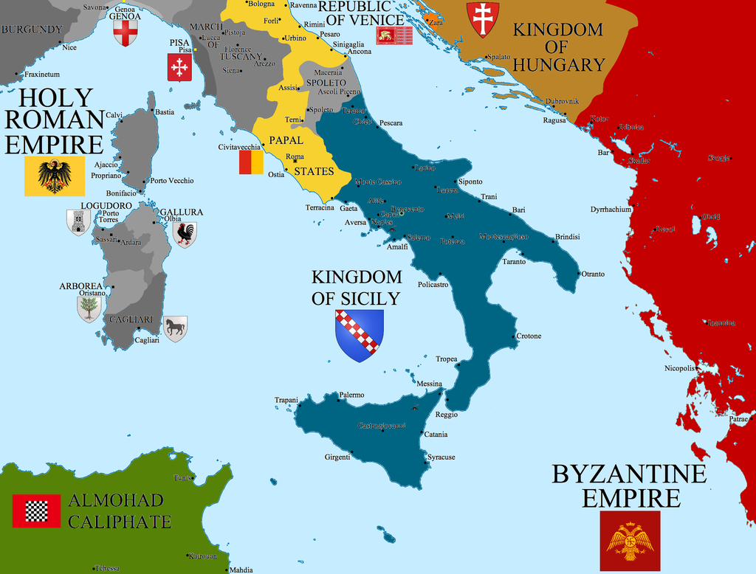
The Arabization of European culture
The School of Salerno
Under the Norman Duke the city became the most important cultural centre of Christian Europe
Port of Salerno became a crossroad for Crusades Army and a base hospital for all the military Christians coming back
Collection of several medical manuscripts coming from Arab Empire

Slide 15
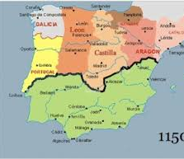
The City of Toledo
The Christian King Alphonse VI conquest the city on 1085 CE
Multicultural city with the same rights
Muslims
Christian Mozarabs
Jews
The translation movement became intense since the XII CE and was organized around the Cathedral of the city

Slide 16
The Toledo School of Translation
Early independent translations due to the abundance of manuscripts in the city
The Benedictine monk Raymond de Sauvetat (1125-1152 CE) organized the translation activates around the Cathedral
Philosophers and philologist came from Palermo and Chartres
The Raymond coordination started on 1130 CE and involved a group of Castilian-speaking Jews and formed the first society of translators.
Among the most important:
Dominicus Gundissalinus (Archdiacon of Segovia)
Solomon (Jew)
Johannes Hispaliense or John of Seville (Mozarab)

Slide 17
1st generation of the Toledo translators
Mozarabs and Jews physicians coming from the South of Spain where the Almoravids practiced a more orthodox and strict Islamic faith
Michael Scot (1170-1294 CE)
Averroes
Gerard of Cremona (1114-1187 CE)
Learned Arabic from Johannes Hispaliensis
70 works
Canon of Avicenna
Galen
Aristotle
Ptolemy
Rhazes
Abulcasis

Slide 18
2nd generation of Toledo translators
New director of the School the bishop Rodrigo Ximenez of Rada (1170-1247 CE)
Herman the German
Aristotle´s Rhetoric chapters lost
Alfred the Englishman
Aristotle minor works
Marcus of Toledo
Galen
Astronomical and astrological works
Daniel of Morley
Introduced in Oxford the new Aristotle

Slide 19
Recovery and synthesis of the Arab medicine in the Medieval European medicine
Reception
Costantinus Africanus
Adelardus of Bath
Dominicus Gundisalvi
Incubation in Salerno and Chartres
Gerard of Cremona
Michael Scot
William of Conches
Peter of Spain
Assimilation
France: Toulouse, Paris and Chartres
England: Adelardus of Bath, Daniel of Morley and other Toledo translator
Italy: Gerard Sabbioneta and John of Palermo, Michael Scot and Pedro Hispanus

