Slide 1
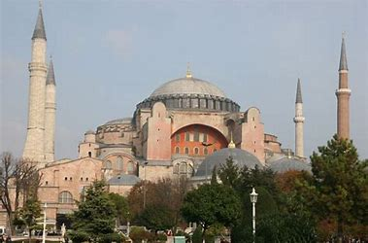
Unit 5 – The Byzantine Arabic and European Medicine
Universidad Complutense de Madrid, Spain

Slide 2
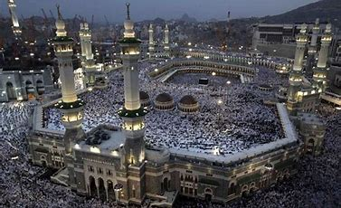
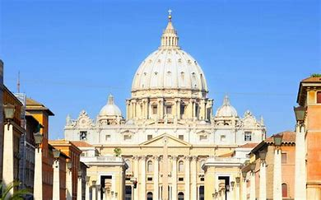
Middle-Age: 5th–15th Centuries
Medicine is a synthesis between the Greek tradition mediated by the Galen’s works and the three cultural frameworks:
Byzantine: oriental Christianism
Islamic: Islamism
Western European: roman Christianism

Slide 3
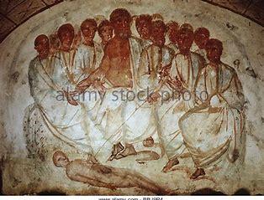
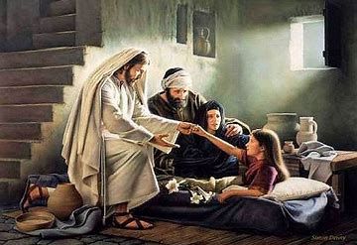
Christianism and Medicine
The Gospel and the duty to care sick
But when he heard this, he said, “Those who are well have no need of a physician, but those who are sick” (Matt. 9, 12)
“It is not the healthy who need a doctor, but the sick. I have not come to call the righteous, but the sinners” (Marc. 2, 17)
“It is not the healthy who need a doctor, but the sick (Luke, V, 31)

Slide 4
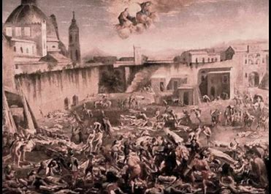
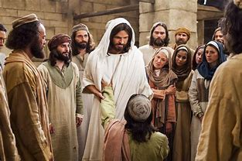
Diseases as wrath of God
Jesus brakes with the traditional pre-Christian religion views: Mesopotamia and Egypt and related Hebrew elaboration in the Old Testament (Deuteronomy, Leviticus) and the Talmud
As he went along, he saw a man blind from birth. His disciples asked him “Rabbi, who sinned, this man or his parent, that he was born blind? ”Neither this man nor his parents sinned” said Jesus” but this happened so that the works of God might be displayed in him” (John, 9, 1-3)

Slide 5
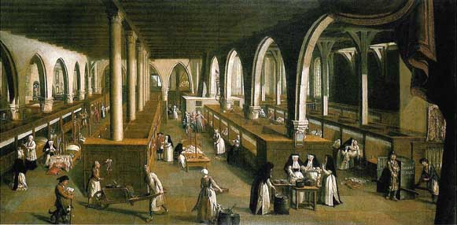
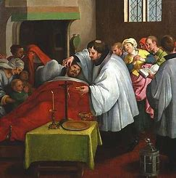
The Christian ethical duty of care
The love toward humankind as a condition for the love toward the art of care
Philanthropía Philotekhnía
The birth of medical charity integrates ethical and clinical care and is the start of a process ended in the building of the first hospitals

Slide 6
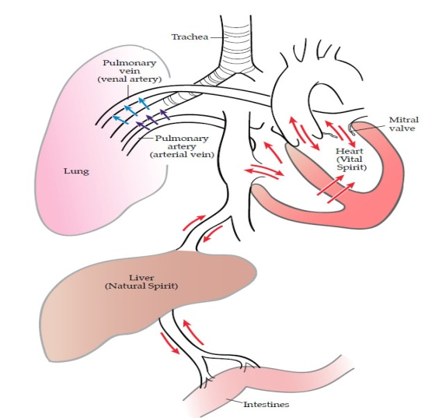
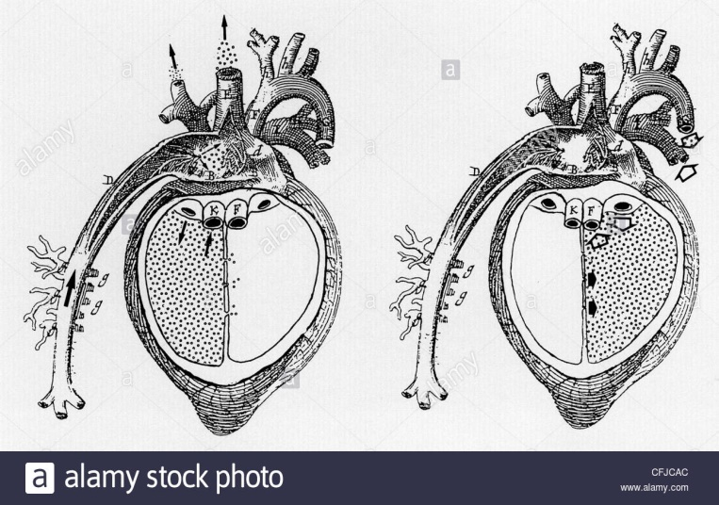
The Decline of Galenism
At the end of the Hellenistic Age there are two different kind of physicians
Greek physicians: iatrosophoi using the Alexandrian interpretative method to read and comment the Hippocratic medicine works under the influence of the Athens Academia philosophy
Latin physicians: translators of Greek physicians and followers of Galen’s medicine

Slide 7
Byzantine Medicine
As a consequence of the division of the Roman Empire in Western and Eastern, Constantinople (Byzantium) became the capital of the Eastern Roman Empire in 330 AC until the 1453.
The division consolidated a new realty in the Eastern side with the following characters:
Greek language
Christianism
Feudal economy
Hellenism

Slide 8
Medicine in the byzantine society
Physician has a prestigious social role
Tax exemption
Building of hospitals
Existence of two different practices:
One in continuity with Hippocratic medicine
Other with a superstitious character

Slide 9
Byzantine medicine and Hippocratic tradition
Big influence of Galen’s works due to the use of Greek language
Decline of Galenism
Exhaustion of Greek culture
The difference between the “polis” and “imperium” as political organizations
Influence of Eastern cultures
The role of faith and religion in every form of knowledge
The decadence of Roman Empire and its civilization
Refuse of part of the Galen’s works for its intrinsic Paganism
Softening of the physiological rationality

Slide 10
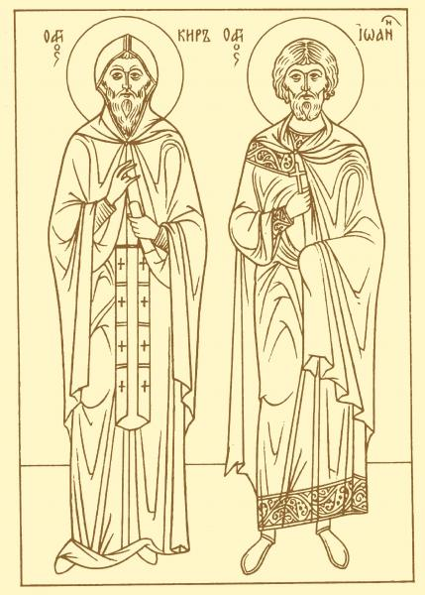
Byzantine medicine and superstitious culture
Big influence of popular medicine
Pre-Hippocratic medicine: incubatio, use of the curative power of the hands, libation
Influence of Jewish Kabbalah
Influence of Egyptian medicine: Thot became Hermes Trismegistus in Greek
Astrology, Alchemy
Overlapping between Pagan and Christian culture in matter of religious rituals
St Cyrus and John: anargyroi (no lucrative practice)
Christian incubatio

Slide 11
Islam
Muhammad (570-632) member of the tribe of Quraysh governing La Mecca
Poor orphan becoming a rich merchant
In the early 40 received a call: Qur’an (Koran) was revealed to him in vision
The last prophet descending directly from Adam and Noah
In 622 A.D. Hegira represents the foundation of Islam, the escape to Medina as consequence of prosecution of Muslims in La Mecca
At the time of his death Islam conquered all Arabia

Slide 12
Arabic medicine
Synthesis between Arabic tribes' magic and empirical medicine and Greek culture as consequence of the expansion of the Islam in Byzantine Empire and Middle East.
Hellenism
Islamic monotheism
Translations of Greek science and medicine in the Islamic culture is produced by the religious belief:
“find knowledge even you need to go to China”
“who leaves his home to find knowledge will find the Allah’s way”

Slide 13
The translation of Greek medicine
Hunayan Ibn Ishaq (Iohannitus)
Works of Hippocrates and Galen in Syriac
Greek and Persian manuscripts into Syriac and Arabic of Hippocratic
Nestorian Christian living in Baghdad
Mesue’ the Old
Director of the Bagdad Hospital
Translation of Greek medicine from Alexandria into Arabic

Slide 14
Isagoge of Iohannitus
Textbook of reference for the Arabic medicine, translation of a work coming from the Alexandrian School, synthesis of galenic medicine in the Arabic world
The translation movement represents an innovative approach to the teaching and learning of medicine and converted the Arabic language in an original language for a scholarship
Hunayn authored a Medical Questions and Answers, a student textbook, following the division between the natural organization of the body and unnatural or contra-natural disease

Slide 15
Rhazes (854-925 A.D.)
The most important clinician of Arabic Medicine
The Virtuous Life (al- Hawi)
A clinical Encyclopedia, description of illnesses and exposition of the related clinical expertise
It highlights the discrepancies between Galen´s theory and his clinical experience
A treatise on the Small-pox and measles
The first clinical monography on the small-pox focused on the clinical observation of the illness
The Comprehensive Book
Introduction to medicine, anatomy, physiology and pathology
Comparison between Hippocratic medicine and direct observation

Slide 16
Avicenna (980-1037 A.D.)
The most influent physician and philosopher of the Middle Age (born in the current Uzbekistan)
The Canon of Medicine is a a medical encyclopaedia and became a standard handbook in the Middle and Modern Age medicine.
All clinical events have a causal reason
He applied the Aristotelian theory of casualty to medicine in the 4 causes of illness
Material cause: the body condition in specific circumstances
Efficient cause: the environmental or cultural habits
Formal cause: the body constitution
Final cause: the body functioning

Slide 17
Medieval Medicine in Europe (V-XV CE)
Monastic medicine
Priest-doctor responds to the Christian duty to assist sick people
It is considered as a philosophy more than a science
It is influenced by the humoral theory and some Hippocratic reference but not for the entire corpus Hippocratic
Some works of Rufus, Dioscorides and Galen and fragments of Byzantine medicine
Non-monastic medicine
Jews doctors
Byzantine doctors
Doctors located in the Barbarians Kingdom

Slide 18
The School of Salerno
Opened in the X c. in Salerno (South of Italy)
Primitive stage
Influence of Byzantine medicine
Pathology focussed on the Hippocratic theory of humour
High Salerno
Constantine the African translations from Arabic to Latin
Method of Healing Galen
Johannitius´s Isagoge´
Aphorism Hippocrates
Low Salerno
Birth of the Universities
Decline of the School

Slide 19
Universities
Since the XII c. the Universities assume progressively the monopoly of knowledge and define a standard of education
Scholasticism as learning and teaching standard method in medicine
Encyclopaedic approach to natural sciences
Experimental method
The most important medical schools: Montpellier, Bologna, Padua, Florence
Case-based learning
Consilium of Tadeo Alderotti: focused on the single clinical case (case study) is useful for the patient (patient-centred medicine) and the medical student

Slide 20
Medicine from the point of view of orthodox theology
Affirmative and positive approach
Jesus Christ heals many sick people, both physically and spiritually.
Church tradition sees Jesus Christ as a “Healer of the soul and of body”
Orthodox theology clearly emphasizes the limitations of medicine: medical healing and restoration of health are temporarily, the salvation given by God is eternal

Slide 21
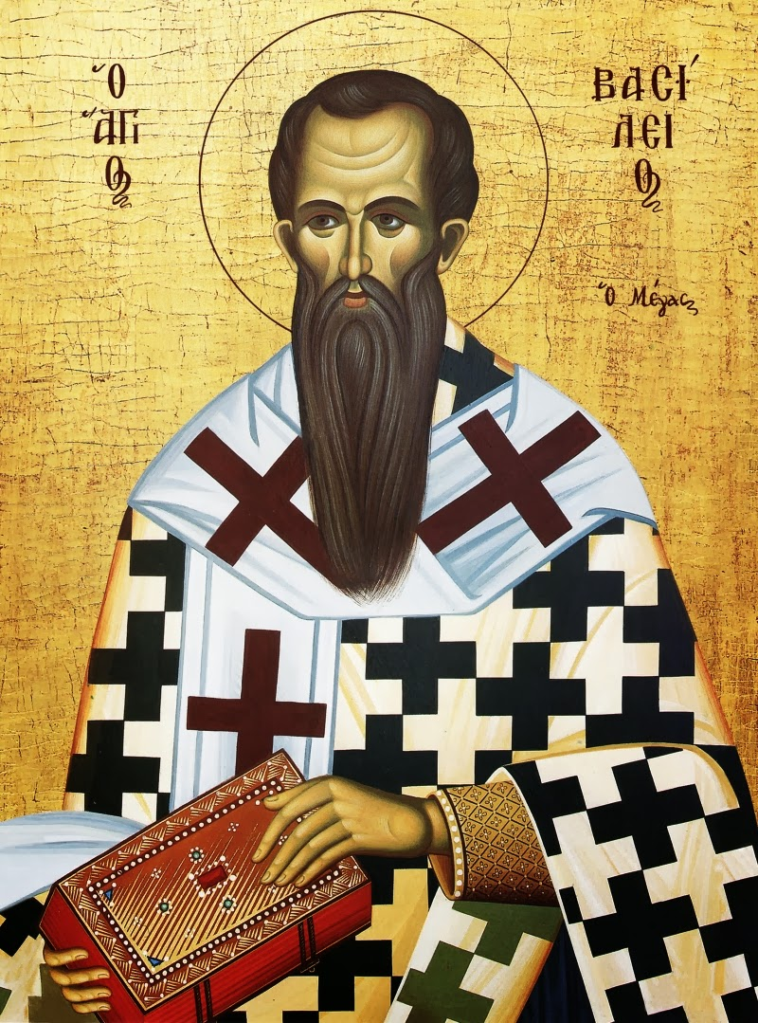
Medicine as God’s gift to human
Basile the Great: Medicine is a God’s gift due to human weakness before pain and disease
Medicine as a pattern for the healing of the soul: as one takes care of his health, in the same way one should care for his/her ethical and spiritual life
Medicine as a special way of loving and caring for one's neighbor

Slide 22
Orthodox Liturgical Life
Orthodox Church, acknowledging the significance of disease and healing, has very early integrated praying for the patients in daily liturgical life
The Sacrament of Anointing (Mark 6, 13)
The pray in the Divine Liturgy for relief of pain, healing of sick, painless death and salvation

Slide 23
Medicine and Church’s diaconia of the sick in the Byzantine Empire
Byzantine xenones – the first public institutions to offer medical services to the sick
„Basilias“ - St Basil built a hospital in 370, in a suburb of Caesarea, with all the necessary qualified staff.
Gregory the Theologian: Basilias a "new city" of charity and diaconia
The Pantocrator Monastery in Constan­tinople had numerous philanthropic facilities, such as hostels for guests and strangers, homes for the elderly and specialized hospitals

