Slide 1
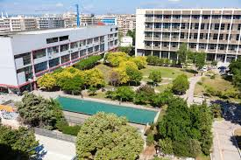
Unit 4 – Medicine and philosophy
Aristotle University of Thessaloniki

Slide 2
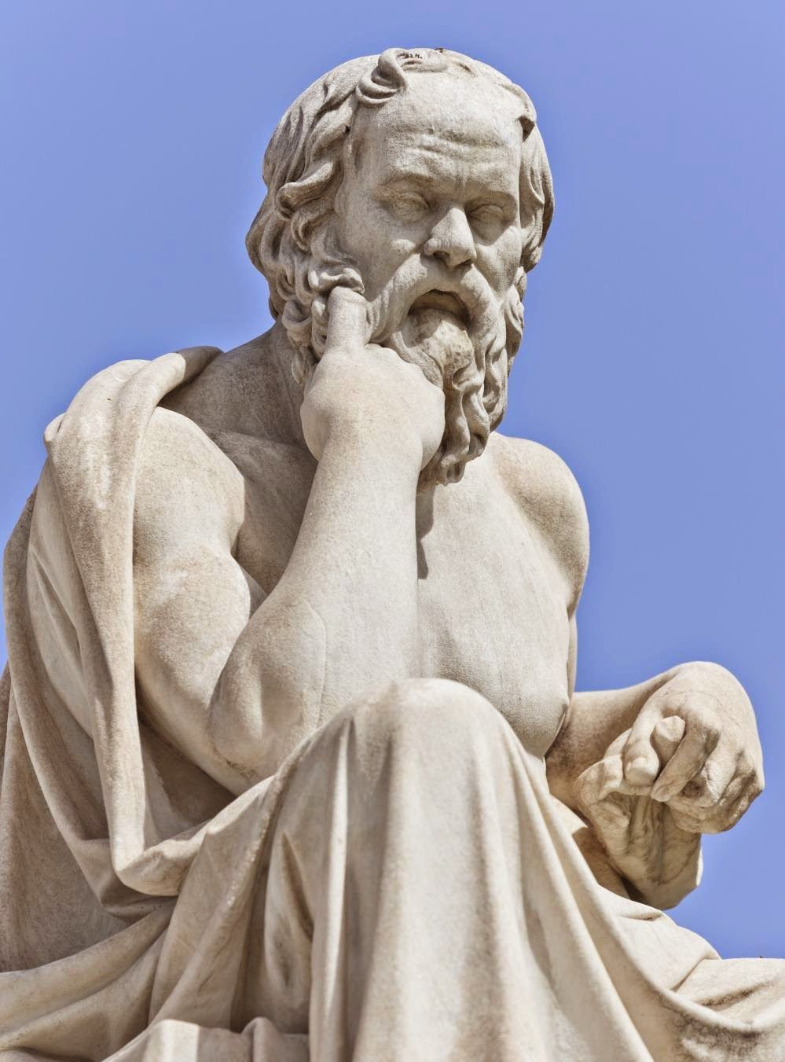
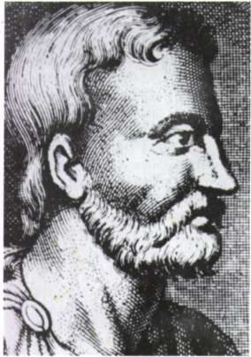
Philosophy and medicine.
What is the relation of philosophy and medicine?
Did philosophy originate in medicine or medicine in philosophy?

Slide 3
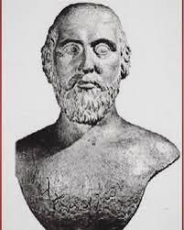
The Relation between Ancient Greek Philosophy and Medicine
The three Milesian philosophers engaged more with cosmology, physics and astronomy than with anthropology and medicine.
From the Pythagorean circle, on the other hand, came Alcmaeon of Croton who established one of the most famous medical schools of antiquity, the medical school of Croton of Italy.
Alcmaeon was partly a philosopher and partly a physician, i.e. he defined theoretical principles and tried to apply them to experience. He taught that the body is consisted of a number of opposite pairs, i.e. cold and hot, liquid and dry etc.

Slide 4
“Sophia”, “Philosophia”, Wisdom, Knowledge, Universal Knowledge.
In antiquity all forms of knowledge were included under “Sophia”. And the “philo-sopher” was the “lover of Sophia”.
The physician was a kind of “Sophos”, i.e. “wise man” that possessed “Sophia” about man.
The philosopher was also a kind of “Sophos” that possessed “Sophia” about man.
Consequently, the question arose: Did philosophy originate in medicine or medicine in philosophy?
The prevailing view is that medicine originated in philosophy rather than the other way round.

Slide 5
The very beginnings of ancient medicine.
The first physicians were the soothsayers or augurs who could tell from the signs of the weather, the flying of birds or the entrails of animals that were sacrificed to gods, which practice in general had to be applied for the cure of the disease or the catharsis of the plague that had befallen the town.
Soon people in classical times realized that all phenomena were natural and divine but also that there were certain elements of these phenomena which they could not explain. This is why they turned for an explanation to philosophy. This is the reason why people turned gradually from religion to philosophy in order to understand medicine.

Slide 6
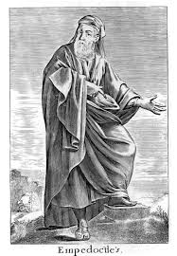
Health, according to Alcmaeon, prevails when there is a harmonious mixing (i.e. κρᾶσις) of these elements, when in other words there is isonomy (or (ἰσονομία). We have disease, on the other hand, when one of these elements prevails and so we have monarchy (or μοναρχία).
Empedocles of Akragas continues the tradition of ancient medicine. He was one of the leaders of the medical school of Italy that disagreed with the Asclepiads of Cos and Knidos. He has written a philosophical treatise On Nature and another treatise related to medicine which has not reached us.

Slide 7
Empedocles’ teaching.
Empedocles was interested in the beginnings of beings and particularly of human beings. According to him, they consist in four elements mixed in different analogies, the rhizomata, which allow him to explain the individual natures, something which in the Hippocratic school acquires a certain importance.
In addition, Empedocles attempted to formulate a theory of physiology of the most important functions of man, i.e. of reproduction, of growth and nutrition, of breathing, of sleep and death, of thinking and understanding.

Slide 8
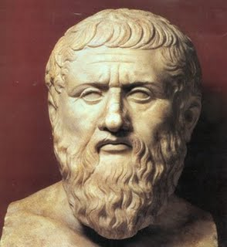
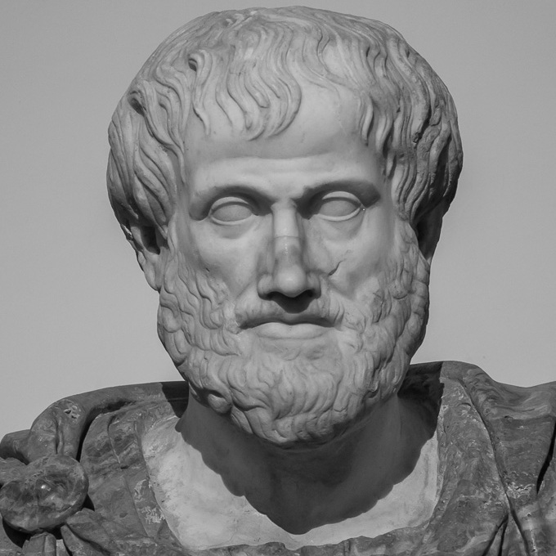
Medicine after Alcmaeon of Croton and Empedocles of Akragas: Plato and Aristotle
Among the philosophers who attempted further to develop complex theories of physiology are: Anaxagoras, Diogenes of Apollonia, Democritus, Hippon of Samos and Philolaos of Croton. Also Plato and Aristotle contributed a lot to the development of medicine.

Slide 9
Plato’s basic medical teaching.
In his treatise Timaeus Plato presents his own creation of the world, and of man. In the same work he introduces the diseases. He distinguishes between the diseases of the body and the diseases of the soul. He further distinguishes the diseases of the body in to three kinds:
The diseases which have to do with the excess or defect (i.e. imbalance) or misplacement of the primary bodies.
The diseases of the secondary tissues.
The diseases which have to do with the breath, the phlegm, the bile and the fevers.
The diseases of the soul, on the other hand, are related with the disproportion between the soul and the body.

Slide 10
Plato’s conception of therapy.
Plato describes how the ancient physician can heal a disease in his dialogue, Charmides. He argues that if a good physician is to heal a pain in the eyes, he has to cure first the head of the patient. He further claims that he cannot cure the head of the patient if he does not cure first the whole body. This is the reason why they prescribe diets in the effort they make to cure the part together with the whole.
Furthermore, Plato argues in the same dialogue that a physician cannot cure the whole body independently of the soul. Because the good and bad things for the body originate in the soul. We should start therefore with the soul, if we wish to cure the pain in the eyes, the head or the body.
Moreover, the soul is healed with certain magical songs, which are good words which bring prudence, moderation and temperance in the soul. And if this temperance is present in the soul, then the head and the body can be restored back to health.

Slide 11
Plato as the first originator of modern Psychotherapy.
By claiming that we cannot heal the body and the head without curing first the soul, Plato has become one of the first originators of modern Psychotherapy in the history of medicine.
It is “The therapy of the word in Greek Medicine” as Dr. Chiara Thumiger (in the attached youtube calls it), by which she implies the whole tradition of the healing of the soul through the use of good words which permeates the Classical antiquity.

Slide 12
Aristotle’s contribution to medicine
Aristotle has not written any treatise on medicine or at least no such a treatise is extant. Nevertheless, he was the son of a physician and consequently we have good reasons to think that he knew quite a lot about medicine.
He has written treatises on biology, about animals and of course about anthropology or ethics, that is on topics which are pretty close to medicine.
Moreover, in his ethical treatises like the Nicomachean Ethics and the Eudemean Ethics, he quite often compares ethical reasoning with medical reasoning. He claims that in both cases knowledge is contingent, that is it can be otherwise, unlike the mathematical and metaphysical knowledge which is necessary, i.e. it cannot be otherwise.
The physician has to judge and calculate each time the amount of medicament he has to prescribe to the patient for the disease, whereas in the case of another patient for the same disease he may have to prescribe a different medicament, his judgment depending each time on a number of different factors.
In the same way, each time the agent passes a judgment or decides to act, he has to take into account not only the particular external circumstances but also the performer’s dispositions, intentions and motives at the moment of the performance of the action. In this respect ethical science like medical science is theoretical and practical/calculative at the same time.

Slide 13
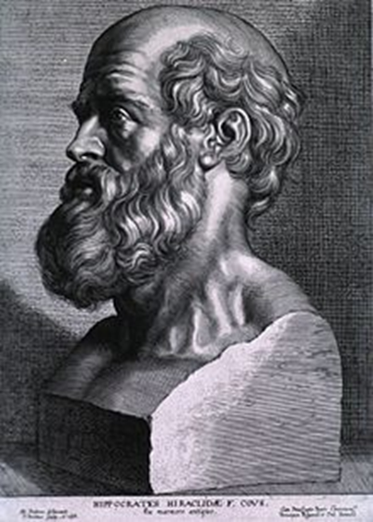
Hippocrates and the separation of medicine from philosophy.
So far medicine appears to be tightly related with philosophy. However, Hippocrates, the famous philosopher-physician of the 4th century BC separated the two. He contends that the attempts of certain physicians up to his days to explain the medical phenomena arguing from certain hypotheses or axioms to conclusions is rather simplistic. Instead he suggests that medicine possesses its own method, independently of the method of philosophy, and in particular of cosmology that aspires to reduce everything to one principle. In his treatise On Ancient Medicine he writes:
“Certain physicians and philosophers assert that nobody can know medicine who is ignorant what a man is; he who would treat patients properly must, they say, learn this. But the question they raise is one for philosophy; it is the province of those who, like Empedocles, have written on natural science, what man is from the beginning, how he came into being at first, and from what elements he was originally constructed”.

Slide 14
Philosophy’s influences on medicine during the Cosmological period.
During the Cosmological period of philosophy physicians attempted to rely the therapeutic science on Cosmology. However, as we just saw, Hippocrates pointed out that that was a mistake and that medicine has its own independent method.
However, the relation between medicine and philosophy remained and, as we will see, different medical schools were influenced by different philosophical schools in so far as theoretical knowledge was concerned:
The Rationalists looked for a kind of theory which could provide them with the possibility to justify the prognosis of a disease and the kind of cure they had to apply.
The Empiricists were influenced by Skepticism and thought that theory came at the end on the basis of the experience that had been accumulated until then.
The Methodists held that the physician had to know medical theory not so much because the theory provided the physician with a means to justify the medical practice he applied but mostly in order to be more convincing to his patients.

Slide 15
Philosophy’s influence on medicine during the Anthropological period of philosophy. Ancient Greek and Roman Medical Deontology.
During the Cosmological period of philosophy physicians looked to philosophy for their method and asked philosophy’s support on issues of knowledge, logic and philosophy of nature.
During the Anthropological period of philosophy, on the other hand, philosophy offers a practical assistance to physicians. If the aim in employing cosmology and theoretical philosophy is to prepare better physicians professionally, the aim in employing philosophical anthropology and ethics is to make physicians better physicians as characters.
Consequently, we have a number of philosophers-physicians during this period who have written a number of deontological treatises with which they attempt to develop and cultivate the physician’s ethos.

Slide 16
Deontological treatises and their influence on the physician’s character.
Among the deontological treatises we can mention:
The ones written by Hippocrates and which are included in the Corpus Hippocraticum. These are:
The Oath, The Physician, Law, Decorum, Precepts, On Ancient Medicine.
Galen’s deontological treatises, especially the treatise, That the excellent physician is a philosopher.
Celsus’ De Medicina, especially the premium.

Slide 17
Stele for a Roman medica - female physician from the 2nd c. By Musé de la Cour d’ Or Metz Métropole.
(from Women in Antiquity – WordPress.com).

Slide 18
The Deontological treatises of the physicians-philosophers.
In the treatise Law Hippocrates explains how one can become possessor of the medical art. According to him five factors should coincide at the same time:
The youth should have the natural inclination. Because where nature resists, education on its own can do nothing.
He should receive the right upbringing and education.
He should find himself in the right environment, i.e. educational environment.
He should devote a lot of time. Time is the word to which Hippocrates attributes a double meaning. His education should have a long duration.
His education should from an early age.

Slide 19
The deontological treatises of the philosophers-physicians continued.
Galen suggests that the youth who is prepared to become a healer or a physician should receive some wider knowledge. His education must also include apart from the specific medical knowledge, some knowledge of the liberal arts (artes liberales), which include arithmetic, geometry, astronomy and music (quadrivium) and also grammar, dialectics and rhetoric (trivium).
This does not sound surprising especially if we take into account that, according to Plato, as we have seen, the role of the physician/healer is to restore the patient’s function(s) back to their natural rhythm. And he can succeed this not by curing the pain in the eyes or the head and the body, but by curing first of all his soul. A healthy and temperate soul is, according to Plato, the presupposition for curing all the diseases of the body. But the physician cannot achieve the cure of the soul, unless he uses, as we have seen, «good words», unless he has tried to instill in the patient’s soul the virtues of prudence and temperance.

Slide 20
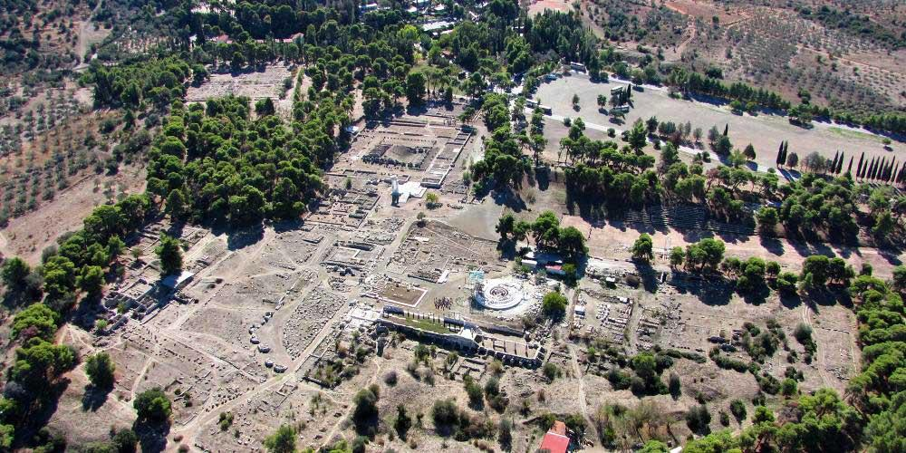
Sanctuary of Asclepius at Epidaurus, Greece. (From World Heritage Journeys).

Slide 21
The deontological treatises of the philosophers-physicians continued.
And, of course, he cannot succeed such a thing unless, together with the strictly medical knowledge, he also possesses knowledge of music, astronomy and rhetoric.
Moreover, by possessing some knowledge of the liberal arts, the physician himself changes as a character, i.e. he cultivates his personality so as to practice his social role in a more humane way. He is learning gradually to approach his patient with due respect and to treat him in a way that that is worthy of the trust that the patient has showed him, since he has placed into his hands the most sacred thing he has, his life. This is why Hippocrates writes in the Physician:
“The intimacy also between physician and patient is close. Patients in fact put themselves into the hands of their physician and at every moment he meets women, maidens and possessions very precious indeed. So towards all these self-control must be used”.

Slide 22
The deontological treatises of the philosophers-physicians continued.
Moreover, in all these meetings with patient, the physician comes across his family members and relatives. Towards all of them he should behave with moderation.
Moderation is not sufficient for the physician. As Hippocrates declares in the Oath, the young physician swears to leave aside any injustice and damage towards the patient (the conteporary principle of non-maleficence) and to enter the patient’s house only for his good (the contemporary principle of beneficence).
Furthermore, the physician should be virtuous and compassionate. And if there is need in some cases to offer his services for free, he should not hesitate to do it, remembering the different benefactions he received in the past and his good name.
«For where there is love of man, there is also love for the art» (Precepts).

Slide 23
The deontological treatises of the philosophers-physicians continued.
It is a happy coincidence, according to Hippocrates, if a physician is both, good in his art and a virtuous character. But where this is not possible, it is better for the physician to be a good man and not particularly a good doctor than a good professional with a bad character and behavior. Hippocrates explanation for this is that the virtuous character compensates for the defective medical art, while the bad character corrupts and destroys even the most perfect art. This is why Hippocrates in his treatise Decorum argues:
“For a physician who is a lover of wisdom is the equal of god. Between wisdom and medicine
there is no gulf fixed; in fact medicine possesses all the qualities that make for wisdom. It has
disinterestedness, shame fastness, modesty, reserve, sound opinion, judgement, quiet, pugnacity,
purity, sententious speech, knowledge of the things good and necessary for life, selling of that
which cleanses, freedom from superstition, pre-excellence divine. What they have, they have
in opposition to intemperance, vulgarity, greed, concupiscence, robbery, shamelessness”.

Slide 24
Physician treating a patient. (Attic red-figure aryballos, 480-470 BC.).
(From Ancient Greek Medicine – Wikipedia).

