Slide 1
Unit 2: History of pre-Columbian and Inca medicine in Peru:
Shamanism and medicinal plants
Agueda Muñoz del Carpio Toia. Md, MPH Universidad Católica de Santa María- Peru

Slide 2
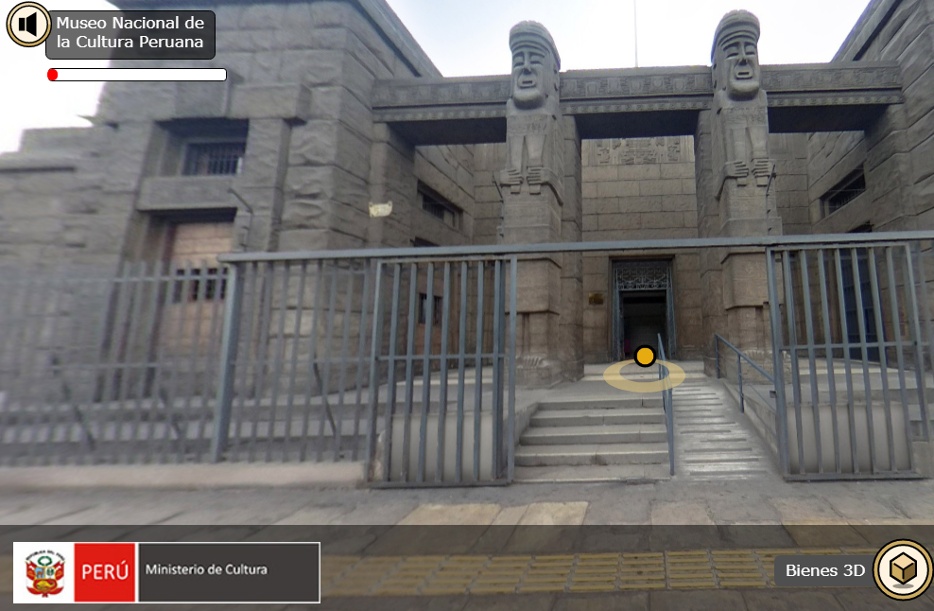
Latin America: Region of wonderful and diverse museums
https://visitavirtual.cultura.pe/recorridos/MNCP/museo-nacional-cultura-peruana/index.html
https://visitavirtual.cultura.pe/recorridos/MSCC/chan-chan/index.html
http://www.precolombino.cl/exposiciones/exposiciones-temporales/el-arte-del-cobre-en-el-mundo-andino-2004/cobre-en-la-mesa-del-chaman/
https://visitavirtual.cultura.pe/recorridos/MUNACH/museo-nacional-chavin/index.html

Slide 3
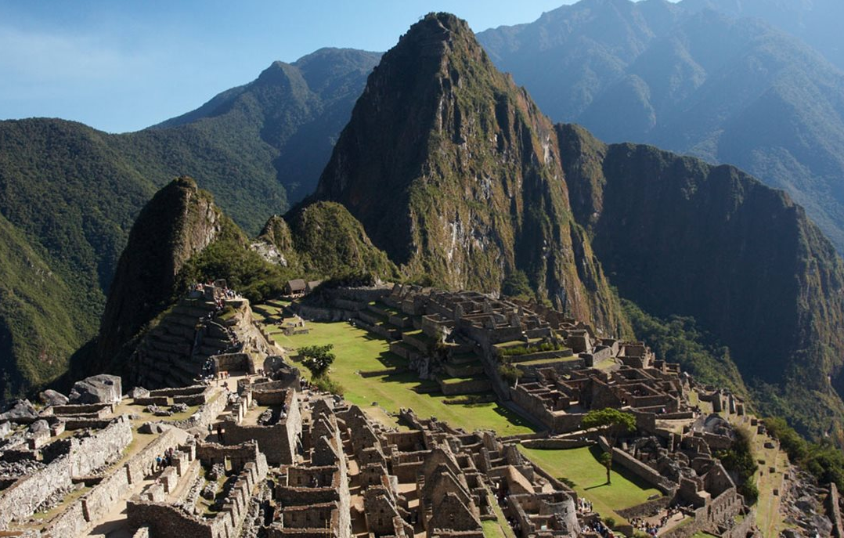
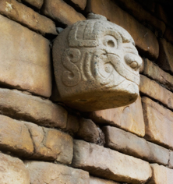
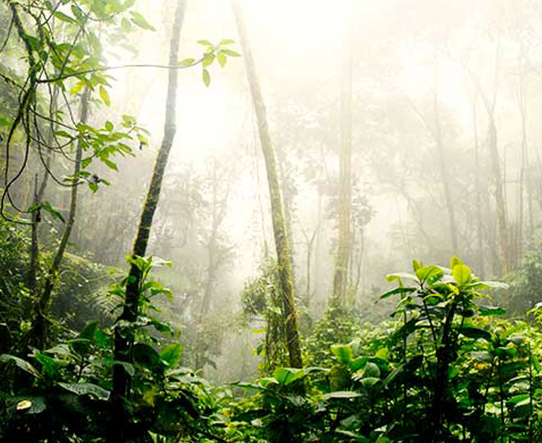
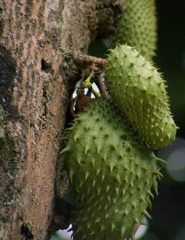
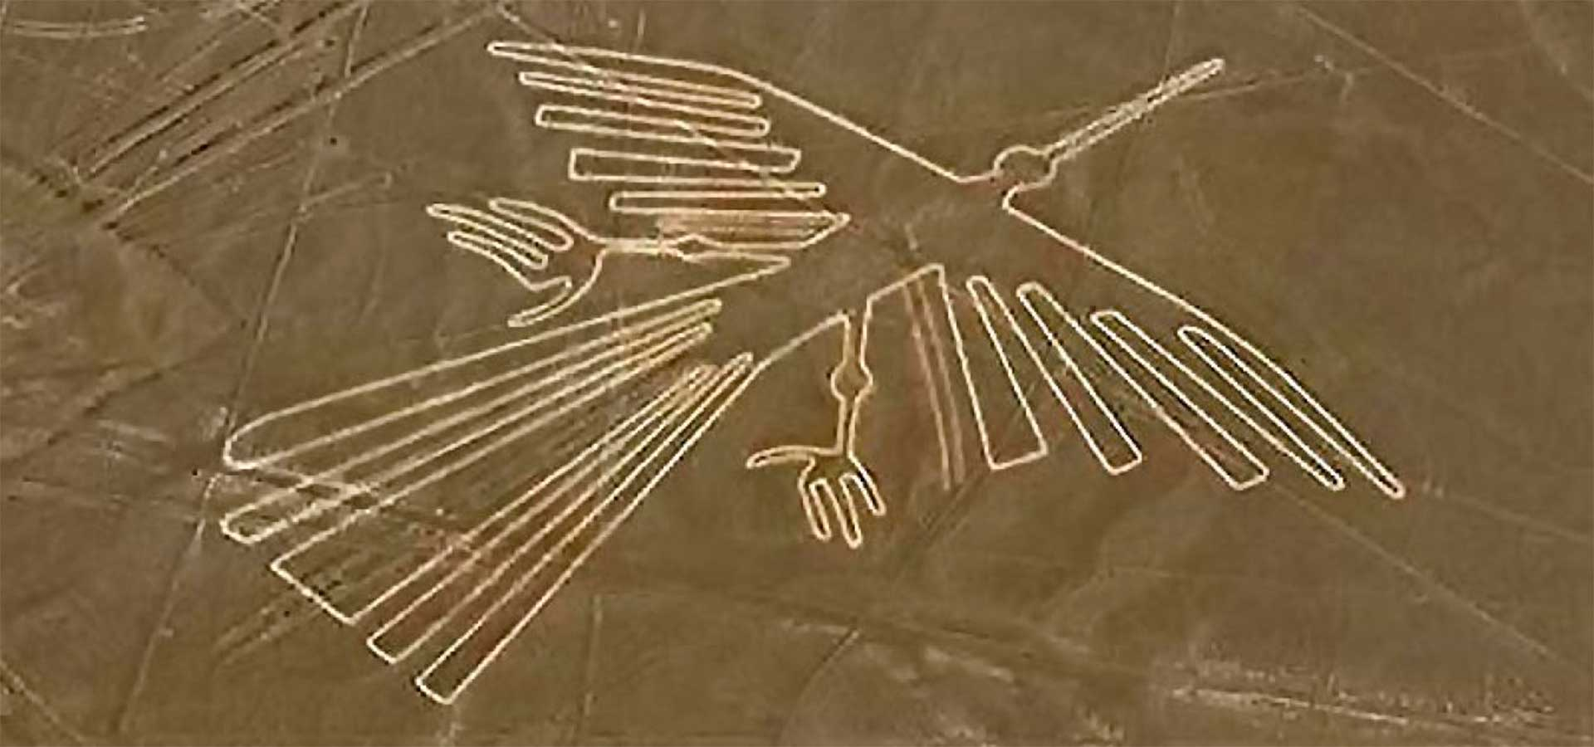
Marvelous nature considered as “Live” museums

Slide 4
Table of contents
Introduction
I. Shamanism:
1. Evidence for Shamanism in pre-Columbian and Inca medicine study
2. Shamanic medicine – definition
3. General aspects of Shamanism
4. Ayahuasca Ritual of Shamanism 5. Shamanic healing ritual
II. Medicinal Plants:
1. Evidence of the use of medicinal plants in pre-Columbian and Inca medicine
2. Evidence based studies on medicinal plants used in pre-Columbian and Inca medicine

Slide 5
Introduction to pre-Columbian medicine
In pre-Columbian culture, disease was the result of an imbalance between body, spirit and nature, where its worse outcome could be death.
According to Andean thought, this imbalance was mainly due to malignant spirits of nature.
Shaman and healer presence became vital to regain balance, because of their ability to perform medical-magical-religious ritual and cure disease.
Therefore, to fully comprehend pre-Columbian medicine, we must dispossess ourselves of hipocratical thinking and enter the worldview of these pre-Columbian cultures.

Slide 6
Introduction to pre-Columbian medicine
Pre-Columbian prehispanic culture, was intimately related to nature, which was conformed by 4 elements: earth - fire - air – water.
Pre-Columbian andean conception used this relation to nature in myths and beliefs, commonly using medicinal plants in their cures due to the knowledge of these plants and their effects (1).
Medicine in pre-Columbian American territory was based on Shamanism and healing. This made Shamans and Healers responsible of the population health (2).
1. Frisancho Velarde Óscar. Concepción mágico-religiosa de la Medicina en la América Prehispánica. Acta méd. peruana [Internet]. 2012 Abr [citado 2020 Mayo 2] ; 29( 2 ): 121-127. Disponible en: http://www.scielo.org.pe/scielo.php?script=sci_arttext&pid=S1728-59172012000200013&lng=es.
2. JORDÁN, RÉGULO G. FRANCO; RÉGULO, G. Chamanismo y plantas de poder en el mundo precolombino de la costa norte del Perú. Perspectivas latinoamericanas, 2015, p. 1-40.

Slide 7
Introduction to pre-Columbian medicine
In pre-Columbian cultures, Shamans were considered part of a privileged elite related to political power. They acted as mediators between divine and earthly while preserving myths and tradition.
Some Shamans were chosen at birth by astrological determination or after survival of a natural disaster such as being struck by lightning.
Due to their importance in pre-Columbian medicine, they should be deeply studied, as well as their rituals and the medicinal plants they used.

Slide 8
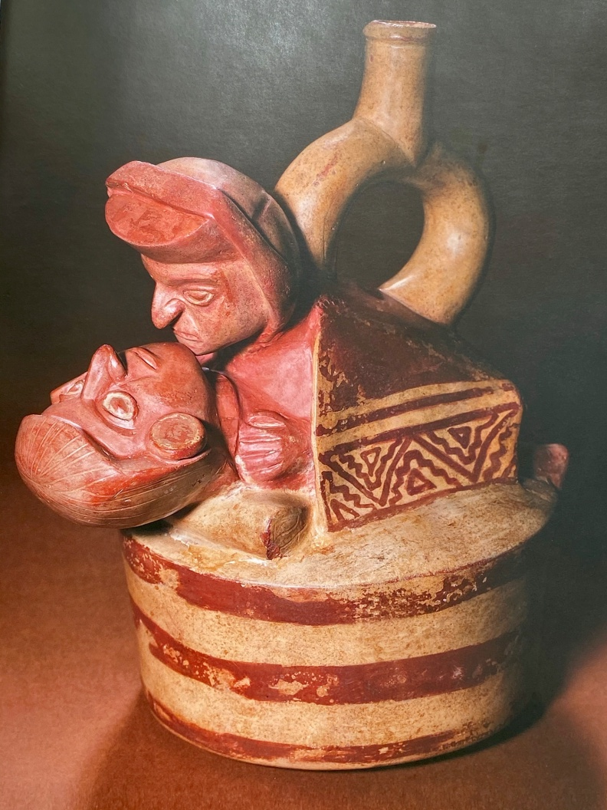
1. Pre-Columbian Medicine
Shamans, healers and midwives were responsable for the pre-Columbian population health.
Among them, Shamans were viewed as mediators between gods and people. They were in charge of maintaining health, treating disease and even chaperoning death in the population.

Slide 9
1. Pre-Columbian medicine
Pre-Columbian medicine in the American continent adapted several procedures to acomplish disease treatments.
On account of Paleopathology studies and narrations, among others, the procedures most frequently developed in pre-Columbian medicine were: (4,5)
Using of medicinal plants
Praying
Offerings
Conjuring
Chanting (3)
Also, in some cases the cure of disease meant surgery
3. Hermida Bustos, Enrique. Paleopatología en la cerámica precolombina malformaciones, deformaciones o anormalidades en las culturas: Valdivia, Chorrera, Guangala y la To-lita. Diss. Universidad Internacional SEK, 2011 Tesis de Maestría en conservación y administración de bienes Culturales. Ecuador 4. Medicina chamánica. Métodos de curación de una Tradición Milenaria. Enrique Gónzalez – Rubio Montoya. 5. El chamanismo entre los indios Ticuna Del Amazonas: Entre la Religión, la Magia y la representación dramática. Javier Ullán De La Rosa. Universidade Complutense – Madrid. España.
https://visitavirtual.cultura.pe/recorridos/MNAAHP/museo-nacional-arqueologia-antropologia-historia-peru/index.html

Slide 10
Healers
IV Moche bottle (Peru)
This ceramic is the representation of a healer in his curative act using his hands.
6. Jordán, Régulo Franco. Oficiantes y curanderos moche, una visión desde la arqueología. Pueblo continente, 2016, vol. 23, no 1, p. 18-26.

Slide 11
2. Definitions
Several definitions of Shamanism co-exist:
«Shaman is a priest-physician who uses magic to cure the ill, guess what is hidden and manage events that affect the well-being of the population.»(7)
«Shamanism is the technique of ecstasy, over which a series of cultural elements attach so that they can co-exist with other forms of religión and magic. This includes all practices by which a mortal can acquire supernatural powers, for good or evil and all the concepts asociated to those practices.» (8)
7. Diccionario Enciclopédico Oceano Uno. Editorial: Océano Langenscheidt 8. Apuntes de Medicina Tradicional. La racionalización de lo irracional. Fernando Cabieses.

Slide 12
2. Definition of Shamanic medicine
«One of the main shamanic powers is the ability to perform physical healings and well as spiritual ones. In Peru, they are currently named healers (“curanderos”) or “vegetalist” physicians (“médicos vegetalistas”), due to their profound knowledge over application and properties of plants, both medicinal and psychoactive. Interestingly in the same cultural context, psychoactive plants (also considered master o potent plants) are generically designated as “the medicine”.» (9)
9. Llamazares, Ana María. "Occidente herido: el potencial sanador del chamanismo en el mundo contemporáneo." (2013).

Slide 13
2. Definition of Shamanic medicine
Moche culture (Peru) ceramic representing a healer chewing coca leaves
6. Jordán, Régulo Franco. Oficiantes y curanderos moche, una visión desde la arqueología. Pueblo continente, 2016, vol. 23, no 1, p. 18-26.

Slide 14
2. Definition of Shamanic medicine
Use of two types of medicinal plants is noteworthy in pre-Columbian Shamanic medicine:
The ritual use of psychoactive plants
The use of medicinal plants
Use of psychoactive plants was fundamental in shamanism as they were considered “sacred” because they would not only cure but also widen the consciousness state of the patient.
9. Llamazares, Ana María. "Occidente herido: el potencial sanador del chamanismo en el mundo contemporáneo." (2013).
10. Exposición. Chamanes y divinidades del Ecuador Precolombino. Comisario: Santiago Ontaneda-Luciano investigador de la Dirección de Museos y Sitios Arqueológicos de la Subsecretaría Técnica de Memoria Social del Ministerio de Cultura y de Patrimonio ecuatoriano. Consejero científico: Francisco Valdez, investigador en PALOC (Patrimonios Locales y Gobernanza), unidad mixta de investigación del IRD y del Muséum National d’Histoire Naturelle.

Slide 15
3. Characteristics of Shamanic medicine
Psychoactive plants were used in Shamanic medicine since the ill would alter their perception through “bodily, auditory and visual sensations or cognitive impacts” and contact supernatural entities or planes”. (7)
The use of psychoactive plants was fundamental for shamanism. These were considered sacred, as they would not only cure but widen the conciousness state of the patient, being able to see more than the physical ailment.
7. Llamazares, Ana María. "Occidente herido: el potencial sanador del chamanismo en el mundo contemporáneo." (2013).

Slide 16
3. Characteristics of Shamanic medicine
«The conciousness state achieved by sacred plants heightens sensibility in a way such that the person is capable of capturing energy and vibrations which ordinary concience could not register. This has been compared to having a “sixth sense”, in which sensibility is overdeveloped. In Shamanic work this is fundamental in the healing process, since a great deal of the work is energy-related and invisible to the naked eye. In the majority of cases, the Shaman must also take these plants to capture the bio-energetical state of the people and also operate on them.» (9)
9. Llamazares, Ana María. "Occidente herido: el potencial sanador del chamanismo en el mundo contemporáneo." (2013).

Slide 17
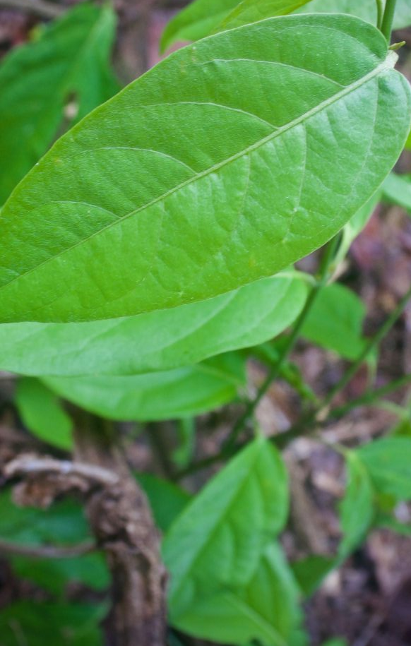
3. Characteristics of Shamanic medicine
The use of plants like Ayahuasca was essential in pre-Columbian shamanic medicine to access other planes of reality through “an amplified concience” in order to analize and understand the imbalanced problem.
Stone mortar used in the preparation of medicine.
https://visitavirtual.cultura.pe/recorridos/MUNACH/museo-nacional-chavin/index.html
Ayahuasca
11. Castillo. J; Chamanismo Piaroa. En: Poveda, J.M. (Ed) Chamanismo. El arte natural de curar; Temas de Hoy; Madrid; 1997. p.357-362.

Slide 18
3. Characteristics of Shamanic medicine
In Peru, several shamanism traditions co-exist, each with their own characteristics according to the region from where they originated.
Evidence shows that pre-Columbian cultures also had diferent shamans. Ceramics and archeological remains show this, especially in the materials used, healing spaces and methodology.
In pre-Columbian cultures, there were differences between Shamans from the coast, Andes and amazon jungle. Also, there differences between northern, central and southern Shamans.
North: Includes Amazon jungle Shamans who used medicinal plants in ther healing rituals, including the Ayahuasca ritual. Information on the use of animals, from the sea and jungle (serpents) has been found.
Center and South: Shamans from these areas frecuently used coca leaves and other native plants that only grew at medium and high altitude. Information on the use of animals such as llamas has been found.
15. Diego Alonso Huerta Jiménez. Chamanismo y Turismo Místico en el Perú: Un Estado De la Cuestión. Novum Otium 2(1) 2016 . ISSN 2414-0759

Slide 19
3. Characteristics of Shamanic medicine
The Shamans life was never static, but would ascend as their competence grew. It could reach superior categories until achieving the title of “spiritist Shaman”.
Spiritist Shamans knew the trance technique, which is the momento when their spirits left their bodies, so that healerspirits would possess them in order to visualize a specific cure for their patient.
Shamans that performed this type of healing in which the incorporated spirits were more effective, due to their contact with a parallel universe.(16)
Chanchan Museum:
Anthropomorphic bottle (character in trance)
https://visitavirtual.cultura.pe/recorridos/MSCC/chan-chan/index.html
16. Javier Ullán De La Rosa. El chamanismo entre los indios Ticuna Del Amazonas: Entre la Religión, la Magia y la representación dramática. Universidad Complutense – Madrid. España.

Slide 20
3. Characteristics of Shamanic medicine
The Shaman was a healer present in pre-Columbian culture whose infuence could not be extinguished after the conquest.
Through trance, Shamans achieved «the detachment of their souls from their bodies, allowing their rise to heaven or descent to hell».
This power to freely move through the supernatural worlds was recognized by the people, allowing Shamans to “conduct the souls of their patients”.
12. Carlos Musso. Medicina chamánica: su análisis desde una perspectiva científica. Rev. Hosp. Ital. B.Aires 2015; 35(4): 142-144.

Slide 21
3. Characteristics of Shamanic medicine
Ancient peruvians left testimonials in their ceramics on the communication of Shamans with spiritual forces and their profound respect to animals and nature. (9)
Shamans roles were:
They could see the human soul, recognize problems and dramas in each person, by hearing the patient.
They could cure various ailments.
They could purify houses and people. .
They could accompany death, by providing comfort to patients and supporting them.
They could honor the death of a person, making burials with offerings and personal ítems, due to their beliefs in an afterlife.
A vital funtion of the Shaman for the communities was being a guardian of tradition and psyco-physical equilibrium of the community. They were in charge of updating their knowledge on plants, rituals and disease, to provide service to the community.
9, Occidente Herido: El Potencial Sanador Del Chamanismo en el Mundo Contemporáneo. Mg. Ana María Llamazares . 18. Llamazares, Ana María; Arte chamánico: visiones del universo. En: Llamazares y Martínez Sarasola (Eds.) El lenguaje de los dioses; Buenos Aires; Biblos; 2004. p. 107-108.
19. Martínez Sarasola, Carlos. (2010) De manera sagrada y en celebración. Cap.4 Realidad, mundo invisible y cosmovisión. (Fragmentos Pág.160-202). Editorial Biblos: Buenos Aires.

Slide 22
3. Characteristics of Shamanic medicine
Shamanism defines an experience in which the Shaman mirrors the physical and mental suffering of people. (3)
Shamanism is defined as: one of the ways by which men through time have induced, manipulated and exploited the profound states of an altered concience.» (4)
13. Dos aproximaciones al chamanismo. Sergio Espinosa Proa. Universidad Autónoma de Zacatecas. 14. Los chamanes de la prehistoria. Jean Clottes. David Lewis-Williams. Recensión crítica. Rafael Montes Gutiérrez. Profesor de Geografía e Historia.

Slide 23
3. Characteristics of Shamanic medicine
Pre-Columbian healers in Peru used several medicinal plants. Current proof is more than 1400 registered native medicinal plant species in the country, many of which are used in traditional medicine.
Nowadays, many healers, Shamans and naturopathic doctors preserve traditions and knowledge of these plants.
Healers used plants through progressive observation of their healing properties and passed this knowledge on to the following generations.
https://visitavirtual.cultura.pe/recorridos/MNAAHP/museo-nacional-arqueologia-antropologia-historia-peru/index.html
17. Pamo Reyna Oscar. Medicina Prehispánica. En Alarcón Graciela, Espinoza Luis, Pamo-Reyna Oscar, Eds. Medicina y Reumatología Peruanas: historia y aportes. Lima, Comité Organizador PANLAR 2006.

Slide 24
3. Characteristics of Shamanic medicine
Shamanic knowledge was dual.
Shamans cured physical illness as well as spiritual distress.
Current Shamanic medicine is based in the integral and multidimentional conception of the people, their health, reality and their illness. This idea is the main difference with modern medicine.
The physical and spiritual healing potencial is probably the reason why shamanic medicine has prevailed through-out history.
12. Carlos Musso. Medicina chamánica: su análisis desde una perspectiva científica. Rev. Hosp. Ital. B.Aires 2015; 35(4): 142-144.
19. Llamazares, a. M. The wounded west: The healing potential of shamanism in the contemporary world. ReVision, 2015, vol. 23, no 2&3, p. 6-23.

Slide 25
3. Characteristics of Shamanic medicine
To understand Pre-Columbian healers, it is important to acknowledge the relationship between patient and Shaman:
In the healing ritual, healer and patient align for the process, this means the Shaman locates and balances physical, mental and spiritual aspects of the patient, achieving health by reaching equilibrium.
Shamans used various resources in the healing sessions:
Tobacco: Used for “cleansing and restoring” the person, through a blow of smoke (“soplada”)
Shamanic worktable: A blanket over the ground was used for this purpose. Several elements were placed over it.
Chants, dances and musical instruments: The Shaman used music during healing to call good spirits or cast away malignants ones. This would maintain or regain balance and harmony between physical, mental and spiritual health.
19. Martínez Sarasola, Carlos. (2010) De manera sagrada y en celebración. Cap.4 Realidad, mundo invisible y cosmovisión. (Fragmentos Pág.160-202). Editorial Biblos: Buenos Aires.

Slide 26
3. Characteristics of Shamanic medicine
Shamanic worktable:
Tobacco leaves to «dominate» the opponent and use the enchantment of the hills and lakes.
Water from Las Huaringas lakes (Huancabamba district)
Flowery water, Eau de cologne and Kananga water for protection and flourishing.
Pisco or schnapps (“aguardiente”) to add to the medicine (tobacco) and a spondyl to strenghten it.
Two daggers to «send bad things towards the enemy».
Bull horns to undo every hex.
Locks made with medicinal herbs to «cure and flourish».
Limes to «sweeten and refresh» any type of business.
White sugar to flourish and raise fortune.
White roses to whiten and clear the mind. Also, to attract good clients to the business.
A bell to call the “fright spirits” «espíritus del susto».
A chungana (“sonaja”) or rattle to evoke wind and virtue.
Prodigioso Perú profundo

Slide 27
3. Characteristics of Shamanic medicine
Shamanic worktable
The worktable in Peruvian Shamanism

Slide 28
4. Shamanism rituals

Slide 29
4. SHAMANISM RITUALS
The separation: consists on physical or symbolic isolation of the individual, to separate him from the cause of the illness.
The reincorporation: occurs when the individual acquires a new status and reincorporates to society as a new member.
https://visitavirtual.cultura.pe/recorridos/MNAAHP/museo-nacional-arqueologia-antropologia-historia-peru/index.html
20. Exposición. Chamanes y divinidades del Ecuador Precolombino. Comisario: Santiago Ontaneda-Luciano investigador de la Dirección de Museos y Sitios Arqueológicos de la Subsecretaría Técnica de Memoria Social del Ministerio de Cultura y de Patrimonio ecuatoriano. Consejero científico: Francisco Valdez, investigador en PALOC (Patrimonios Locales y Gobernanza), unidad mixta de investigación del IRD y del Muséum National d’Histoire Naturelle.

Slide 30
4. SHAMANISM RITUALS
Initiation rituals in Shamanism occur in several stages of life:
Birth rituals
Preparation next to their masters during puberty
Initiation rituals of the Shamans
Warrior investiture.
These rituals have three phases: separation, “liminar” situation, and reincorporation.
Rituals to capture time:
Some Shamans had knowledge about the cosmos. This enabled them to predict rain or droughts, which was very useful in agricultural labor.
20. Exposición. Chamanes y divinidades del Ecuador Precolombino. Comisario: Santiago Ontaneda-Luciano investigador de la Dirección de Museos y Sitios Arqueológicos de la Subsecretaría Técnica de Memoria Social del Ministerio de Cultura y de Patrimonio ecuatoriano. Consejero científico: Francisco Valdez, investigador en PALOC (Patrimonios Locales y Gobernanza), unidad mixta de investigación del IRD y del Muséum National d’Histoire Naturelle.
Fuente: Exposición. Chamanes y divinidades del Ecuador Precolombino. Comisario: Santiago Ontaneda-Luciano investigador de la Dirección de Museos y Sitios Arqueológicos de la Subsecretaría Técnica de Memoria Social del Ministerio de Cultura y de Patrimonio ecuatoriano. Consejero científico: Francisco Valdez, investigador en PALOC (Patrimonios Locales y Gobernanza), unidad mixta de investigación del IRD y del Muséum National d’Histoire Naturelle.

Slide 31
4. SHAMANISM RITUALS
Sacrifice rituals:
Ancient pre-Columbian made sacrifices. “It is a sacrifice of death so life will be granted”.The offerings were made for the gods.
Fuente: Exposición. Chamanes y divinidades del Ecuador Precolombino. Comisario: Santiago Ontaneda-Luciano investigador de la Dirección de Museos y Sitios Arqueológicos de la Subsecretaría Técnica de Memoria Social del Ministerio de Cultura y de Patrimonio ecuatoriano. Consejero científico: Francisco Valdez, investigador en PALOC (Patrimonios Locales y Gobernanza), unidad mixta de investigación del IRD y del Muséum National d’Histoire Naturelle.

Slide 32
4. SHAMANISM RITUALS
Healing rituals: the Shaman healer
Shamans performed several rituals to establish the physical, mental, emotional and spiritual balance in the sick human being. In other words, Shamans approached health and disease in a global integral manner.
They knew the secrets of psychotropic plants, such as tobacco and ayahuasca.
Through their healing rituals they aspired to cure, balance and purify using medicinal and psychotropic plants.
https://visitavirtual.cultura.pe/recorridos/MUNACH/museo-nacional-chavin/index.html
Stone nail head shaped as a human with serpent hair and nasal flow.
Fuente: Exposición. Chamanes y divinidades del Ecuador Precolombino. Comisario: Santiago Ontaneda-Luciano investigador de la Dirección de Museos y Sitios Arqueológicos de la Subsecretaría Técnica de Memoria Social del Ministerio de Cultura y de Patrimonio ecuatoriano. Consejero científico: Francisco Valdez, investigador en PALOC (Patrimonios Locales y Gobernanza), unidad mixta de investigación del IRD y del Muséum National d’Histoire Naturelle.

Slide 33
4. SHAMANISM RITUALS
Healing rituals: the Shaman healer
Shaman healers had the responsability of curing and healing people. They developed a comunicative and helping relationship with their patients. Their roles were:
1) Health restoration.
2) Cleansing
3) Purifying.
4) Repairing.
5) Improving the individual´s relationships with his group and surroundings.

Slide 34
4. SHAMANISM RITUALS
Healing rituals: The Shaman healer
Shamans prepared their own medicine.
https://visitavirtual.cultura.pe/recorridos/MNAAHP/museo-nacional-arqueologia-antropologia-historia-peru/index.html

Slide 35
4. SHAMANISM RITUALS
Funeral rituals
In the Shamanic world, life and dead had great relevance, therefore rituals were followed for both.
In pre-Columbian culture, death was important since it was the opportunity for the dead to return to mother earth for a later rebirth.
The study of archeological remains has revealed that mortuary practices varied upon the social status of the person: some were buried in simple tombs, while others were buried in ostentatious tombs. Upper-class individuals were wrapped in blankets (“fardos”).
Fuente: Exposición. Chamanes y divinidades del Ecuador Precolombino. Comisario: Santiago Ontaneda-Luciano investigador de la Dirección de Museos y Sitios Arqueológicos de la Subsecretaría Técnica de Memoria Social del Ministerio de Cultura y de Patrimonio ecuatoriano. Consejero científico: Francisco Valdez, investigador en PALOC (Patrimonios Locales y Gobernanza), unidad mixta de investigación del IRD y del Muséum National d’Histoire Naturelle.

Slide 36
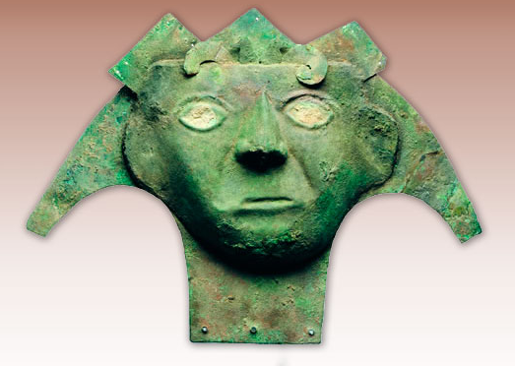
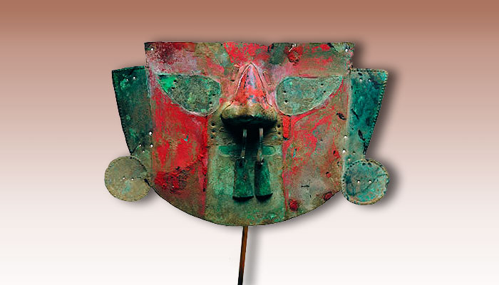
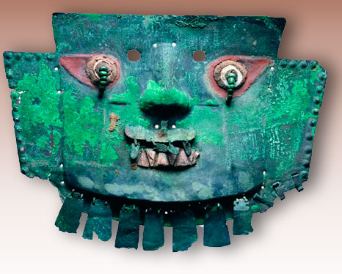
4. SHAMANISM RITUALS
Death rituals. Masks with the fase of death.
Museo chileno de arte precolombino. http://www.precolombino.cl/exposiciones/exposiciones-temporales/el-arte-del-cobre-en-el-mundo-andino-2004/el-rostro-de-la-muerte/#!prettyPhoto[galeria]/6/

Slide 37
5. Ayahuasca Ritual of Shamanism
Ayahuasca means “dead person, spirit, soul or ancestor" and huasca means “chord or rope" (Metzner, 2005) in quecha language . This psychotropic plant was used by Shamans in pre-Columbian medicine and continues to be used as such.
Currently, it is known that Shamans extracted an alcaloid whose main ingredient is a hormone called Dimethyltryptamine or DMT. This hormone is inhibited by an enzime called monoamine oxidase or MAO. To neutralize this enzime, ayahuasca is mixed with banisteriopsis caapi, which contains three inhibitory substances: harmine, harmaline and tetrahydroharmine. Shamans consider the main ingrediente of this mixture to be banisteriopsis caapi. Psycotria viridis, which contains dimethyltryptamine is nonetheless an additive whose presence is indispensable, as that of introns, pejoratively called “trash DNA” because they are made up of not coding segments that apparently have no use.
Fuente: Prodigioso Perú Profundo. Chamánico, Cósmico, Simbólico. Francis Devigne

Slide 38
5. Ayahuasca Ritual of Shamanism
Ayahuasca is a mixture of native plants most used by healers and native shamans in pre-Columbian medicine.
The most common preparation is as a beverage.(22)
To prepare Ayahuasca, the following ingredients must boil:
Banisteriopsis caapi stems: containing B-carbolines, such as harmina, tetrahydroharmina (THH) and harmaline, with inhibitory properties for monoaminooxidase (antidepressants) (22), (23)
Psychotria viridis bush leaves: containing tryptamine N, N-dimethyltryptamine (DMT) “agonist of the receptor sites of 5-HT-2A and sigma-1, which is also associated to antidepressant, anxiolytic and psychoactive effects” (22)
Diplopterys cabrerana leaves: containing tryptamine N, N-dimethyltryptamine (DMT) “agonist of the receptor sites of 5-HT-2A and sigma-1, which is also associated to antidepressant, anxiolytic and psychoactive effects” (24)
21. Prodigioso Perú Profundo. Chamánico, Cósmico, Simbólico. Francis Devigne
22. González, D., Cantillo, J., Pérez, I. et al. Therapeutic potential of ayahuasca in grief: a prospective, observational study. Psychopharmacology 237, 1171–1182 (2020). https://doi.org/10.1007/s00213-019-05446-2
23. Escobar Cornejo Guillermo Saúl, Ramos Vargas Luis Fernando. La ayahuasca bajo los ojos del mundo. Rev Med Hered [Internet]. 2018 Oct [citado 2020 Mayo 7] ; 29( 4 ): 268-269. Disponible en: http://www.scielo.org.pe/scielo.php?script=sci_arttext&pid=S1018-130X2018000400013&lng=es. http://dx.doi.org/https://doi.org/10.20453/rmh.v24i2.604.
24. Domínguez-Clavé E, Soler J, Elices M et al (2016) Ayahuasca: pharmacology, neuroscience and therapeutic potential. Brain Res Bull 126:89–101. https://doi.org/10.1016/j.brainresbull.2016.03.002

Slide 39
5. Studies on the ritual of Ayahuasca
Shaman healers used Ayahuasca in pre-Columbian medicine, to heal “diseases from the mind and thoughts”. Nowadays, several studies are trying to verify its therapeutic properties:
Various studies have tried to determine the therapeutic effect of ayahuasca over psychological processes:
Soler et al. (2018) found 4 sessions of Ayahuasca could be effective in reducing experience avoidance (promoting the acceptance of feelings and negative thoughts) and in 8 weeks, stress based on complete attention was reduced (MBSR) (25)
González et al. (2017), in an observational study, found ayahuasca had therapeutic potential over pain related to grieve due to death of a loved one (22).
In a study performed with 50 shipibos (Peruvian Amazon Indigenous) who participated in the ritual of Ayahuasca and were grieving due to the death of a family member , it was concluded: “Our results suggest that Ayahuasca has therapeutic value in reducing the seriousness pf pain. Acceptance and descentralization are psychological processes that mediate the improvement of grieve symptoms”(23)
25. Soler J, Elices M, Franquesa A, Barker S, Friedlander P, Feilding A, Pascual JC, Riba J (2016) Exploring the therapeutic potential of ayahuasca: acute intake increases mindfulness-related capacities. Psychopharmacology 233:823–829. https://doi.org/10.1007/s00213-015-4162-0

Slide 40
6. Plants in pre-Columbian medicine
Pre-Columbian medicine has left an important legacy to future generations on the use of medicinal plants.
Next, evidence of the use of medicinal plants, with their native (common) and scientific names.

